Slide 1
Multiple Resource Theory as a Computational Model
Andrew Beck
PSYC 792
March 1, 2012

Slide 2
Components of the Computational Model
Different resources
Task analysis shell
Conflict matrix
Computational Formula
Total Interference values

Slide 3
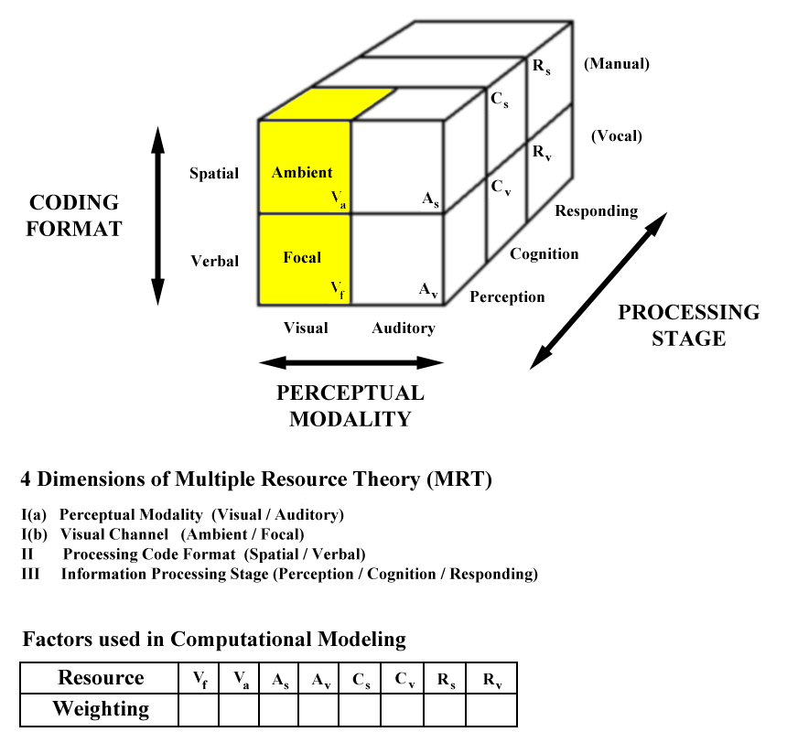
Different Types of Resources From Multiple Resource Theory

Slide 4
Stage | Resource | Abbreviation | Example
Perception | Visual-Spatial Visual-Ambient | VS VA | Estimating distances; lane keeping
Perception | Visual-Verbal Visual-Focal | VV VF | Reading traffic signs
Perception | Auditory-Spatial | AS | Audio location
Perception | Auditory-Verbal | AV | Listening to a message
Cognition | Cognitive-Spatial | CS | Mental rotation
Cognition | Cognitive-Verbal | CV | Rehearsing a phone number
Responding | Response-Spatial | RS | Various manual activities
Responding | Response-Verbal | RV | Speaking

Slide 5
Task Analysis Shell
Demand Scalars
Demand vectors

Slide 6
Demand Scalars and Vectors
Demand Vectors are sometimes referred to as a Resource Vector
The Demand Vector is simply a collection of Demand Scalars for each individual task
A Demand Scalar is task-specific demand level for one resource
Example: Task A might have a demand level of 2 for the Auditory-Spatial component, while Task B might have a demand level of 0 for that same component
Horrey & Wickens 2003

Slide 7
Demand Scalars and Vectors
“Each task is coded in terms of its dependence on a given resource on an ordinal scale, depending on task characteristics and overall difficulty.”
A value of 0 means that a specific task is not reliant on a specific resource at all.
Simply monitoring a computer screen will probably not involve a Response-Verbal component.
A value of 1 means that a specific task demands some amount of a certain resource.
Driving on a straight stretch of highway with no traffic during the day might require some Visual-Ambient resources, but not too much.
Horrey & Wickens 2003

Slide 8
Demand Scalars and Vectors
As tasks become more complex, this value may increase to 2 or 3.
For most applications, a coding system of three levels (0, 1, 2) is adequate.
Horrey & Wickens 2003

Slide 9
Demand Scalars and Vectors
As a simplified example…
Keeping your car in the center of the lane on an uncluttered freeway during the day may require resources at the perceptual, cognitive and response levels.
Demand Scalars: 1, 1, 1
Demand Vector: 1-1-1
Total Demand Score: 3
However, driving on a freeway with lots of curves at night may demand different amounts of these same resources.
Demand Scalars: 2, 1, 2
Demand Vector: 2-1-2
Total Demand Score: 5
Horrey & Wickens 2003

Slide 10
Demand Scalars and Vectors
Demand Vector
Task | Perception |  |  |  | Cognition |  | Response |  | Sum of Demanded Resources
 | VA | VF | AS | AV | CS | CV | RS | RV
Task A | 2 | 2 | 2 | 0 | 0 | 2 | 0 | 2 | 10
Task B | 0 | 1 | 0 | 0 | 3 | 0 | 3 | 0 | 7
Demand Scalars for Task B

Slide 11
Demand Scalars and Vectors
Demand Vector
Task | Perception |  |  |  | Cognition |  | Response |  | Sum of Demanded Resources
 | VA | VF | AS | AV | CS | CV | RS | RV
Task A | 2 | 2 | 2 | 0 | 0 | 2 | 0 | 2 | 10
Task B | 0 | 1 | 0 | 0 | 3 | 0 | 3 | 0 | 7
Demand Vector for Task B

Slide 12
Conflict Matrix

Slide 13
An Example Conflict Matrix
Task B Resources | Task A Resources
 |  | Perceptual |  |  |  | Cognitive |  | Response
 |  | VA | VF | AS | AV | CS | CV | RS | RV
 | VA | 0.8 | 0.6 | 0.6 | 0.4 | 0.7 | 0.5 | 0.4 | 0.2
 | VF |  | 0.8 | 0.4 | 0.6 | 0.5 | 0.7 | 0.2 | 0.4
 | AS |  |  | 0.8 | 0.4 | 0.7 | 0.5 | 0.4 | 0.2
 | AV |  |  |  | 0.8 | 0.5 | 0.7 | 0.2 | 0.4
 | CS |  |  |  |  | 0.8 | 0.6 | 0.6 | 0.4
 | CV |  |  |  |  |  | 0.8 | 0.4 | 0.6
 | RS |  |  |  |  |  |  | 0.8 | 0.6
 | RV |  |  |  |  |  |  |  | 1.0
Wickens 2002

Slide 14
Conflict Matrix
This is a matrix showing the amount of conflict between resource pairs.
If two tasks cannot share a resource, the conflict value is 1.0
Two tasks both demanding a spoken response
If two tasks can perfectly share a resource, the conflict value is 0
Wickens 2002

Slide 15
How to Derive the Values Within a Conflict Matrix
Every channel pair has a baseline conflict value of 0.2, instead of 0
This is a “fundamental cost of concurrence.”
Each added dimension of overlapping resources increases the conflict value by 0.2
Cognitive resources do not involve the Auditory-Visual modality distinction.
Therefore, their conflict with perceptual resources (which do have this modality distinction) is defined as an average value between sharing and separate modalities.
Wickens 2002

Slide 16
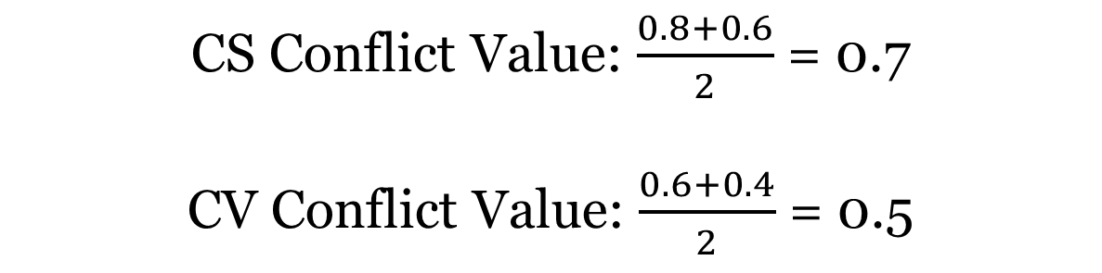
How to Calculate CS and CV Conflict Values
 | Task A
Task B |  | Perceptual |  |  |  | Cognitive |  | Response
 |  | VA/VS | VF/VV | AS | AV | CS | CV | RS | RV
 | VA | 0.8 | 0.6 | 0.6 | 0.4 | 0.7 | 0.5 | 0.4 | 0.2
CS Conflict Value: $\frac{0.8+0.6}{2}$ = 0.7
CV Conflict Value: $\frac{0.6+0.4}{2}$ = 0.5
Wickens 2002
Notes:
Cognitive-Spatial, Cognitive-Verbal; Visual-Spatial, Visual-Verbal; Auditory-Spatial, Auditory-Verbal
Cognitive and Perceptual resources are grouped together, but they did not share the Auditory-Visual modality

Slide 17
How to Derive the Values Within a Conflict Matrix
It may assumed that values along the negative diagonal would always have a value of 1.0 (i.e. conflict values between Task A RV and Task B RV), this is not always the case
Two manual responses may show high (0.8), but not impossible conflict
Voice responses cannot be shared and, thus, have a conflict value of 1.0
Wickens 2002

Slide 18
How to Derive the Values Within a Conflict Matrix
Lastly, conflict values may be adjusted in certain circumstances to account for the physical separation of the two channels in question.
The conflict value on the Visual-Focal channel may be lowered if the two visual sources are physically close together, rather than far apart.
Wickens 2002

Slide 19
Computational Formula
Demand component
Conflict component

Slide 20
Computational Formula Components
The computational formula consists of two components:
Demand Component
This component penalizes the pair of tasks for its total resource demand value
Conflict Component
This component penalizes the pair of tasks according to the degree of conflict between resource pairs with non-zero conflict values.
Wickens 2002
Notes:
Penalizes refers to an increase in the overall total interference value
The greater the conflict between two resource pairs, the greater the increase in total interference value
A 0 value on one resource pair indicates that there is no conflict between the pair

Slide 21
Demand Component
To calculate this component
Take the average of the total resource demand value for each task, along all of the included resource components
Task A has a total resource demand value of 8 across 8 resource components
8/8 = 1
Task B has a total resource demand value of 7 across 8 resource components
7/8 = .88
Simply add these two values together for a each task pair
Demand Component for AB: 1 + .88 = 1.88
Wickens 2002

Slide 22
Conflict Component
Using 2 tasks across two resource types…
0.8 + 0 + 0.3 + 0 = 2
0.8 + 0.3 + 0.3 + 1.0 = 2.4
 | Task A
Task B |  | VF (2) | RS (1)
 | VF(1) | 0.8 | 0.3
 | RS (1) | 0.3 | 1.0
 | Task A
Task B |  | VF (2) | RS (0)
 | VF(1) | 0.8 | 0.3
 | RS (1) | 0.3 | 1.0
Wickens 2002

Slide 23
Total Interference Value

Slide 24
Total Interference Value
The Total Interference Value is simply the Demand Component added to the Conflict Component for a given task combination.
From the previous example:
Task | Demand Component | Conflict Component | Total Interference Value
AB | 1.88 | 2 | 3.88

Slide 25
Total Interference Value
The Total Interference Value for a task pair is a relative value, not an absolute value.

Slide 26
A Simplified Example
From Wickens 2002

Slide 27
Components of the Computational Model
Different Tasks
Different Resources
Demand Scalars
Demand Vectors
Conflict Matrix
Computational Formula
Total Interference Value

Slide 28
Outline of a Simple Experiment
Only two resources will be considered
Perceptual cognitive (PC)
Response (R)
Task A
A demanding monitoring task, with no response required
Task B
A tracking task involving both perception and response
Task C
A tracking task with a more complicated response than Task B
Wickens 2002

Slide 29
Demand Scalars and Vectors
Task | Perceptual Cognitive | Response | Total Demand Score
Task A | 2 | 0 | 2
Task B | 1 | 1 | 2
Task C | 1 | 2 | 3

Slide 30
Simplified Conflict Matrix
 | Perceptual Cognitive | Response
Perceptual Cognitive | .80 | .30
Response | .30 | 1.0

Slide 31
Computational Formula
Task | Demand Component | Conflict Component
AA | 1 + 1 = 2 | 0.8 + 0 + 0 + 0 = 0.8
BB | 1 + 1 = 2 | 0.8 + 1 + 0.3 + 0.3 = 2.4
CC | 1.5 + 1.5 = 3 | 0.8 + 1 + 0.3 + 0.3 = 2.4
AB | 1 + 1 = 2 | 0.8 + 0 + 0.3 + 0 = 1.1
AC | 1 + 1.5 = 2.5 | 0.8 + 0 + 0.3 + 0 = 1.1
BC | 1 + 1.5 = 2.5 | 0.8 + 1 + 0.3 + 0.3 = 2.4

Slide 32
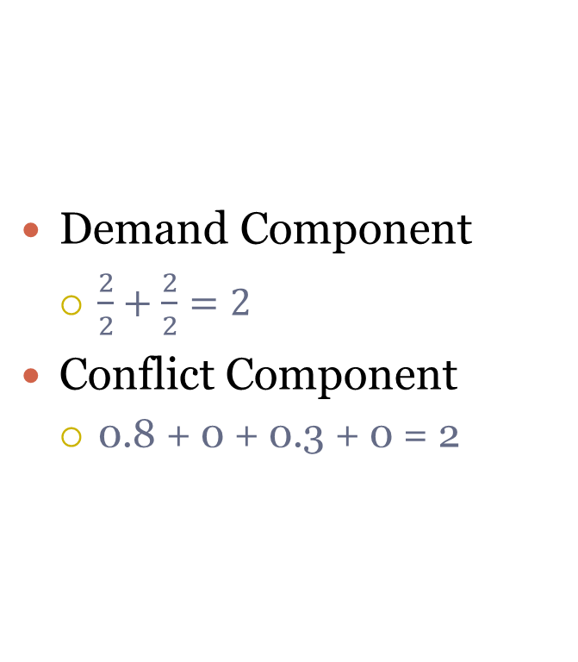
Calculations of the Computational Formula for the Task Combination of AB
 | Task A
Task B |  | PC (2) | R (0)
 | PC (1) | 0.8 | 0.3
 | R (1) | 0.3 | 1.0

Slide 33
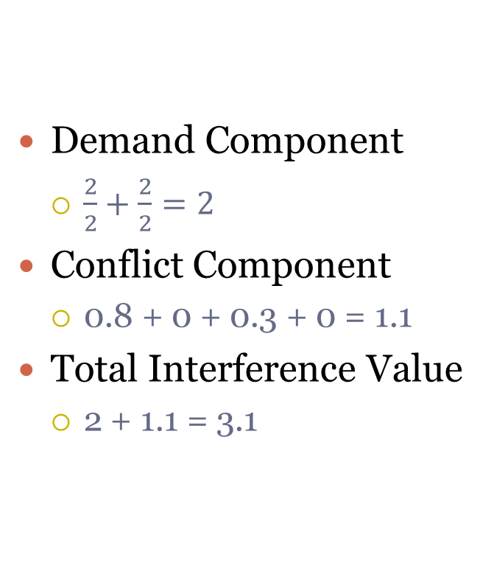
Total Interference Value
 | Task A
Task B |  | PC (2) | R (0)
 | PC (1) | 0.8 | 0.3
 | R (1) | 0.3 | 1.0

Slide 34
End Results
Task | Demand Component | Conflict Component | Total Interference Value
AA | 1 + 1 = 2 | 0.8 + 0 + 0 + 0 = 0.8 | 2.8
BB | 1 + 1 = 2 | 0.8 + 1 + 0.3 + 0.3 = 2.4 | 4.4
CC | 1.5 + 1.5 = 3 | 0.8 + 1 + 0.3 + 0.3 = 2.4 | 5.4
AB | 1 + 1 = 2 | 0.8 + 0 + 0.3 + 0 = 1.1 | 3.1
AC | 1 + 1.5 = 2.5 | 0.8 + 0 + 0.3 + 0 = 1.1 | 3.6
BC | 1 + 1.5 = 2.5 | 0.8 + 1 + 0.3 + 0.3 = 2.4 | 4.9

Slide 35
References
Horrey, W.J. & Wickens, C.D. (2003). Multiple resource modeling of task interference in vehicle control, hazard awareness and in-vehicle task performance. Proceedings of the 2nd International Symposium on Human Factors in Driving Assessment, Training and Vehicle Design. Park City, UT.
Wickens, C.D. (2002). Multiple resources and performance prediction. Theoretical Issues in Ergonomic Science, 3(2), 159-177.

