Slide 1
Systematic Development of a Mental Workload Construct
Van Acker, Parmentier, Vlerick & Saldien (2018)

Slide 2
Motivation
Our understanding of Mental Workload still lacks theoretical coherence
The human factors/ergonomics literature is characterized by numerous ad hoc operationalizations
Given this “fuzzy” set…the Mental Workload construct has been resistant to recursive development, improvement and validation

Slide 3
Representative Operational Definitions
“any measure of the amount of mental effort required to perform a task” Dictionary of Human Factors/Ergonomics
“an inferred construct that mediates between task difficulty, operator skill and observed performance” Neville Moray (1979)
“How hard the brain is working to meet task demand” Ayaz et al. (2012)

Slide 4
ad hoc Definitions
“the level of attentional resources required to meet both objective and subjective performance criteria, which may be mediated by task demands, external support and past experience” Young & Stanton (2001)
“a hypothetical construct that represents the cost incurred by a human operator to achieve a particular level of performance” Tony Andre (2001)
“intended to capture limitations on the operator’s information processing apparatus” Danny Gopher & Manny Donchin (1986)

Slide 5
ad hoc Definitions
“the cost of performing one task in terms of the reduction in the capacity to perform additional tasks, given that the two tasks overlap in their resource demands” Art Kramer (1987)
“refers to that portion of an operator’s limited capacity actually required to perform a particular task” O’Donnell & Eggemeier (1986)

Slide 6
van Acker et al. Remediation Strategy
Perform a critical concept analysis using Walker and Avant’s (2011) Strategies for Theory Construction in Nursing
Literature review to reveal a construct’s Defining Attributes (essential characteristics)
Systematically organize Antecedents and their relationships to predictive outcomes (i.e., Consequences)
Develop Antecedents -> Construct -> Consequences working model that demonstrates internal consistency
Constrain construct using “competing scenarios” that incorporate ideal, related, borderline and contrary “case studies”

Slide 7
Mental Workload Attribute Analysis
Information processing models/architecture
Attention Theories: Working memory architecture monitoring and allocation of attention “resource” models trump “filter” models varieties of attention: selective, divided, vigilance multitasking Multiple Resource Theory (Wickens’ “cube”) controlled processing—automaticity continuum
Monitoring and effective allocation of attentional resources requires effort
Cognitive effort is accompanied by distinctive subjective experience (negative valence???)

Slide 8
Synthesis of the Defining Attributes of the Mental Workload Construct
Spending Cognitive Resources
Triggering Subjective Experience

Slide 9
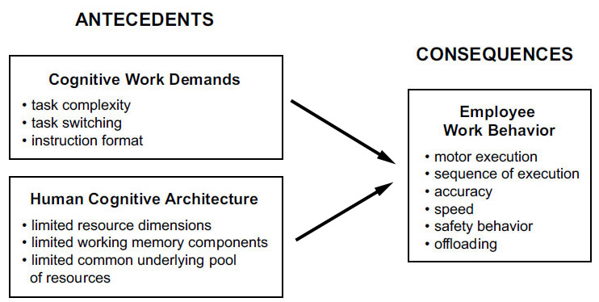
Antecedents -> Consequences Relationship that Created a Need for the MWL Construct
Yikes!

Slide 10
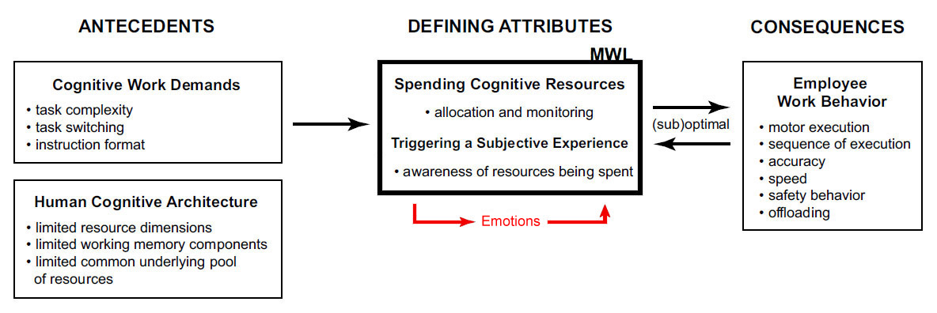
Antecedents -> Construct -> Consequences Conceptualization of Mental Workload

Slide 11
Proposed Operational Definition
Mental Workload is a subjectively experienced physiological processing state, revealing the interplay between one’s limited and multidimensional cognitive resources and the cognitive work demands being exposed to

Slide 12
A bit of a non sequitur?
Page 355…
“…these multiple cognitive resources are considered to draw from the same underlying pool of energy resources as do emotional resources and physical resources (Kahneman, 1973; Norman & Bobrow, 1975; Mandler, 1979). This way…these three load factors can in fact draw resources away from each other.”
Seems to “confabulate” the mutually exclusive concepts of single resource versus multiple resource theory ???

Slide 13

Wither thou goest, Human Factors….
Do not be discouraged by the “state of the art” in mental workload and cognitive science (writ large). Even the basic study of physics has muddled through similar concept development problems in the past.
Case in point:
The concept of TEMPERATURE.
Hasok Chang’s most excellent book explores the struggles of competing operational definitions of temperature in the 18th and 19th centuries and the ultimate development of a representational model following many decades of struggle and research. It is worth careful reading as it chronicles the evolution of a construct from a purely applied operationalized state (akin to today’s MWL) to a fully representation construct based on a well-defined mechanism.

