Slide 1
HF Constructs and the Explosive Use of the NASA-TLX
De Winter (2014)

Slide 2
Operationalism
Mental workload is a highly operationalized construct
Operationally defined constructs do not arise from directly observable system attributes. They do not purport to describe empirical reality but, instead, are designed to predict rather than explain phenomena of interest
Pragmatic and application oriented

Slide 3
Operationalism
“The key to operationalism is that the measurement procedure simultaneously defines concepts and measures them...
An attribute is defined by its measurement procedure, no more and no less, and has no ‘real’ existence beyond that….
Therefore, special care should be taken towards the construction of the measuring instrument and the precision of the definition.” page 293
But, what is “measurement”?

Slide 4
“Measurement is the assignment of numbers to an object or event according to a rule” (S.S.Stevens)
Taxonomy of Measurement
TYPE PROPERTIES STATISTICS Nominal categories mode, frequency
Ordinal rank order median
Interval rank, equal intervals, mean arbitrary zero
Ratio rank, equal intervals, universal linear, absolute zero nonlinear ops

Slide 5
Reification of Mental Workload… and its name is the NASA-TLX

Slide 6
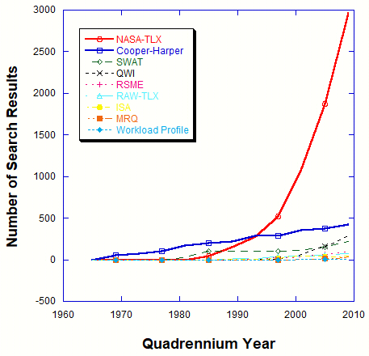
TLX – Task Load Index
Cooper-Harper
SWAT – Subjective Workload Assessment Technique
QWI – Quantitative Workload Index
RSME – Rating Scale Mental Effort
ISA – Instantaneous Self-Assessment
MRQ – Multiple Resources Questionnaire
WP – Workload Profile
Culturomic Analysis

