Slide 1
A Neuro-Metabolic Signal of Cognitive Effort?
Wiehler, Branzoli, Adanyeguh, Mochel & Pessiglione (2022)

Slide 2
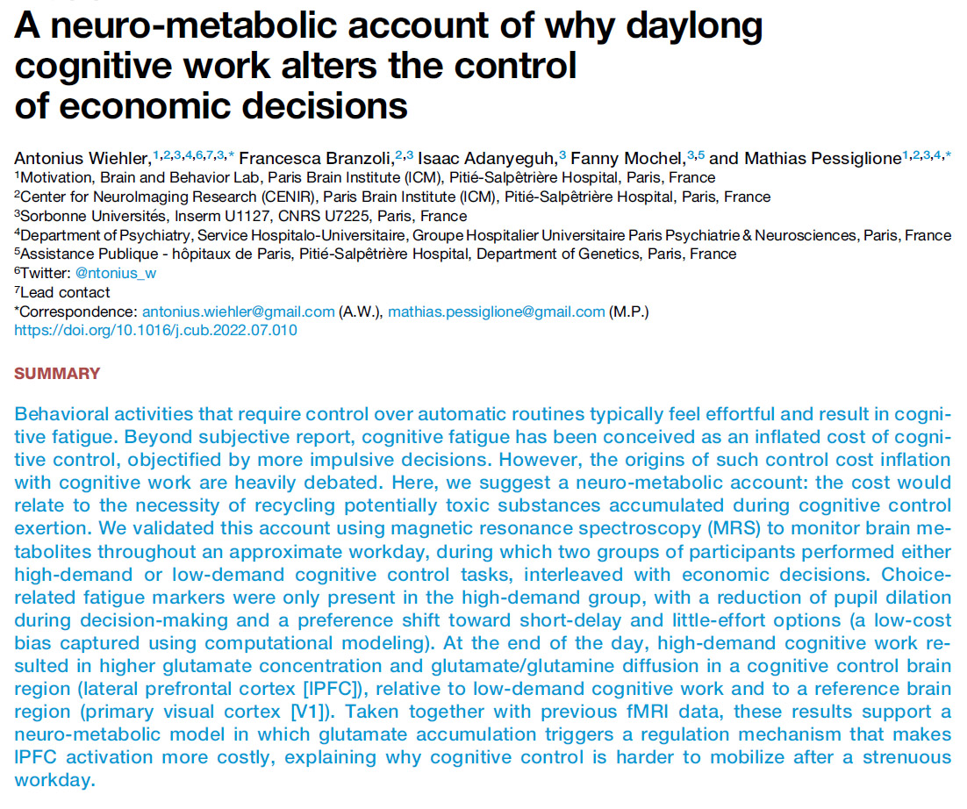

Slide 3
Introduction
Previous research demonstrates that exerting cognitive control is both effortful and fatiguing (e.g., chess players)
fMRI studies indicate lateral prefrontal cortex (lPFC) recruitment when subjects engage in cognitive control tasks
Why is cognitive control effortful???

Slide 4
Functional Explanation
“The general idea is that cognitive fatigue would be a sensation generated by the brain, whose purpose is to stop performing the current demanding task for the benefit of a more rewarding activity”
A nudge to switch tasks when the current task requires high costs
Evolution of a cost-benefit analysis to modify behavior to “enjoy available pleasures or avoid “opportunity costs”

Slide 5
Glutamate Neuro-Metabolic Hypothesis
Lateral PFC activity is associated with cognitive control requiring high levels of glutamate-based neuronal processing
High level of glutamate activity may be detected as a depletion within the neurons and/or a dispersion in the synaptic space outside of the neurons, per se.
Depletion would affect function; Diffusion could be indicative of glutamate “toxicity” due to insufficient re-uptake.
Magnetic Resonance Spectroscopy (MRS) can be tuned to quantify the internal concentration of glutamate as well as its diffusion into the extracellular synaptic space

Slide 6
Experimental Design: Cognitive Load Tasks
Induce cognitive fatigue via day-long performance of validated cognitive control tasks:
N-back working memory management task
N-switch task
serial letter presentation; letter color red or green;
color specified task:
upper vs. lower case; vowel vs. consonant
“Easy” vs “Hard” Groups
Easy -> 1-back; N-switch 1 per 24 trials block (N=16)
Hard -> 3-back; N-switch 12 per 24 trials block (N=24)

Slide 7
Experimental Design:
Signatures of Cognitive Fatigue
Increased Low-Cost Preference on economic decision-making tasks
Reduced decision-making deliberation time (RT)
Reduced pupillary dilation response
Optimized ¹H MRS concentration of glutamate at left lPFC
(concentration of neurotransmitter inside neurons)
Diffusion-weighted ¹H MRS (diffusion into synaptic space)

Slide 8
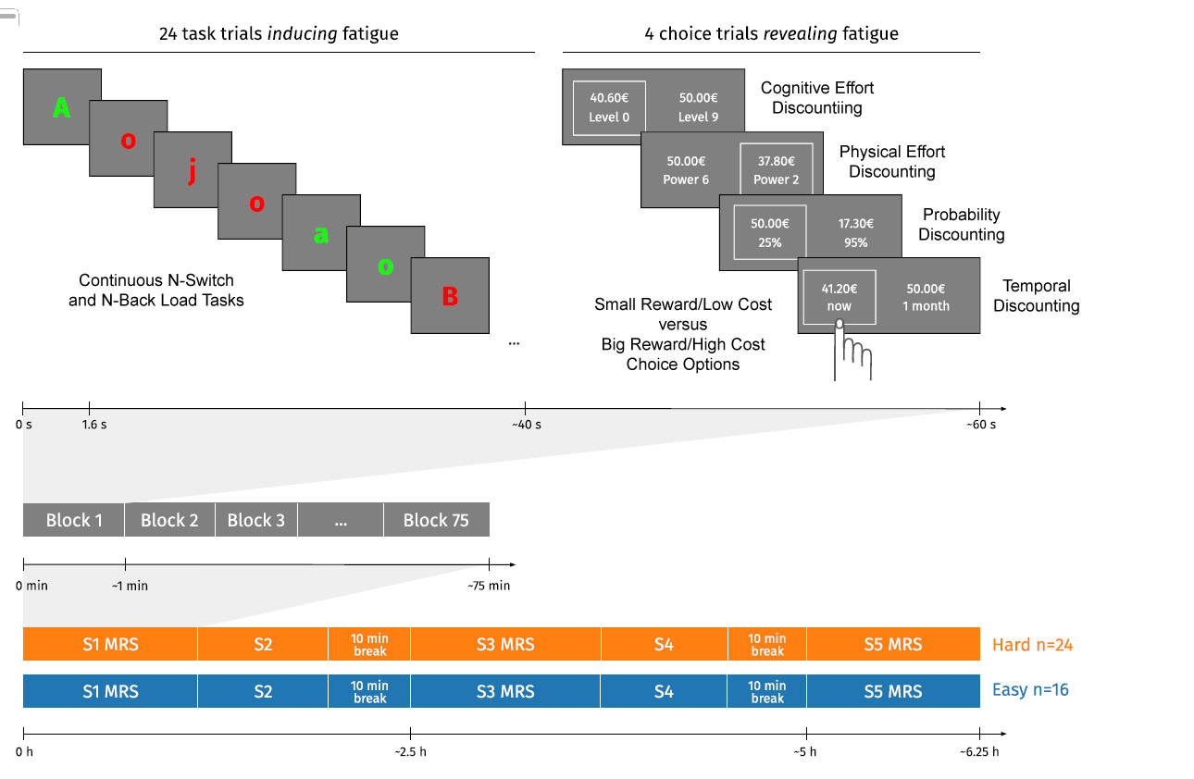
Experimental Design

Slide 9
Behavioral Results

Slide 10
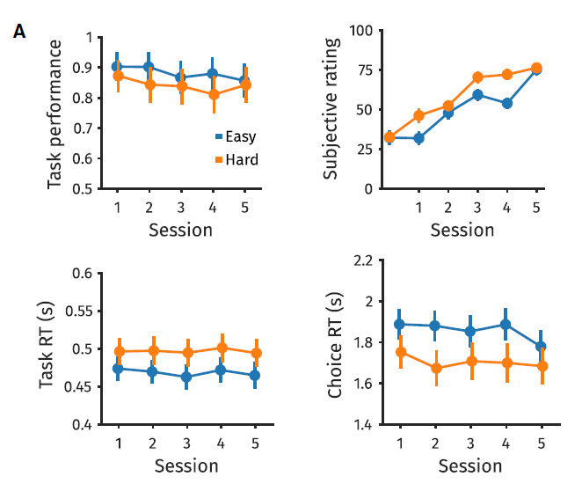
“Totally Exhausted”
Percent Correct
Easy > Hard (p<0.01)
Session decline (0.001)
Session increases (p<0.001)
No Group effects
“Top Form”
Hard < Easy
(Less deliberation time)
Hard > Easy (p<0.001)
No Session effects
(Exclusive of Probability Discounting)

Slide 11
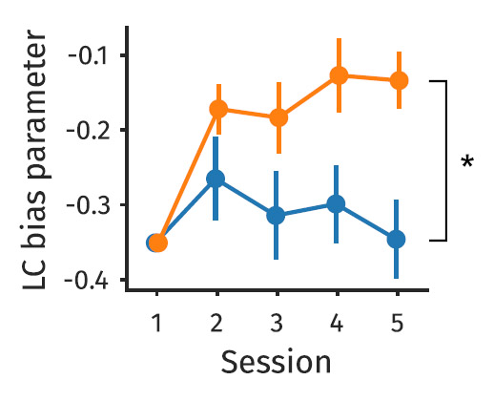
Computational Modeling Revealed a Shift in Choice Preference Toward Low-Cost Option for “Hard” Group across Sessions*
Hard Group
Easy Group
* Given the cognitive effort required to do the necessary “deep dive” to comprehend the nature of the computational model, the creator of this Powerpoint is taking the authors’ “word for it”.

Slide 12
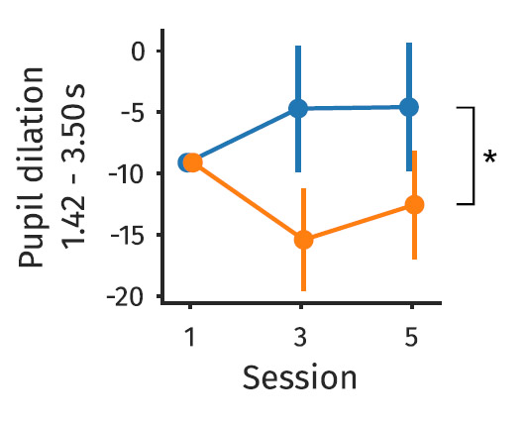
Pupillary Index of Cognitive Effort
Pupillary response during the deliberation phase of the decision-making process (1.4-3.5 seconds following choice stimulus presentation) demonstrated a reduction in pupillary dilation across Sessions for the “Hard” group.
This is consistent with reduced cognitive effort following cognitive fatigue in the “Hard” group.

Slide 13
Neuro-Metabolic Results

Slide 14
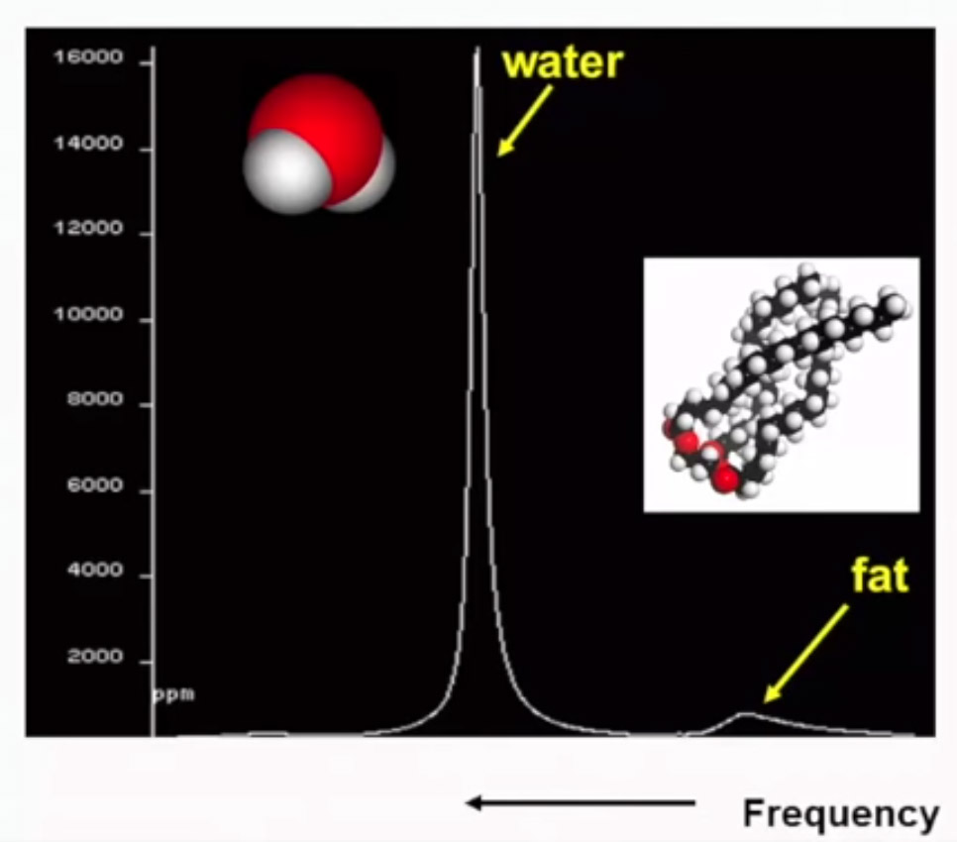
Frequency spectrum of a typical sample returned by a conventional MRI scan.
Note how the H+ ion spike “dominates” the low Signal-to-Noise regions delimited by the red arrows that indicate the domain of the chemical metabolites of interest

Slide 15
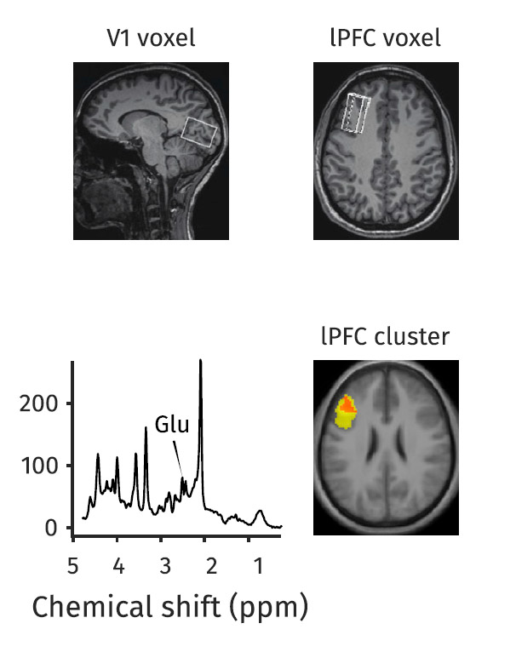
Magnetic Resonance Spectroscopy
The massive H+ ion signal can be attenuated by generating a specific RF-signal and the scanner’s filtering and time-constant parameters can be tuned to extract a very weak and “noisy” response spectrum that reflects the level of glutamate in the voxel under analysis.
The signal is so weak that many samples must be collected and averaged in order to generate a reliable estimate.
This significantly reduces the temporal and spatial resolution of MRS imaging.

Slide 16
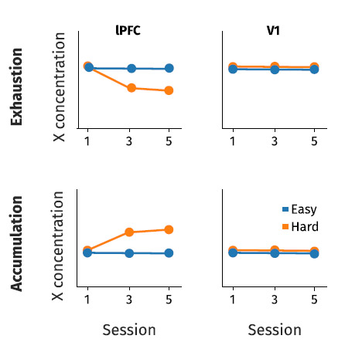
Two competing signatures of the left PFC Glutamate Effort/Fatigue Hypothesis

Slide 17
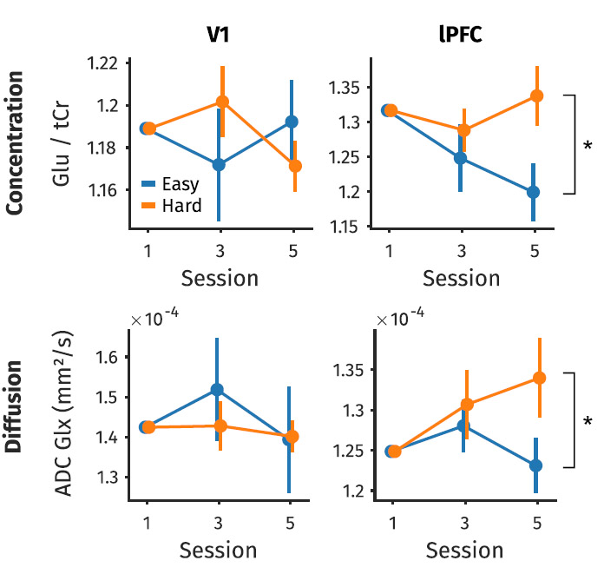
The “messy” but suggestive MRS Results
Consistent with a “Glutamate Toxicity” interpretation
(Extracellular space)
See next slide
Interesting Note:
Glutamate Toxicity is a “player” in the pantheon of theories vying to explain Alzheimer’s Disease

Slide 18
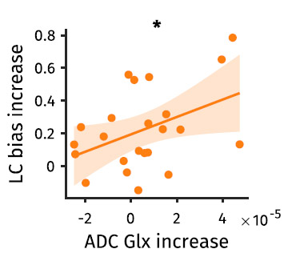
Diffusion-weighted MRS Significantly Correlated with Low-Cost Decision Bias
(“Hard” Group Only)

