Slide 1
Speech Chronemics
Hidden Dimensions of Speech
H.P. Krüger (1989)
Department of Psychology
University of Würzburg

Slide 2
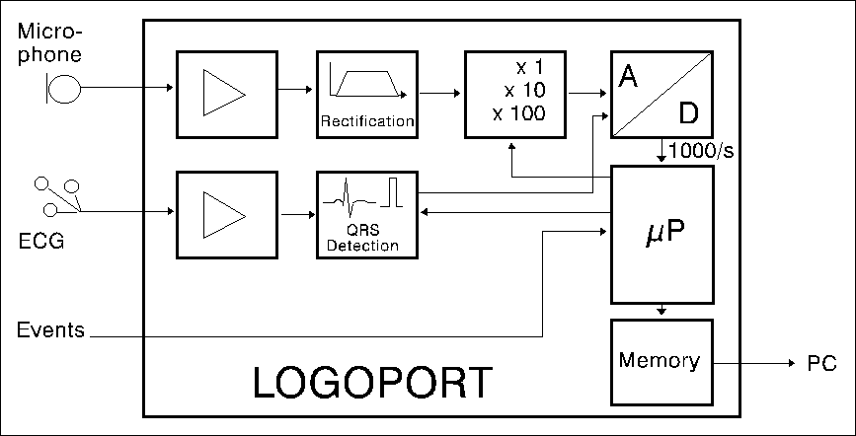
Logoport Apparatus

Slide 3
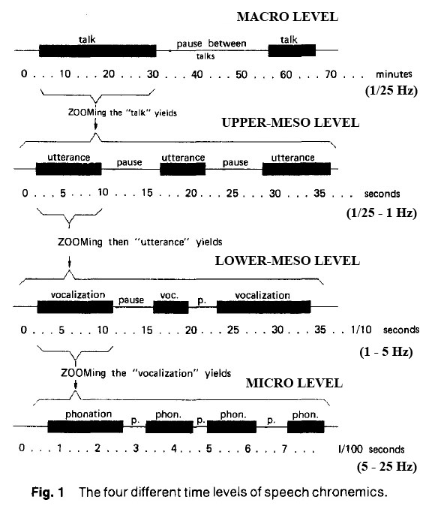
Nonverbal Information Content of Speech Changes across Temporal Scale

Slide 4
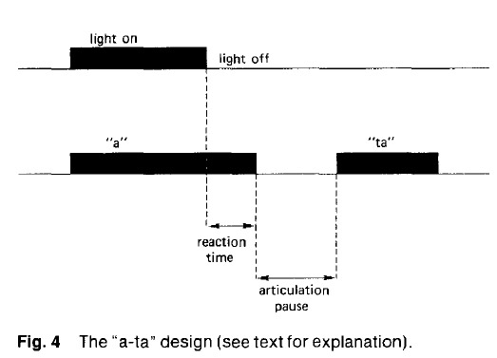
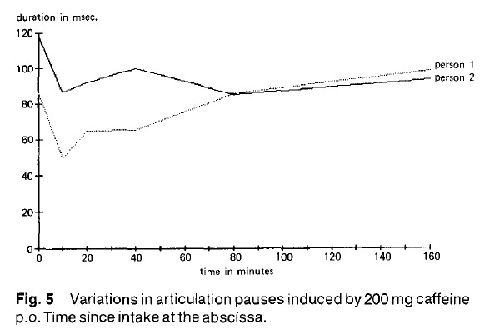
Effects of Arousal (Caffeine)

Slide 5
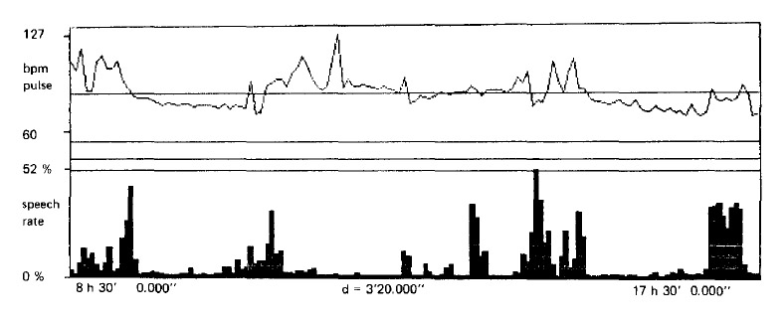
Speech v. Arousal Relationship

Slide 6
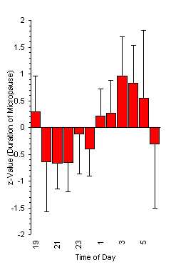
Circadian Rhythm of
Arousal/Fatigue

Slide 7
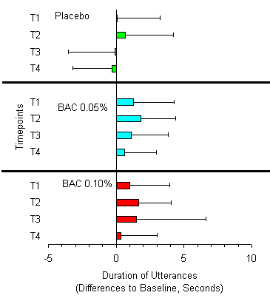
Blood Alcohol Level

