Slide 1
Data-Limited vs. Resource-Limited Modes of Cognitive Processing
Norman & Bobrow (1975)
HCI guy collaborates with Comp Sci guy and look what happens…

Slide 2
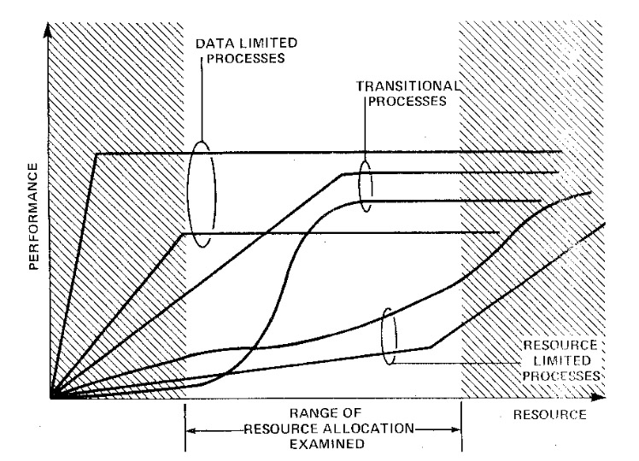
Performance-Resource Functions (A dynamic family of curves)

Slide 3
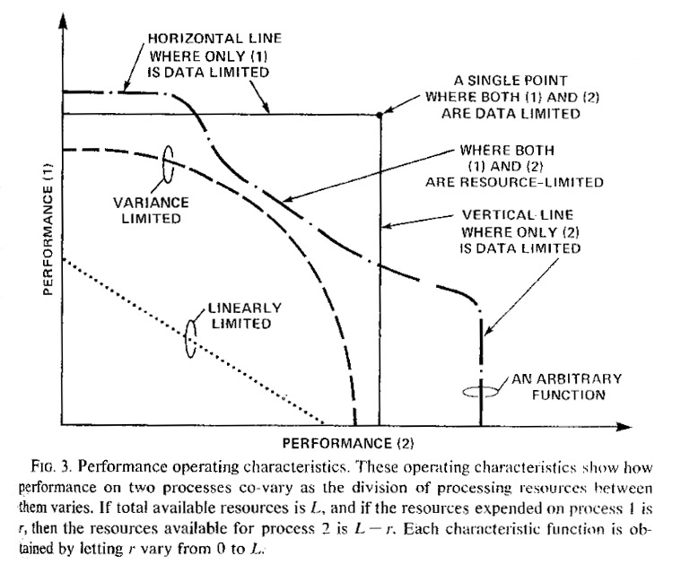
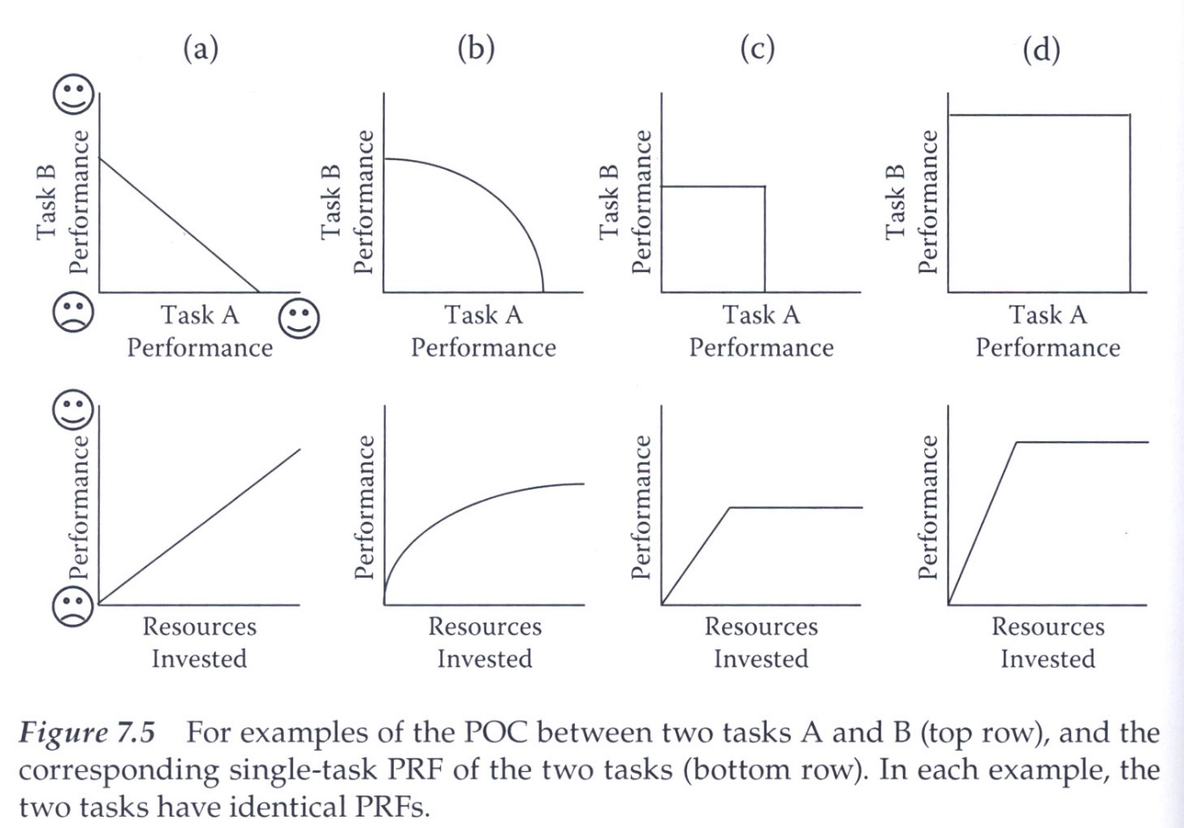
Performance Operating Characteristics (Virtually “useless” theoretical construct)
Forgetaboutit

Slide 4
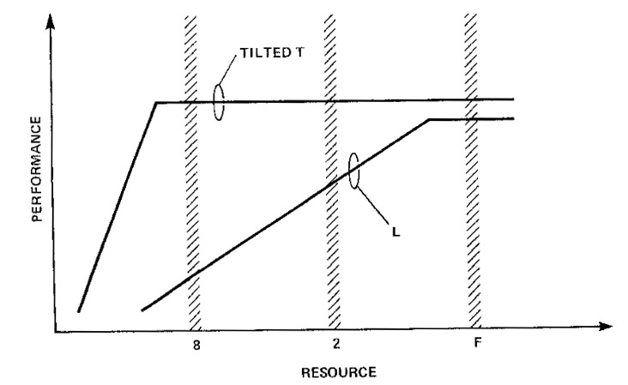
Cued Spotlight of Attention Paradigm (Beck & Ambler, 1973)

Slide 5
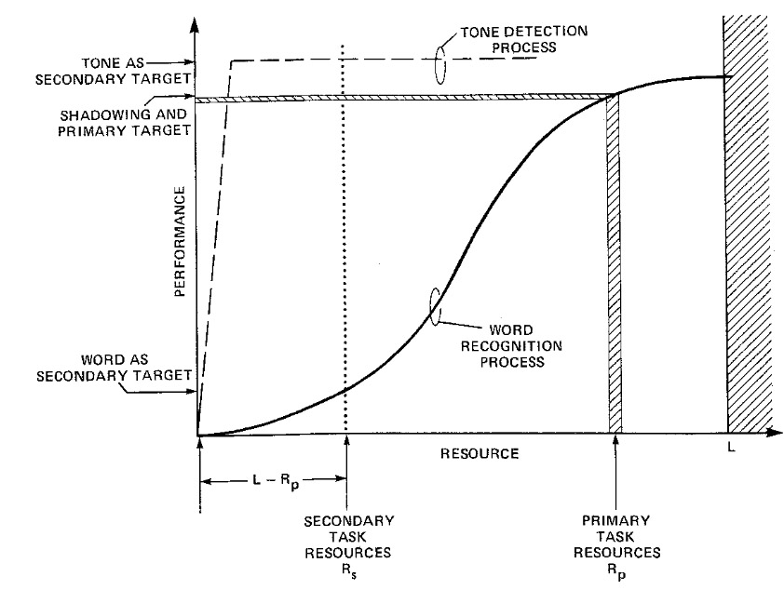
Competitive Auditory Shadowing (Treisman & Geffin, 1967; Lawson, 1966)

Slide 6
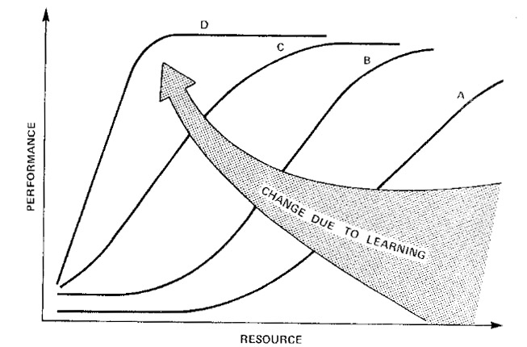
Development of Automaticity

