Slide 1
NASA Task Load Index (TLX)
Hart & Staveland (1987)

Slide 2
NASA TLX
NASA TLX is the product of a multi-year development project based upon 3461 workload ratings collected from 247 subjects across 16 experiments (see Hart & Staveland, 1987)
Workload is assessed using self-reports on 6 dimensions
(determined by meta-analysis and sequential factor analyses)
Workload ratings are combined into a global score based upon weights reflecting the priorities of individual operators

Slide 3
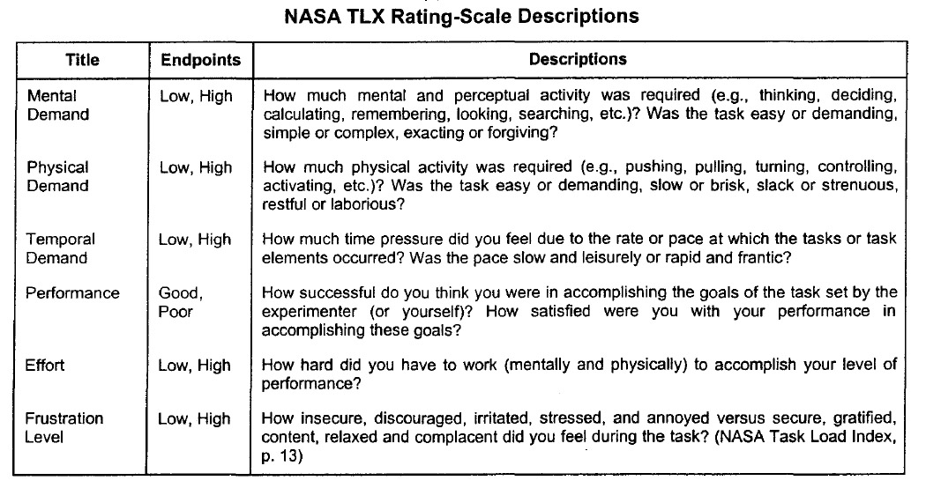

Slide 4
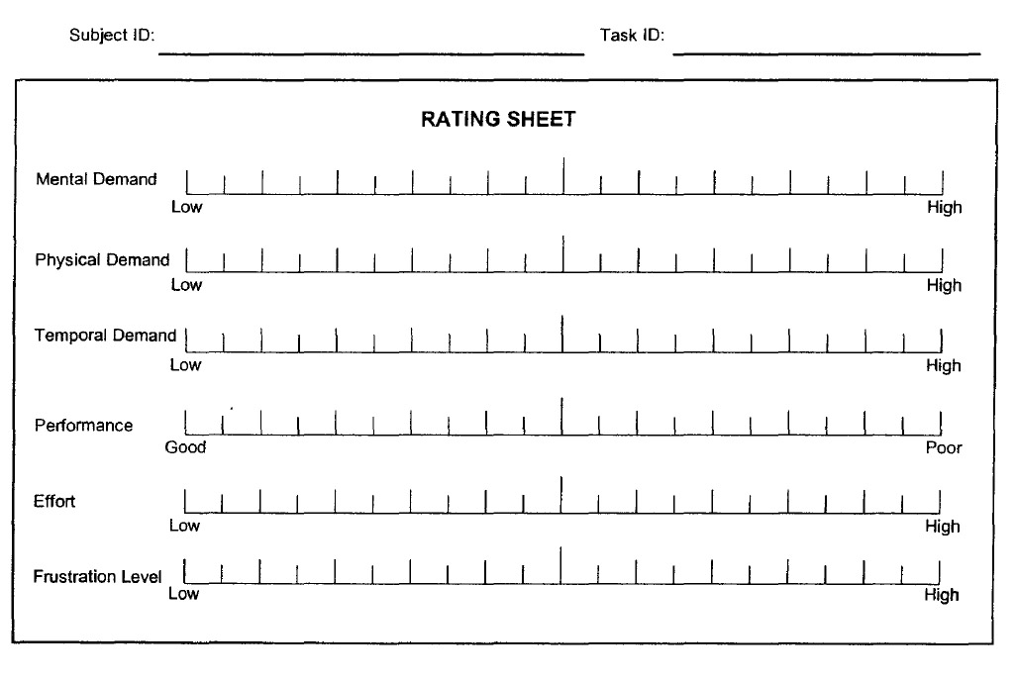
Scale Polarity Reversal reported to cause problems

Slide 5
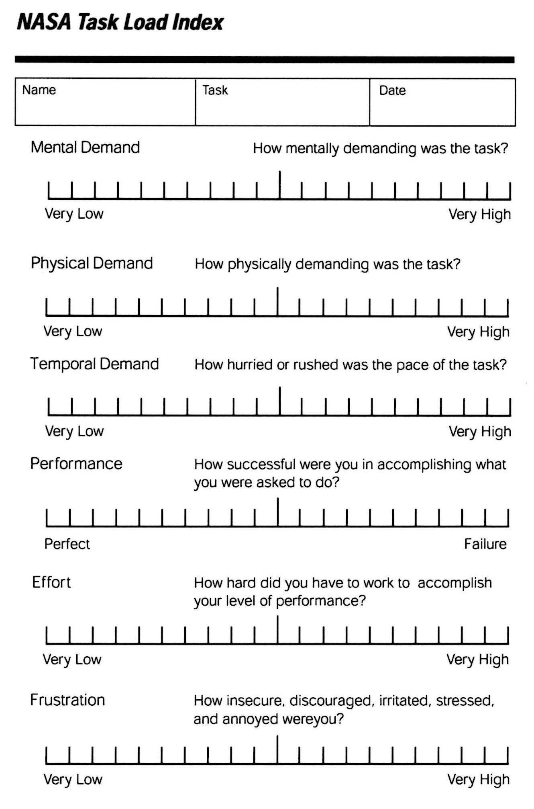
Revised Rating Score Card

Slide 6
Experimental Procedure
Instructions – Scale definitions and Rating Card
Familiarization – Use scale to rate workload on practice or
reference tasks
Collect Workload Ratings
Pair-wise prioritization of all 15 possible pairing of the six TLX
dimensions collected and used to weight workload ratings
Weighted sum of six workload scales used to generate a
global workload score

Slide 7
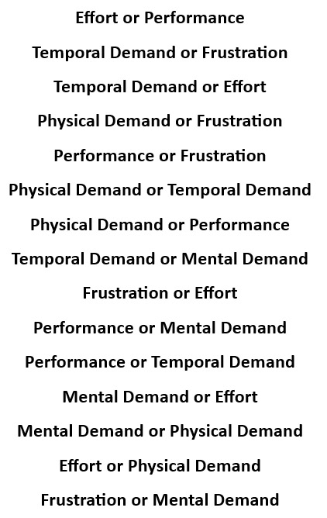
15 Pairwise Comparisons:
Which item was more important in your experience of workload on the experimental task?
Randomize order of pairs

Slide 8
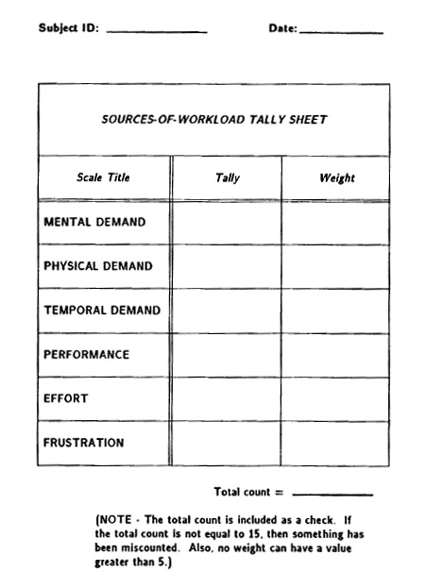
Tally Sheet used to convert pair-wise comparison data into scale weights

Slide 9
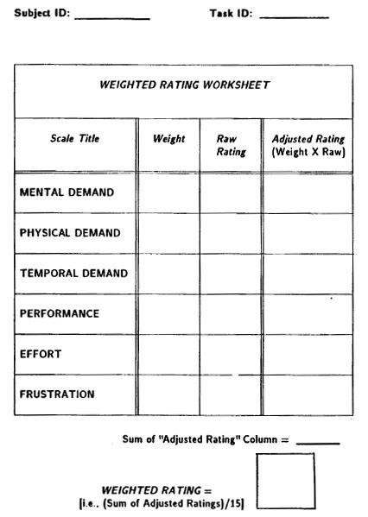
Work sheet for combining scale ratings and weights into a global workload score

Slide 10
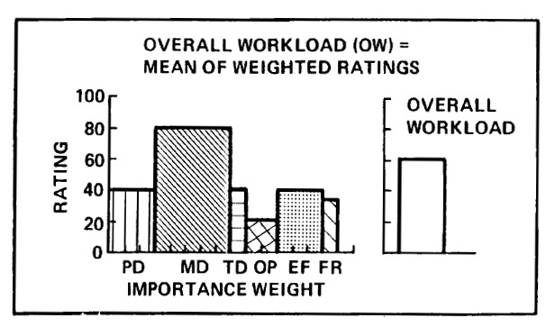

Slide 11
TLX Characteristics
Scale weights can provide “diagnostic” information independent of
the scale ratings
Scale weights were designed to accommodate individual differences
in the priorities assigned to each workload dimension
Global NASA-TLX score can be computed without the weighting
operation….Unweighted score is actually more “reliable” in
some applications (but at what cost?)
Weighted vs. unweighted score correlation reported at 0.94
(Eggemeier & Mitchell (1992)
The exact time at which the “Sources of Workload Evaluation” takes
place is not critical….as long as it occurs AFTER the experimental
task is experienced
A set of weights is “domain specific”

Slide 12
More TLX Characteristics
High correlation between “online” and retrospective TLX ratings (especially when retrospective ratings accompanied by videotaped memory “refresher” – Hart et al., 1986; Haworth et al., 1986)
Delays of 15 minutes did not affect workload ratings; delays of 48 hours resulted in TLX’s failure to discriminate workload levels
(Moroney, Biers & Eggemeier, 1995)
Battiste & Bortolussi (1988) reported test-retest correlation of 0.77
Score card can typically be completed in less than 1 minute
(i.e., compatible with operational scenarios)

Slide 13
TLX (continued)
The NASA TLX’s sensitivity and validity have been verified in various flight scenarios and an array of lab tasks, including:
Sternberg memory search
Choice RT paradigms
Critical instability tracking control
Compensatory tracking
Mental arithmetic
Mental rotation
Visual target acquisition
grammatical reasoning, etc., etc.

