Slide 1
Sound and Hearing

Slide 2
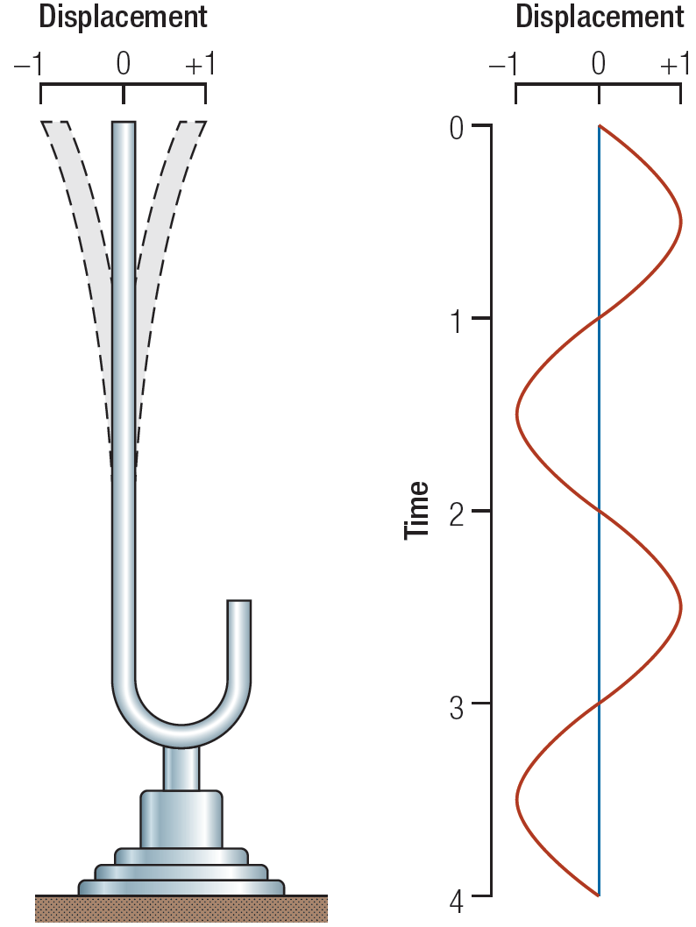
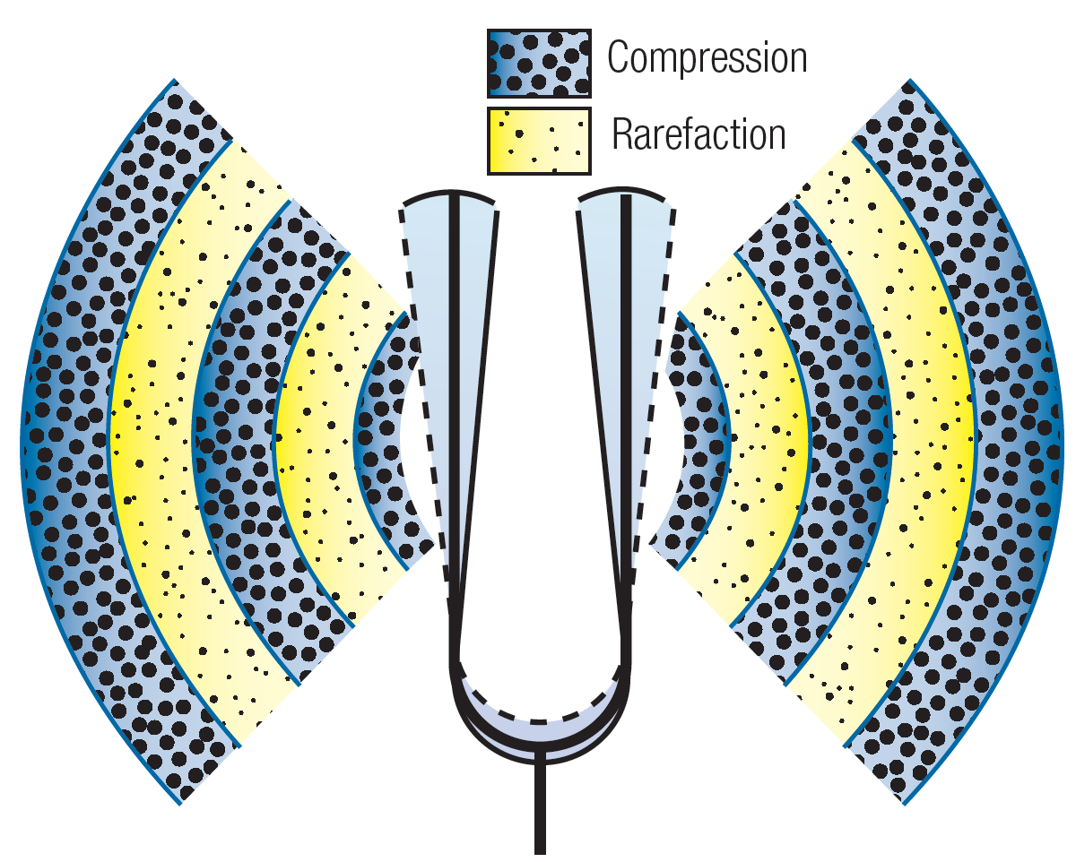
Nature of the Sound Stimulus
“Sound” is the rhythmic compression and decompression of the air around us caused by a vibrating object.

Slide 3
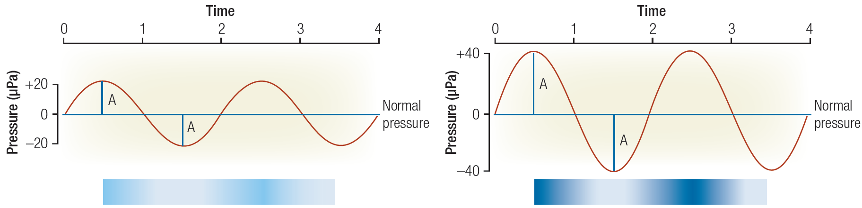
Sound Wave:
Amplitude and Frequency (Hz)
Sound Pressure is measured in units called Pascals
1 Pascal (Pa) = 1 Newton of force/m²
1 atmosphere = 100,000 Pa
Human absolute hearing threshold = 0.00002 Pa = 20 microPa
(i.e., 2 ten billionths of an atmosphere)
Frequency measured in cycles/sec = Hertz (Hz)
Nominal range of sensitivity: 20 – 20,000 Hz

Slide 4
The “decibel” (dB)
The decibel is a logarithmic unit used to describe a ratio (i.e., log (x/y))
In engineering analyses, it is used to normalize “power” measurements
to a known reference and then compresses the resulting ratio using
a log₁₀ operation.
This format is convenient for engineering analyses involving
wide dynamic ranges (when very small and the very large
magnitudes must be considered simultaneously).
dB = 10 log(Observed Power / Reference)

Slide 5
dB_{SPL}
The transducers (microphones) on sound level meters measure sound pressure (i.e., N/m² or Pascals).
Pressure needs to be converted to power prior to calculation
of the decibel equivalent….i.e., acoustic power = pressure²
Finally, we need to agree upon a Reference value.
By convention, we use 20 microPa (i.e., the hearing threshold)
Thus:
dB = 10 log (Observed Pressure² / 20 microPa²)
However……..

Slide 6
dB_{SPL} (continued)
Prior to the advent of hand-held calculators and computers
(circa 1970), performing a squaring operation was computationally expensive and prone to error.
To reduce computational demands, hearing science adopted a somewhat confusing convention in the specification of the
dB_{SPL} unit:
dB_{SPL} = 20 log (Observed Sound Pressure / 20 microPa)
+6 dB_{SPL} = doubling sound pressure +20 dB_{SPL} = 10x pressure
+3 dB_{SIL} = doubling acoustic power +10 dB_{SIL} = 10x acoustic power

Slide 7
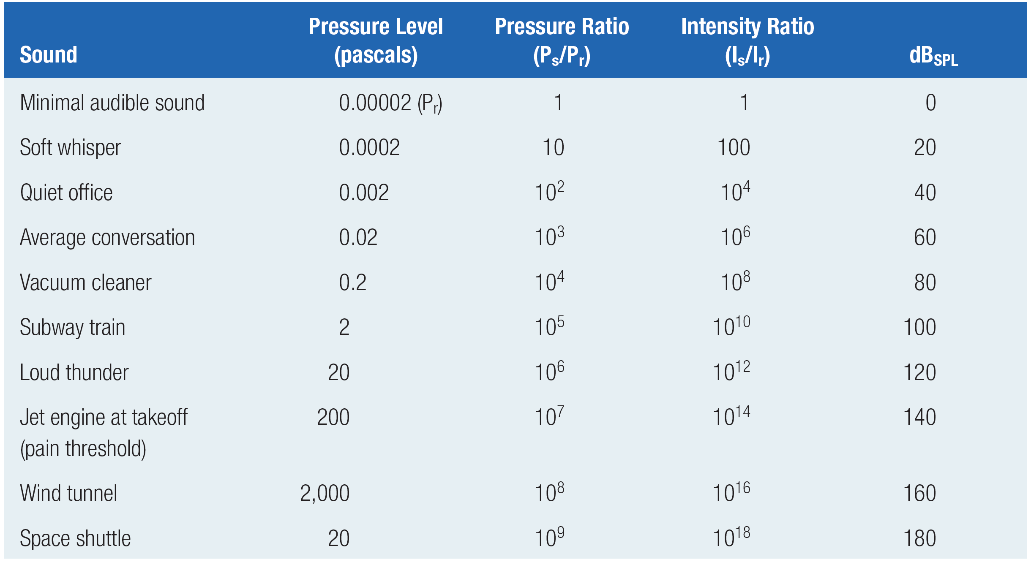
Some Typical Sound Amplitude Values

Slide 8
More about those pesky decibels
JND for sound intensity is about 1 dB_{SPL} for most of normal range of hearing
What does 0 dB_{SPL} mean?
Hint: 20 log (20 microPa/20 microPA) = 0 dB_{SPL}
If one machine emits 80 dB_{SPL} then how much sound amplitude would be expected from two machines side-by-side?
2 x 80 = 160 dB_{SPL} ??? (That’s pretty intense)
Convert from dB_{SPL} back to raw pressure, sum
the pressures, then convert sum to dB_{SPL}
80 dB_{SPL} → antiLog(80/20) → 10,000
20 log (10,000+10,000) = 86 dB_{SPL} (approx.)

Slide 9
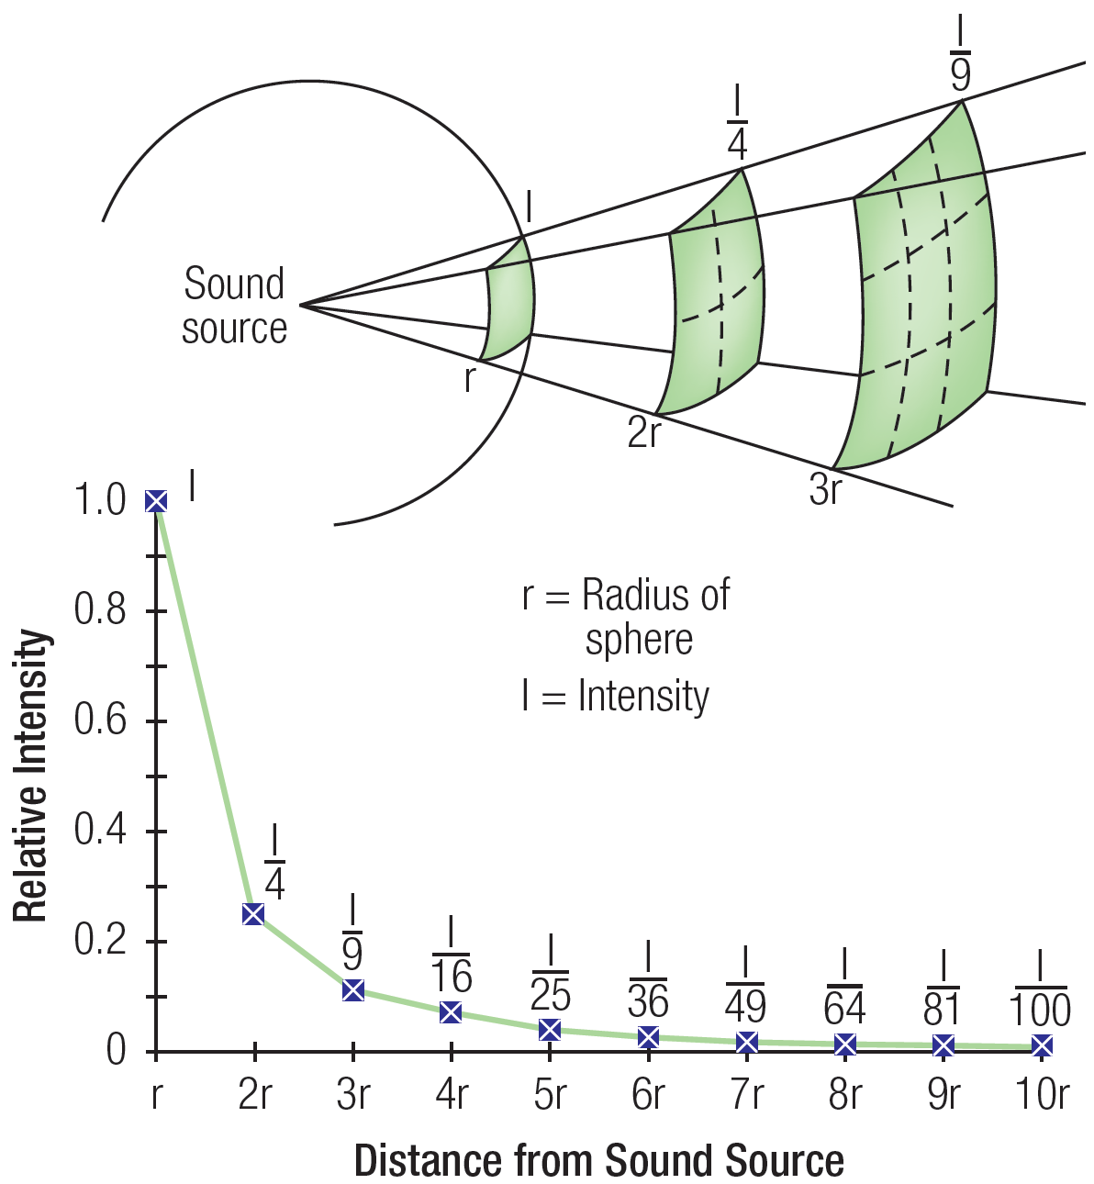
Inverse-Square Law
Area of sphere = 4πr²

Slide 10
A “Better” Sound Amplitude Table?
dB_{SPL}
Loud hand clapping at 1 m distance
Siren at 10 m distance
Hand (circular) power saw at 1 m
Very loud expressway traffic at 25 m
Lawn mower at 10 m
Refrigerator at 1 m
Talking; Talk radio level at 2 m
Very quiet room fan at low speed at 1 m
Normal breathing at 1 m
0 Absolute threshold

Slide 11
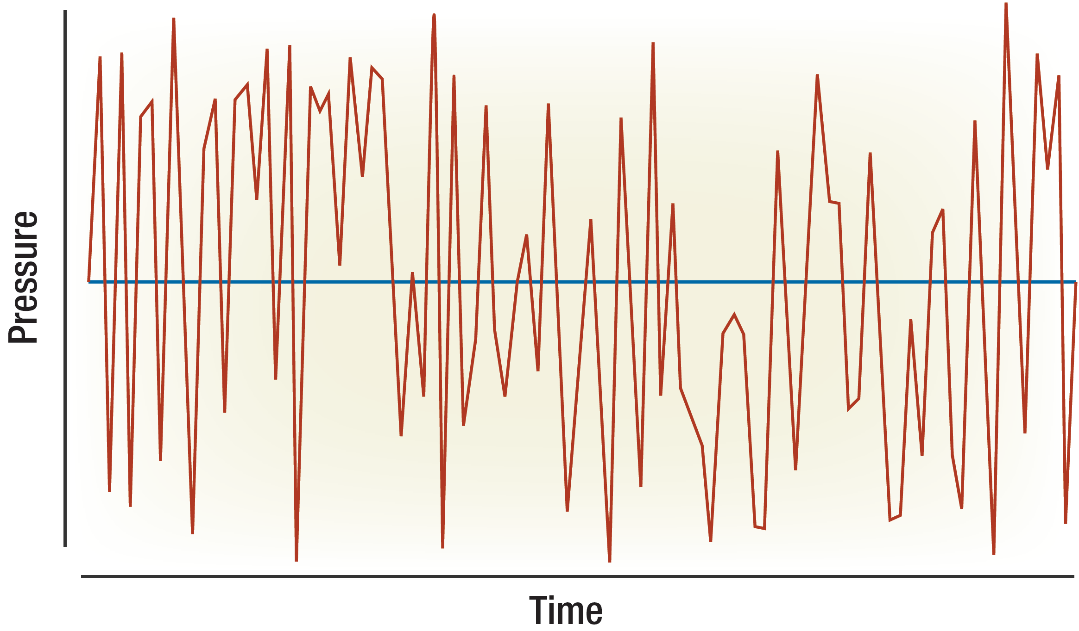
Most Sound Stimuli are Complex

Slide 12
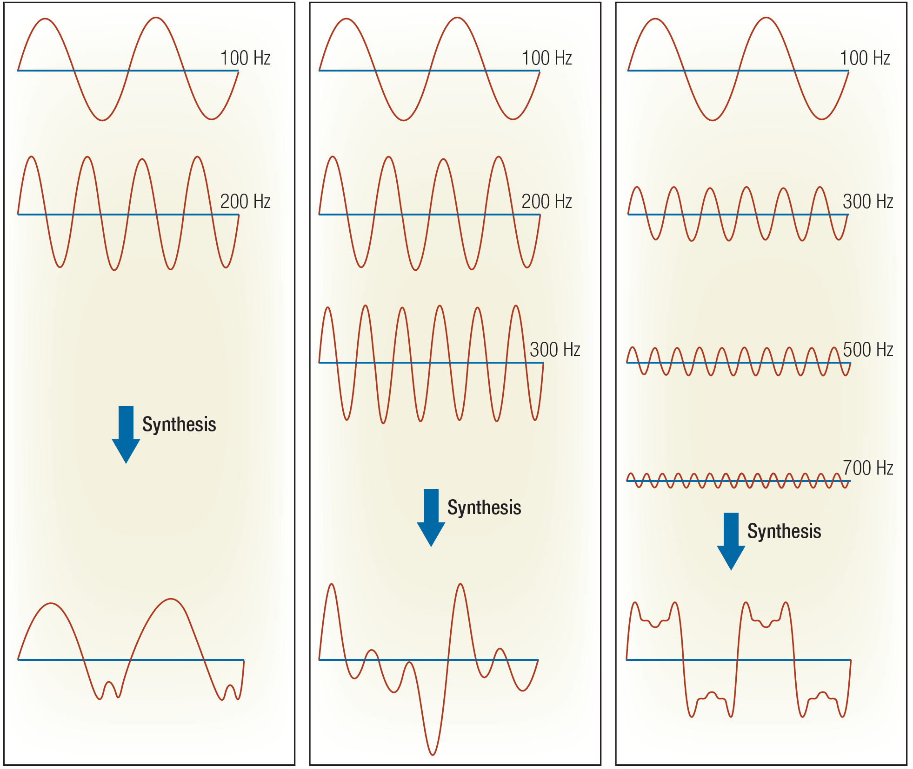
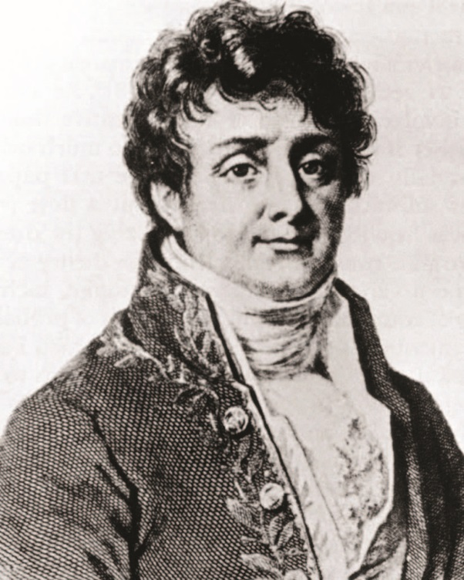
Complex Sound = Sum of Sines
(Fourier Theorem Revisited)
J.B.J. Fourier
(1768-1830)
Fourier Sound Applet

Slide 13
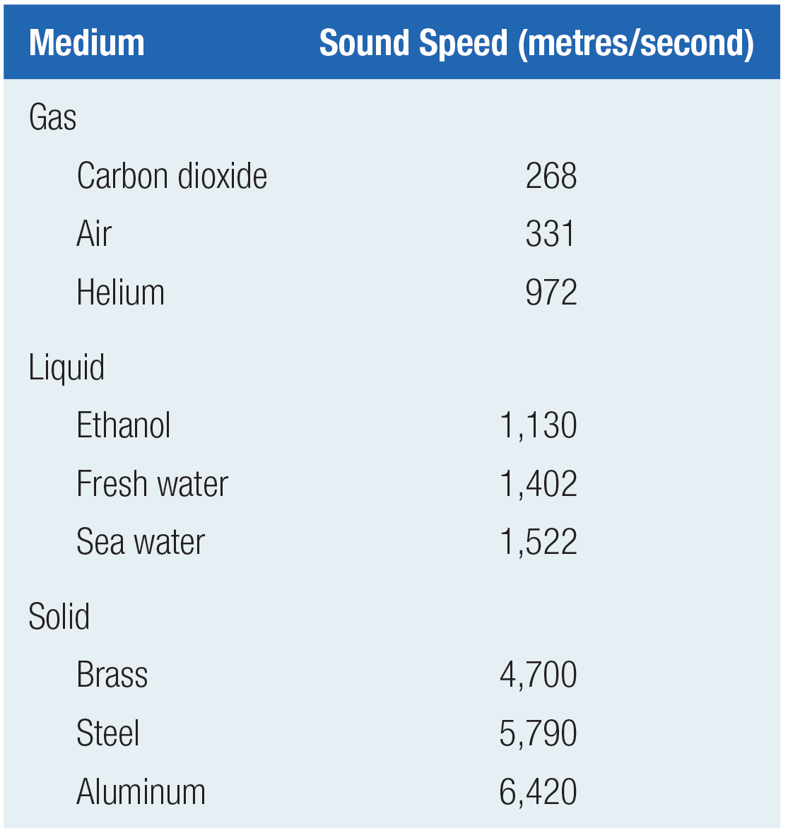
Speed of Sound
Acoustic energy results from a
traveling wave of rhythmic “compression” through a physical medium (e.g., air; water; steel).
It is the “compression” that travels not the medium, per se.
The characteristic speed of this travelling wave varies as a function of the medium (elasticity; density).
The speed of acoustic energy through the air (aka “sound”) is
331 m/sec (or 742 MPH) at 0-deg C
(Faster at higher temperatures).

Slide 14
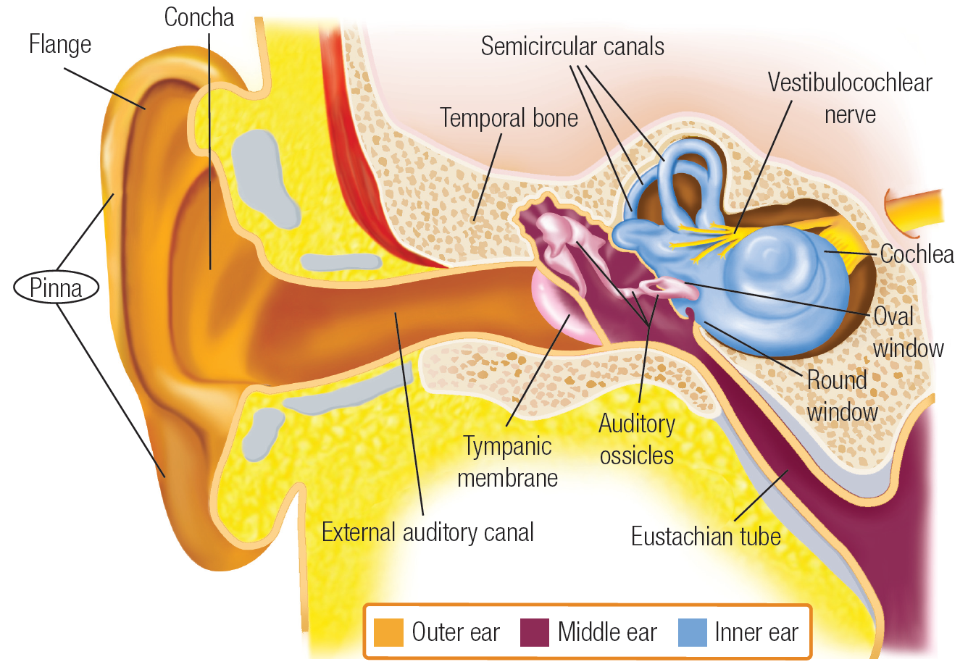
Gross Anatomy of the Ear

Slide 15
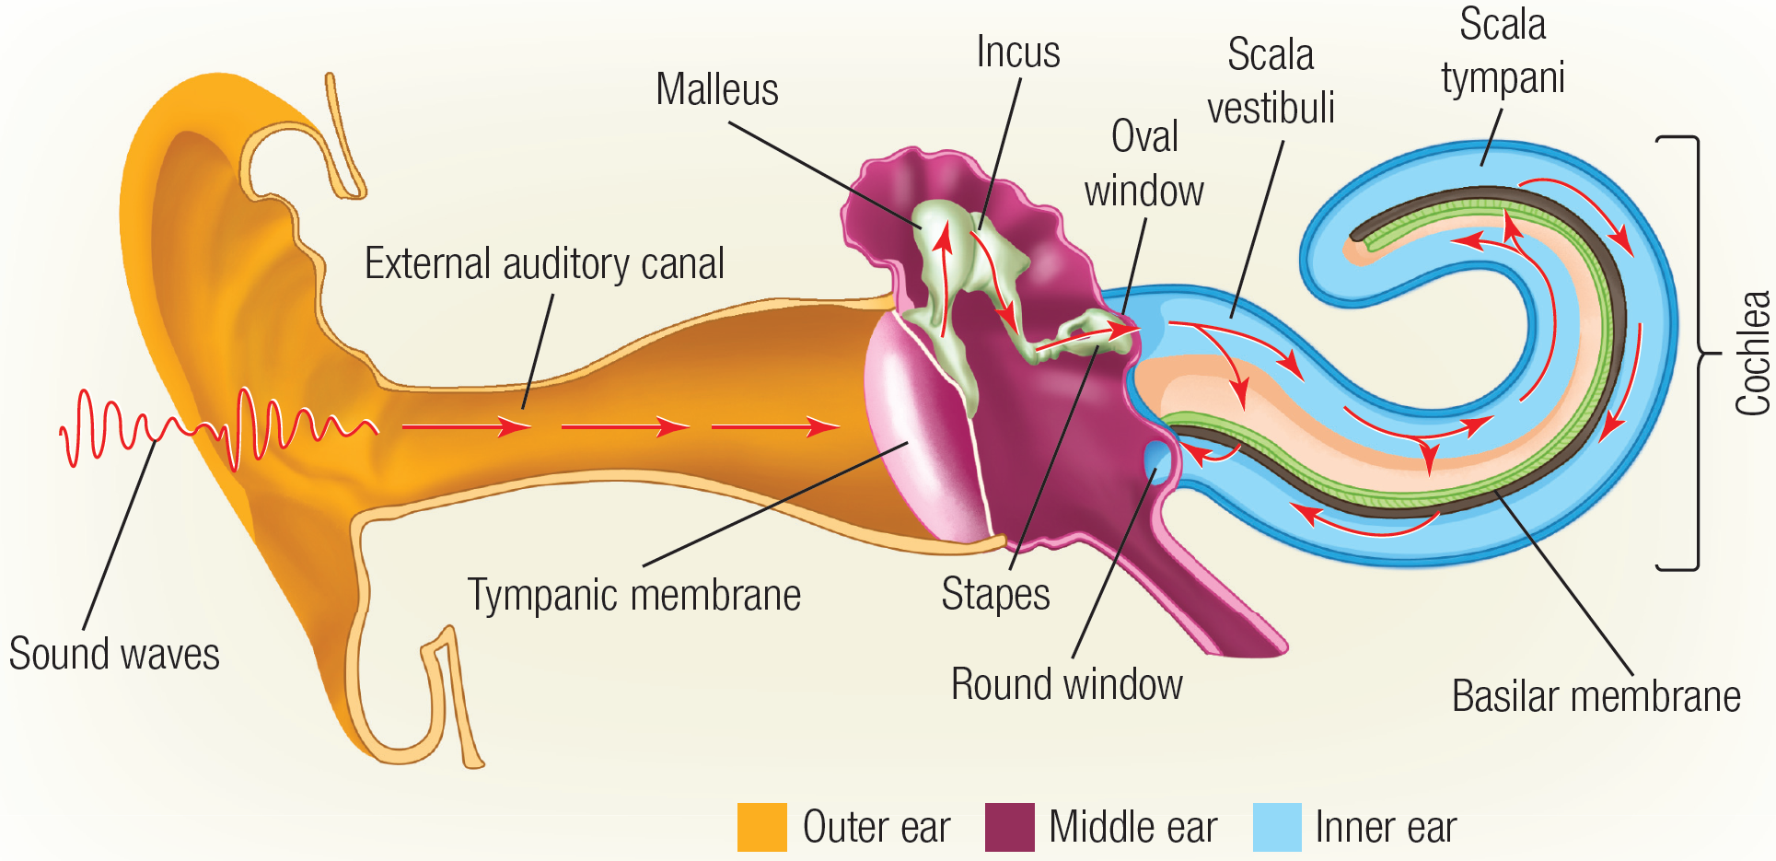
Flow of Acoustic Energy
(The “Impedance Problem”)

Slide 16
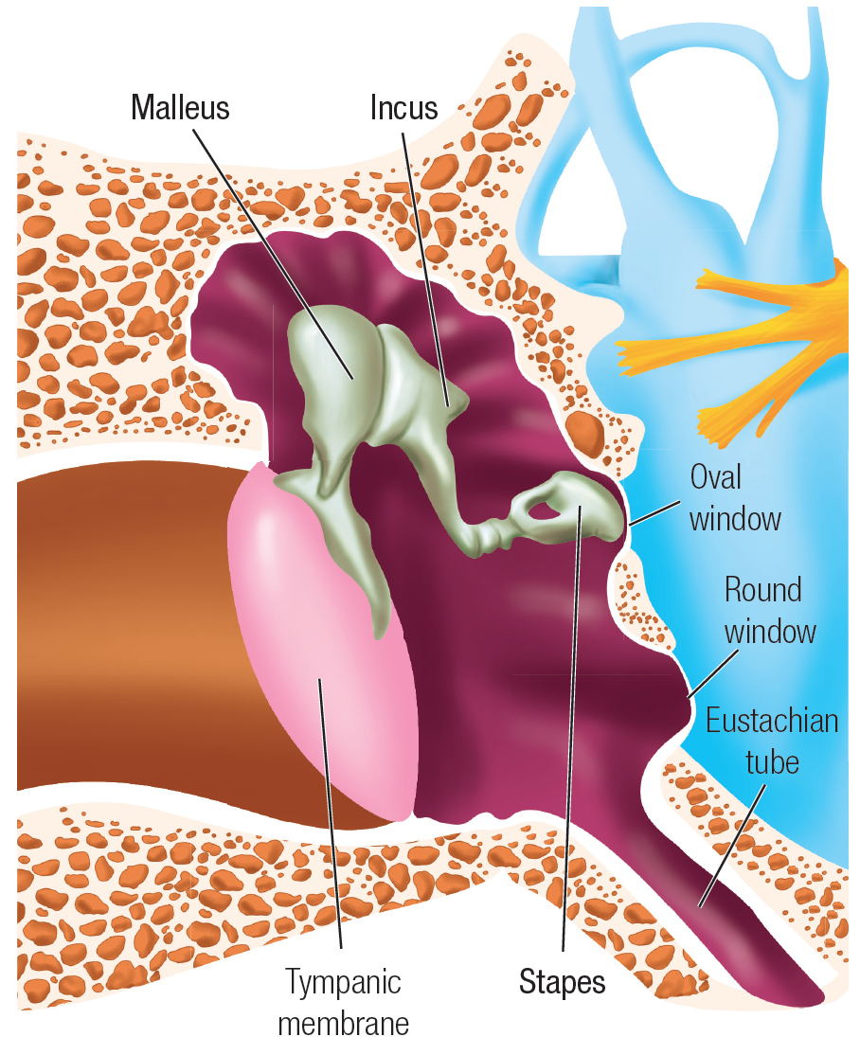
The “Impedance Problem”
99.9% of sound energy in the air is reflected at the air:water boundary
(10 log(0.1/100)) = -30 dB loss) (1/1000x)
How does the ear compensate for this loss as sound energy is transmitted from the air to the fluid that filled the cochlea?
2 dB gain via ossicular leverage (1.6x)
25 dB gain via surface area condensation
(eardrum → stapes) (316x)
~5 dB gain at mid-frequencies (3x) due to pinna and auditory canal resonance

Slide 17
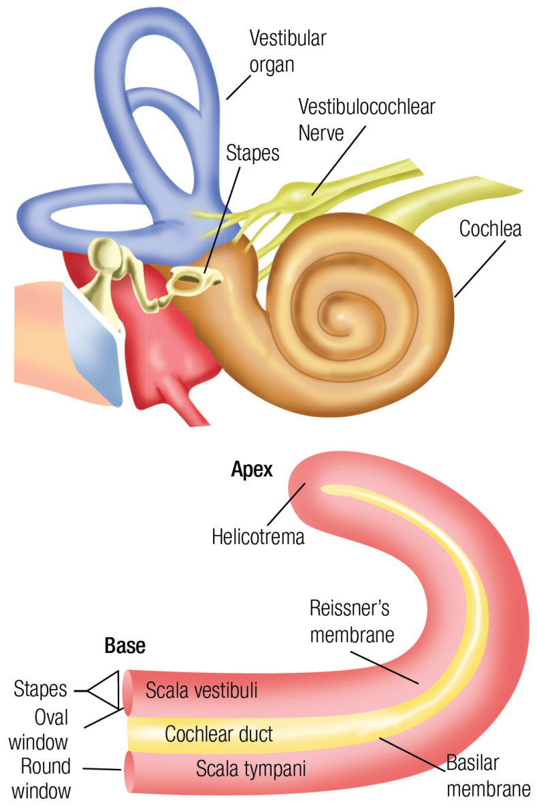
The Cochlea

Slide 18
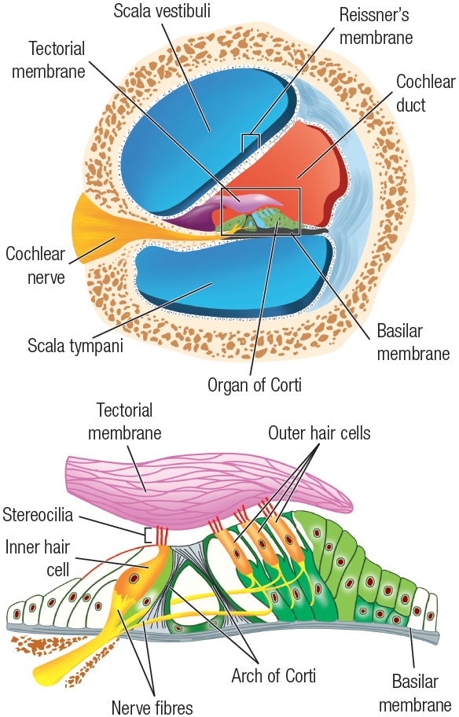
The Organ of Corti
3000-3500 Inner Hair Cells (IHC)
12,000 Outer Hair Cells (OHC)

Slide 19
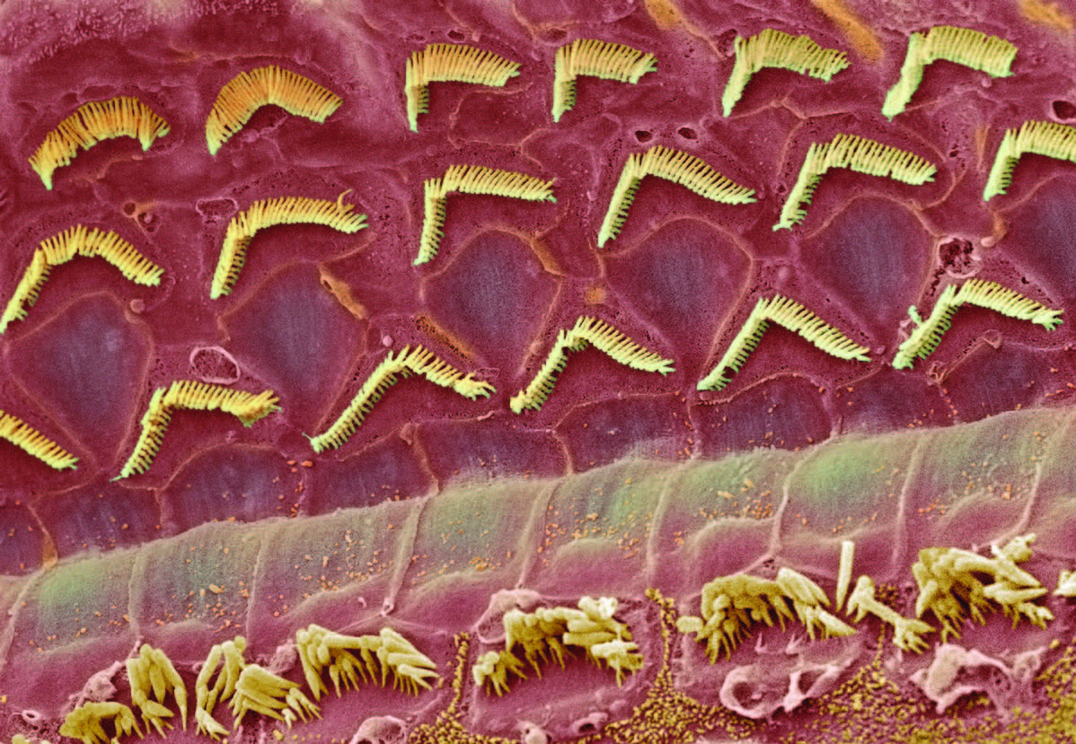
Photomicrograph: Sensory Hair Cells
Three rows of
Outer Hair Cells
One Row of Inner Hair Cells

Slide 20
Auditory Transduction

Slide 21
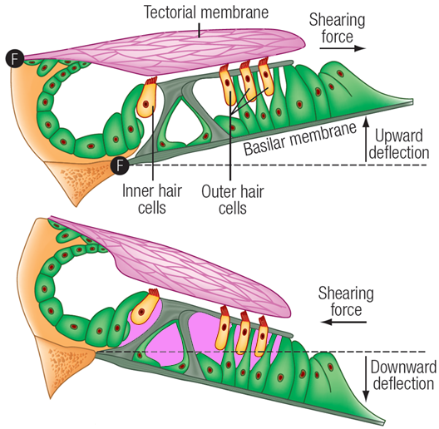
Basilar Membrane Modulation
Effects upon Sensory Hair Cells
Note: K⁺ ion concentration gradient across sensory hair cells (see pink cavities)

Slide 22
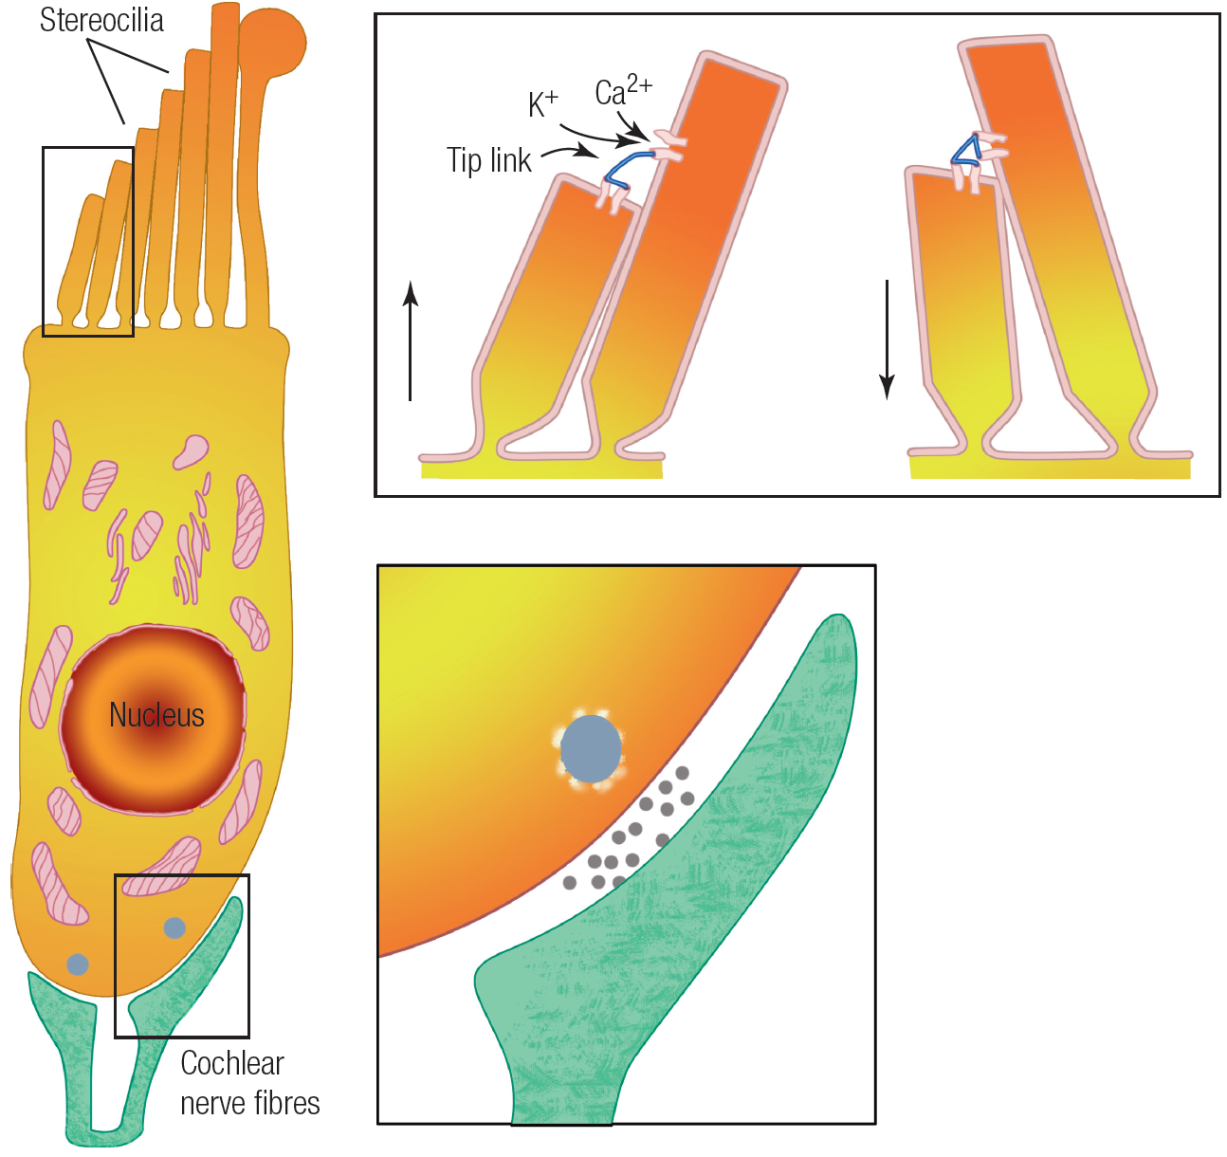
IHC Stereocilia “Tip Links”
“tip link” connects gate to adjacent cilia.
Shearing motion forces gate to open.
Mechanical open-and-close of
gate modulates influx of potassium ions (much FASTER than slow chemical cascade in visual transduction).
K⁺ depolarization of IHC triggers release of glutamate at cochlear nerve fiber synapse.

Slide 23
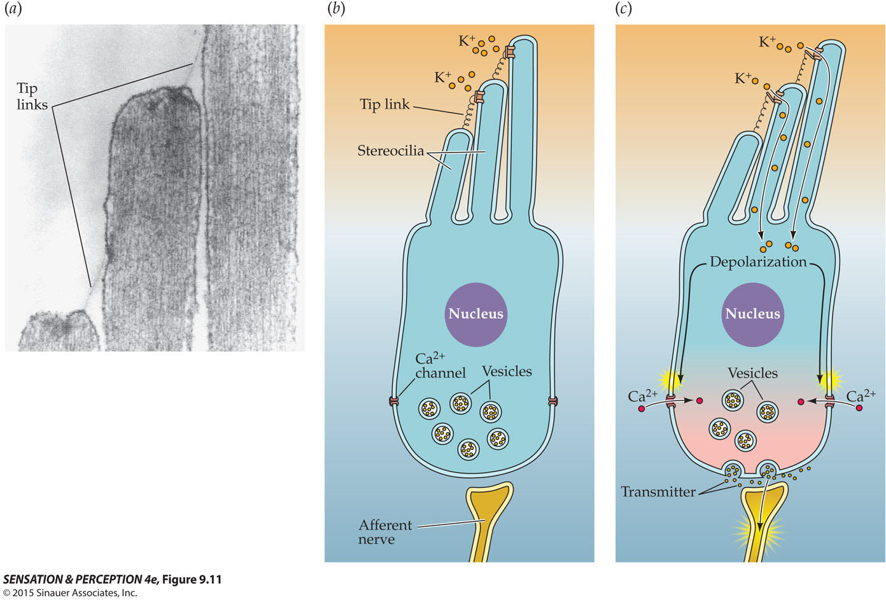
IHC Auditory Transduction

Slide 24
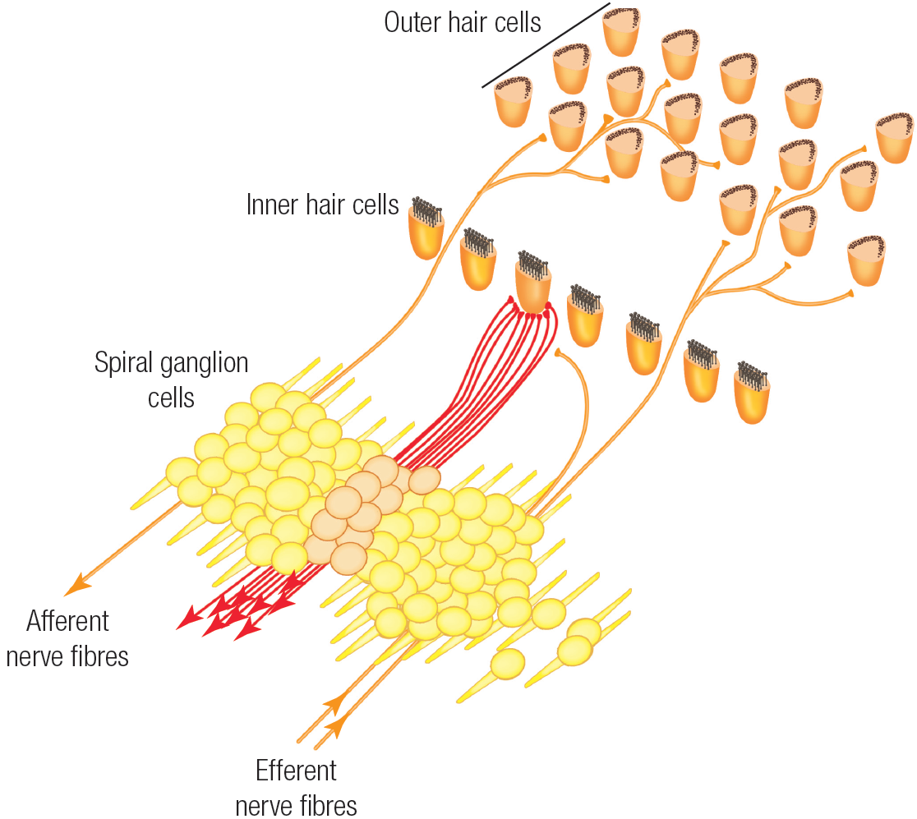
Innervation of 3000 IHCs versus 12,000 OHCs
30,000+ fibers in cochlear nerve. Nearly 10:1 fiber-to-IHC innervation ratio.
Sparse number of fibers carry info from OHC to brain.
Small number of fibers descend from brain to OHCs.
Role of OHC’s?
Mechanical gain
otoacoustic emission

Slide 25
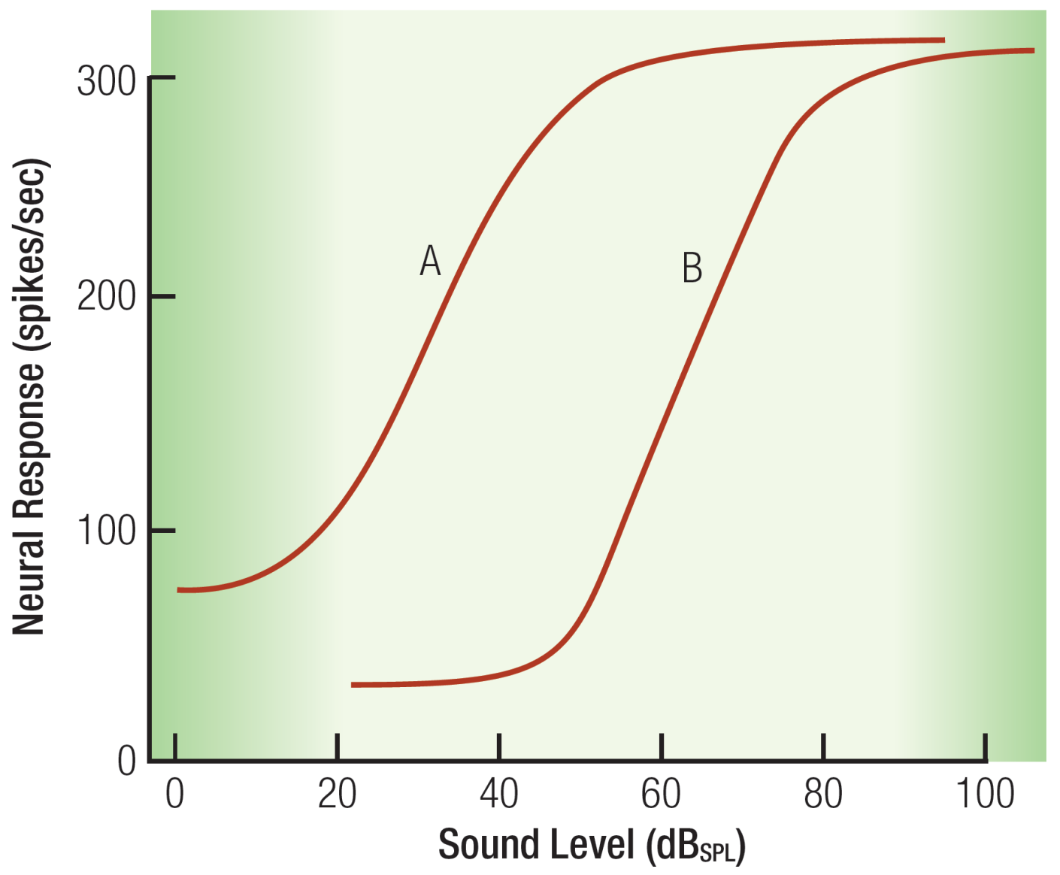
Sound Amplitude Coding
(“Divide and Conquer”)
Multiple nerve fibers for each IHC.
Each nerve fiber tuned to a different 40 dB “range” of stimulus intensity.
Intensity-level multiplexing

Slide 26
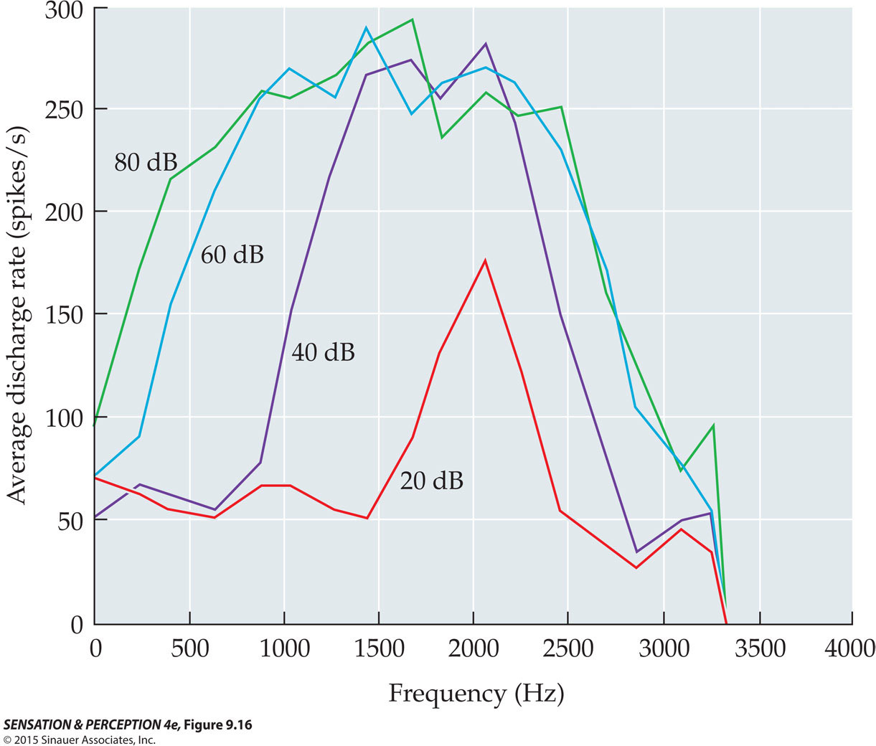
Tuning Specificity of Cochlear Nerve
Fibers “Broadens” with Increased Intensity
Q: Why the broadening and asymmetry? A: Look to the Basilar membrane’s response

Slide 27
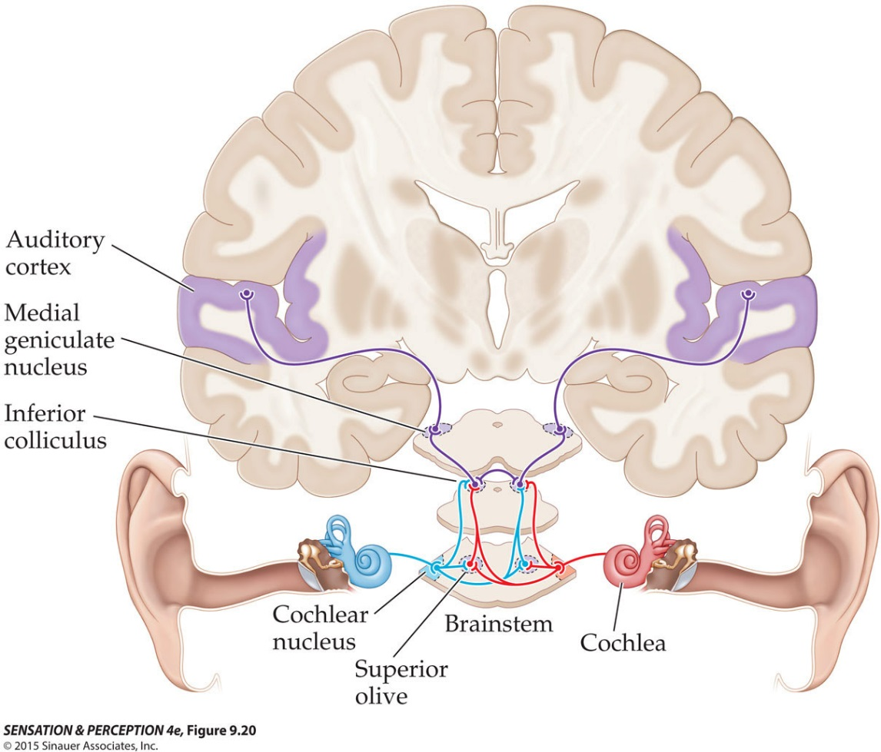
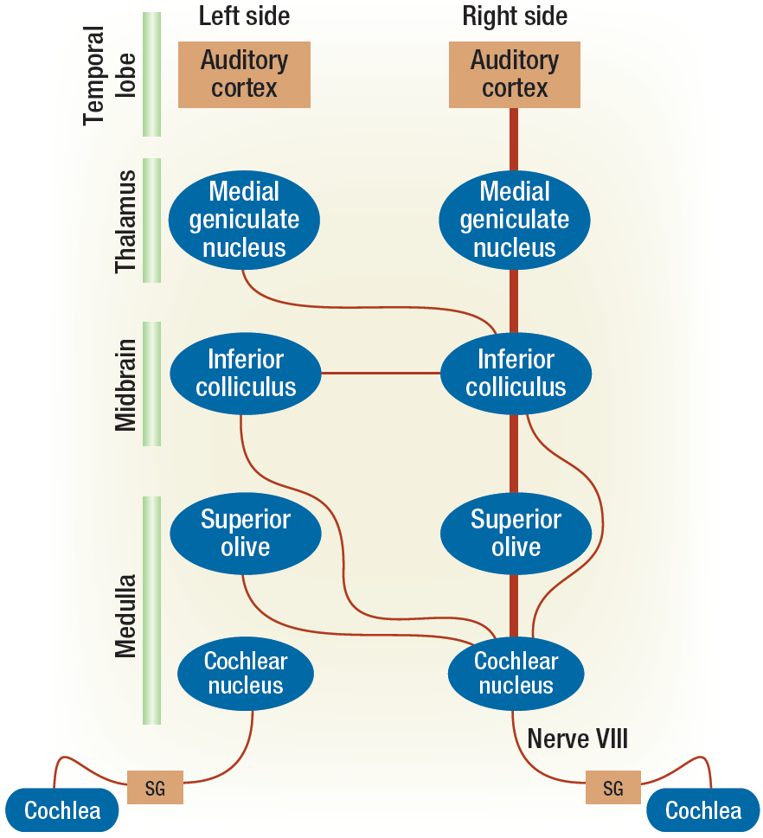
Ascending Pathways

Slide 28
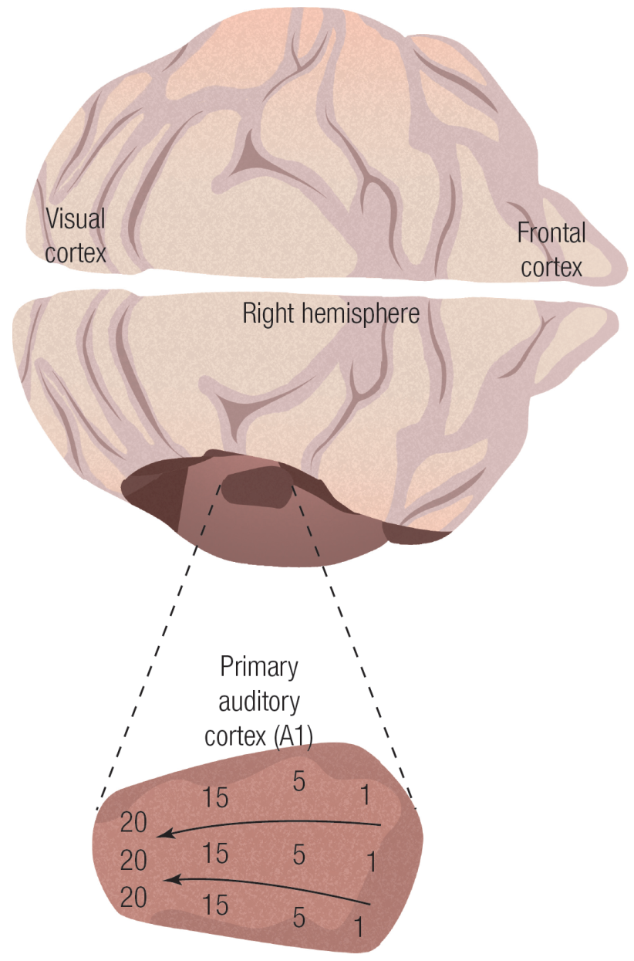
Tonotopic Organization of Primary Auditory Cortex (A1)
Also note:
Segregation of monaural versus binaural cells is maintained.
Binaural cells loosely organized according to spatial location of stimulus source.

Slide 29
Auditory Frequency Coding
(What is the neural code for “pitch”?)

Slide 30
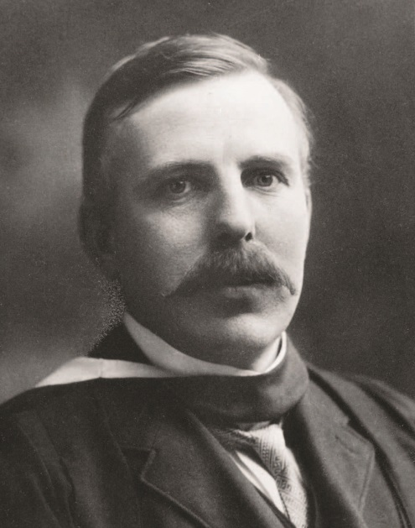
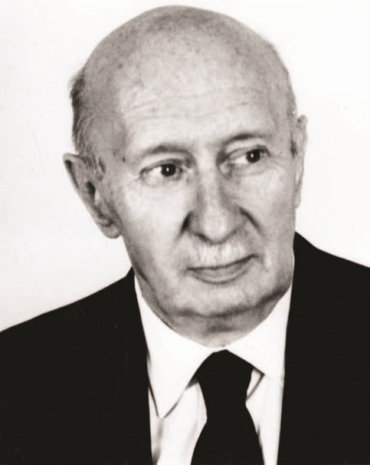
Frequency Mechanism versus
Place Mechanism
Frequency Theory
Place Theory
Ernest Rutherford
(1871-1937)
Georg von Békésy
(1899-1972)

Slide 31
Frequency Theory (Rutherford)
Basilar membrane analogy to microphone diaphragm
Each oscillation yields nerve pulse
Problem: Max. neural response approx. 500 Hz
Solution: Time division multiplexing
(aka “Volley Principle” )
Supported by “cochlear microphonic”
(Wever & Bray; but consider Botox results)

Slide 32
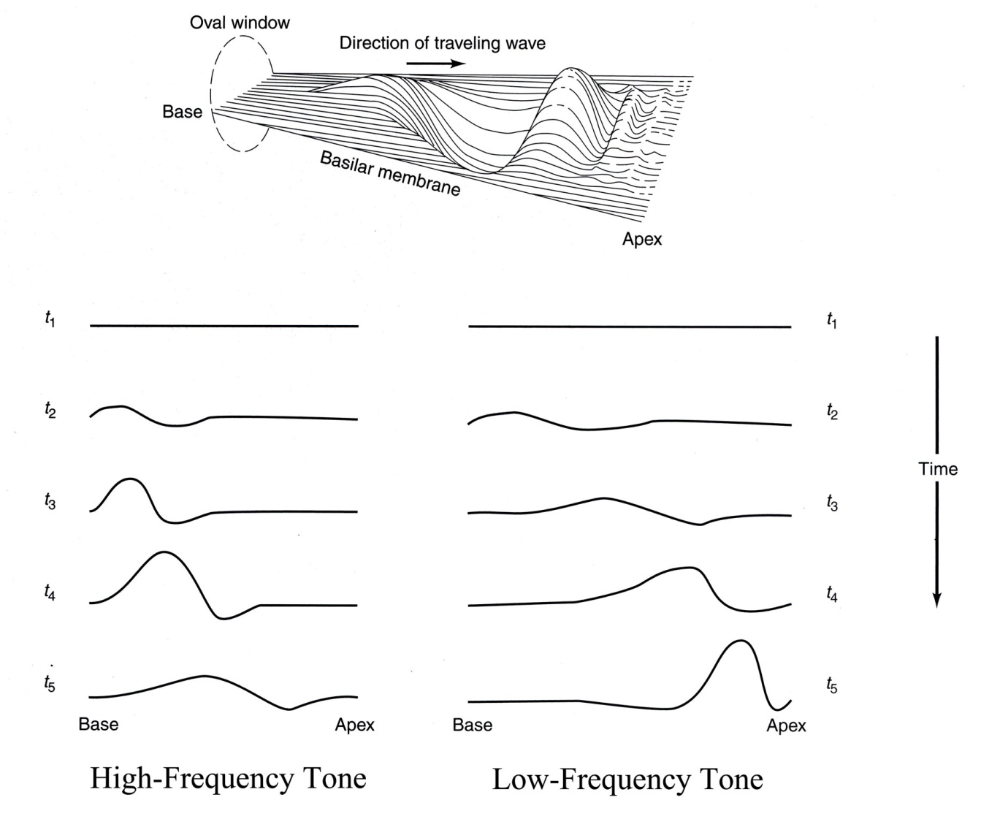
von Békésy Place Theory:
Focus on Basilar Membrane Dynamics

Slide 33
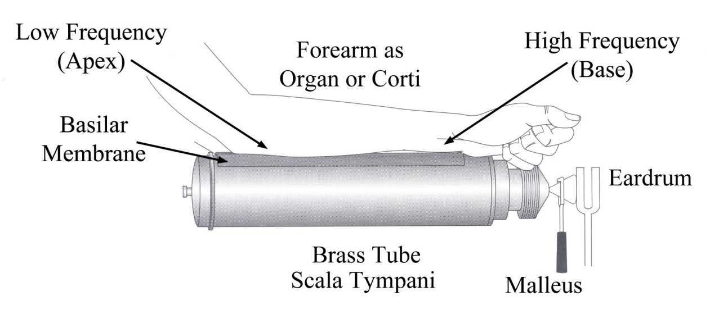
The Simple Beginnings for von Békésy’s Nobel Prize

Slide 34
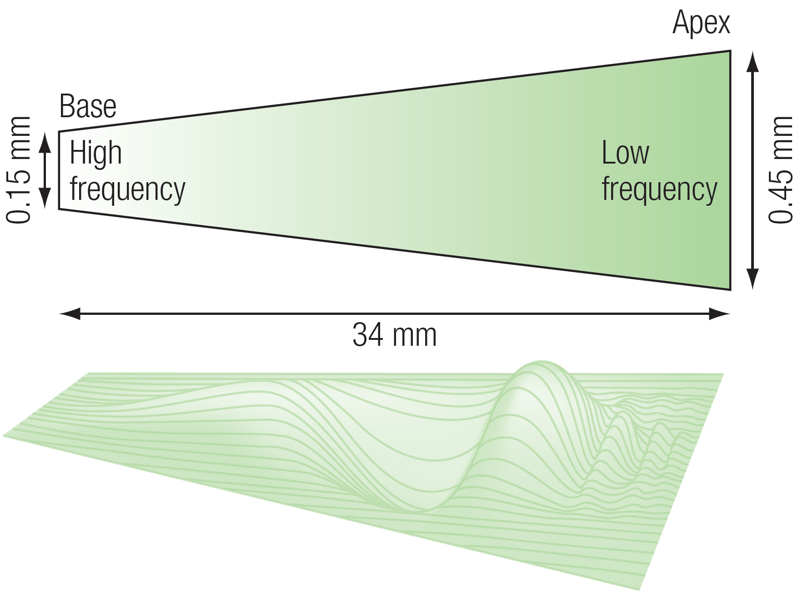
Basilar Membrane Response to Pure Tone Stimulus

Slide 35
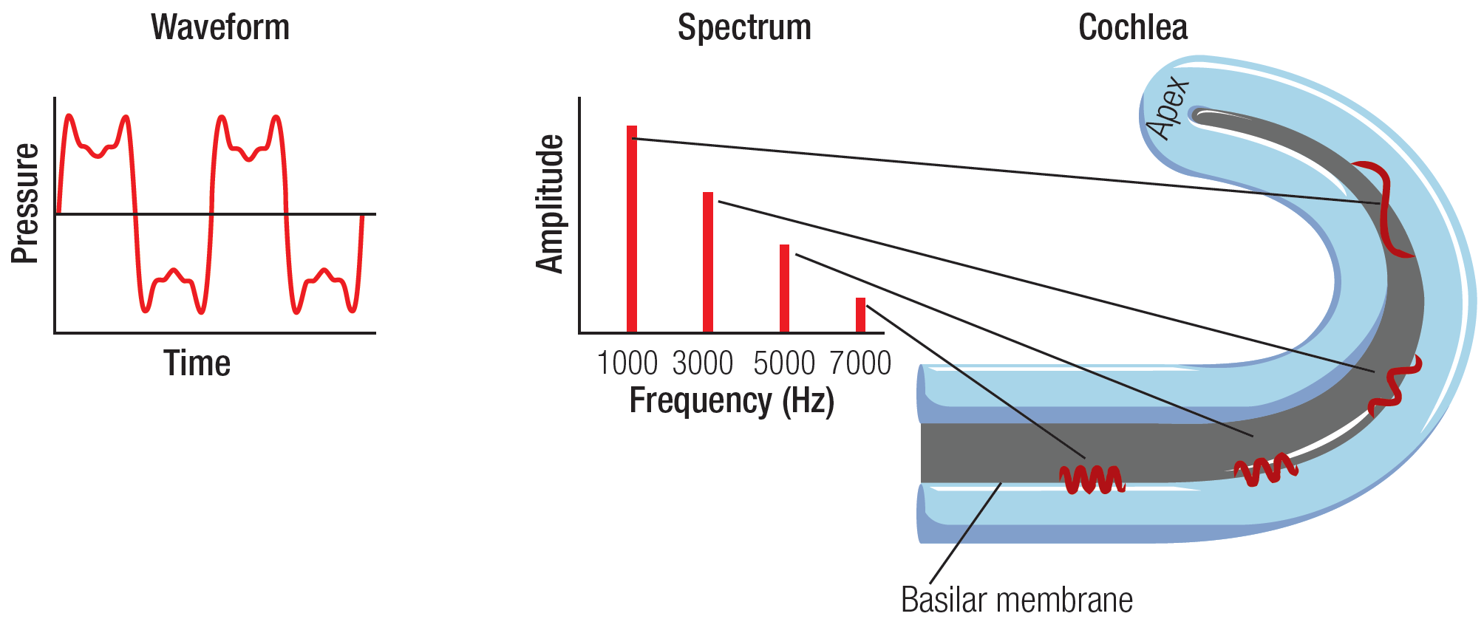
Von Békésy’s “Place Mechanism” as Biological Fourier Analyzer
Basilar Membrane Dynamic Simulation (animation)

Slide 36
Functional Aspects of Hearing

Slide 37
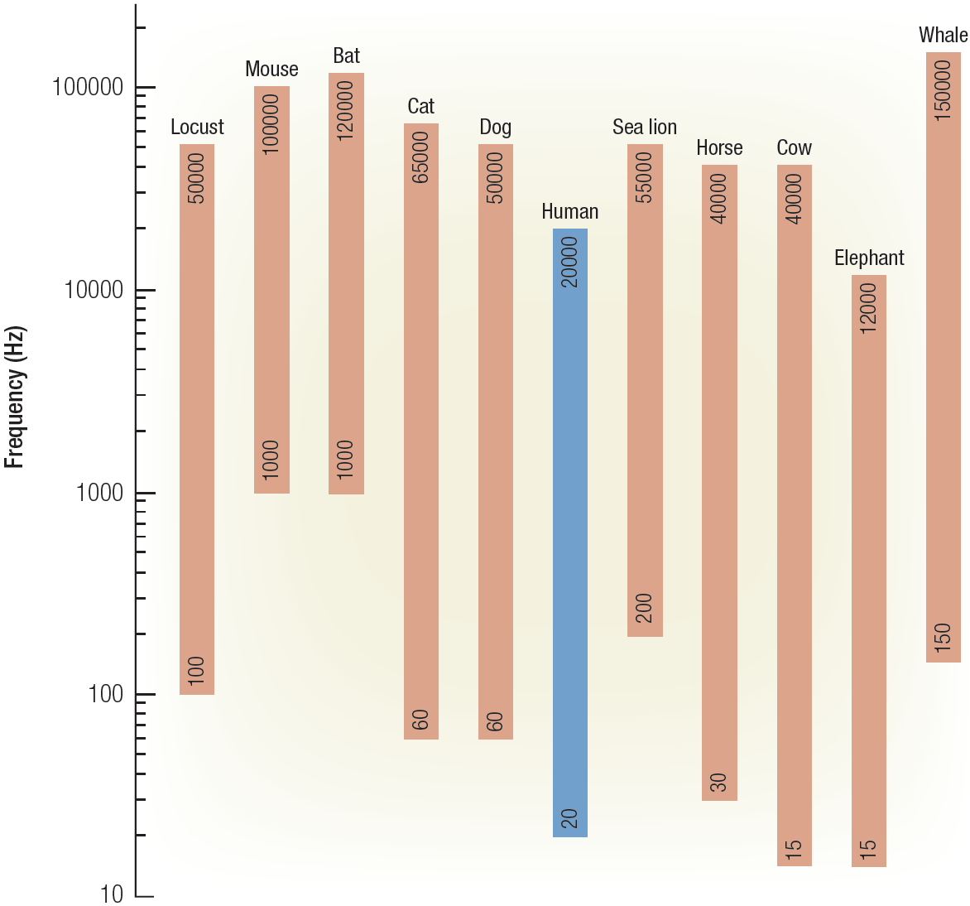
Species-Specific Frequency Range

Slide 38
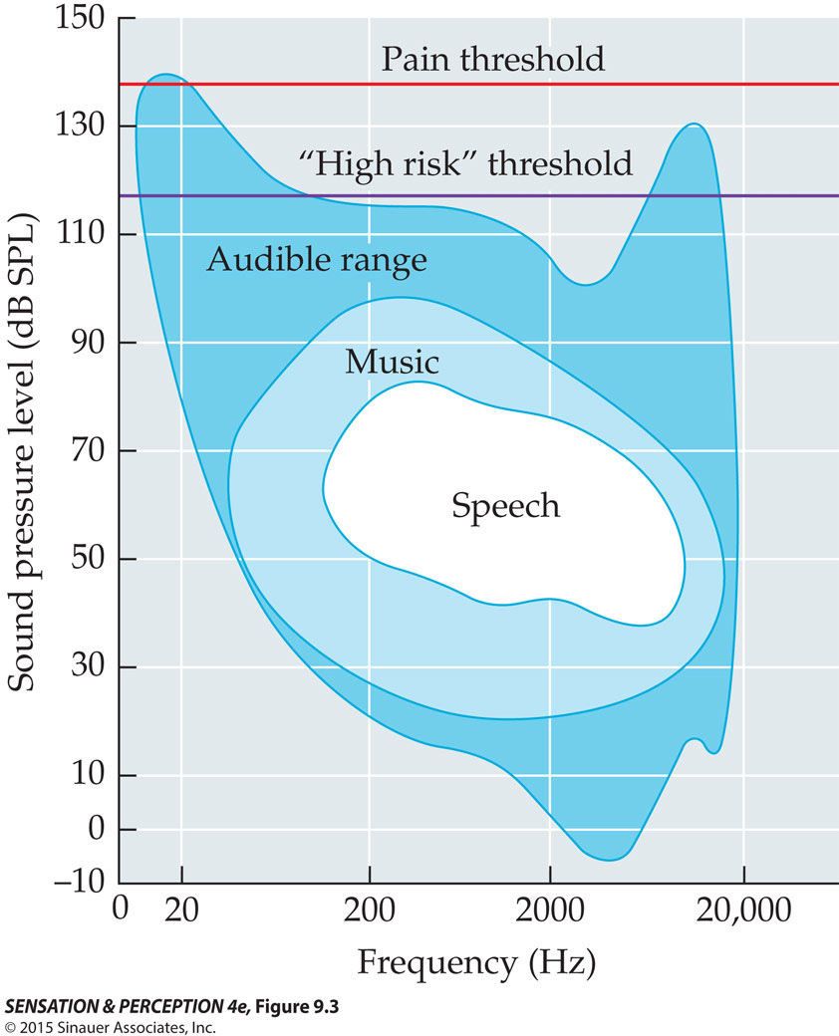
Human “Earscape”

Slide 39
Minimum Audibility Curve
Average detection threshold for 18-yr-olds for 1KHz tone at sea level is
20 microPa (μPa)
Minimum occurs at approx. 3 KHz
Binaural intensity thresholds are 3 dB lower than mono

Slide 40
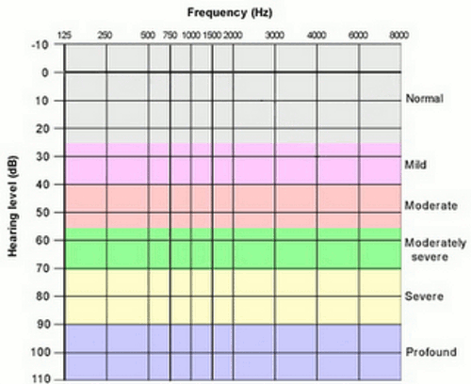
Clinical Audiogram (dB_{HL})
dB-HL (Hearing Level) uses a different reference level for each test frequency.
That reference level represents the average threshold (18 yr-olds)
demonstrated at that frequency.
Hence, a value of 0 dB-HL means “average” hearing level at the frequency under test.

Slide 41
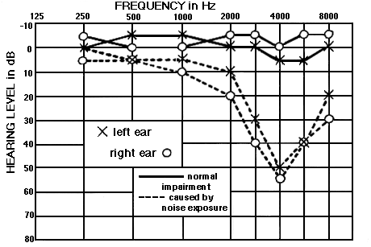
Normal vs. Noise-Induced Hearing Loss
Note “notch”
At 4 KHz.
Source: http://mustelid.physiol.ox.ac.uk/drupal/?q=acoustics/clinical_audiograms

Slide 42
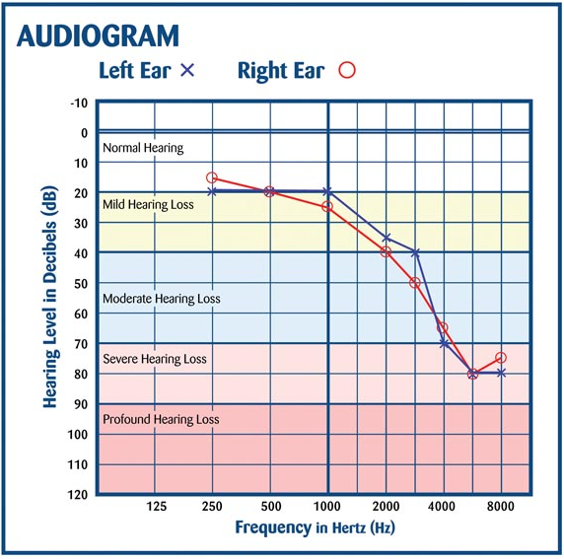
Age-related Hearing Loss
(Presbycusis)
Inevitable or preventable?

Slide 43
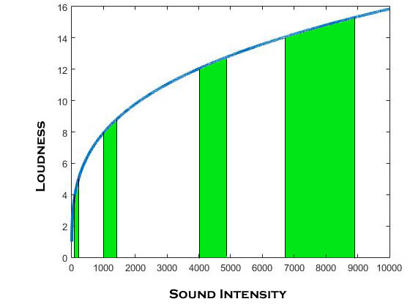
Loudness is non-linear

Slide 44
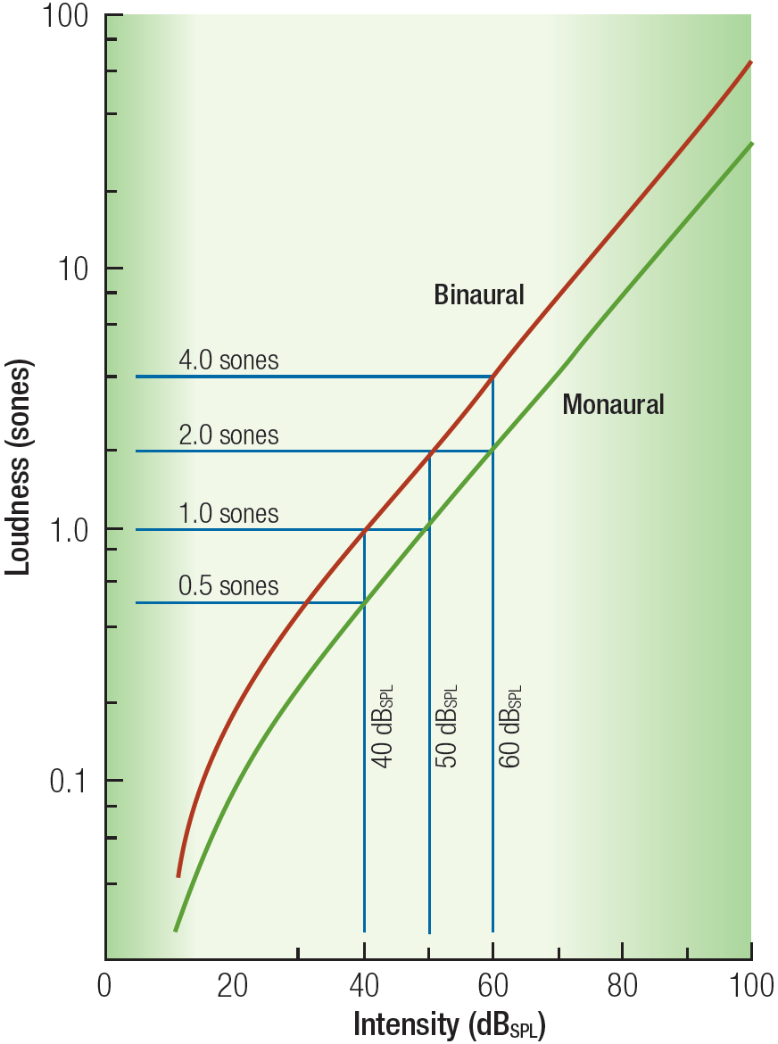
Loudness
Stevens’ SONE SCALE
of Loudness Perception
Perceptual Anchor:
1 sone = loudness of 1 KHz
at 40 dB (40 phons)
Find the dB level that is twice as loud (2 sones) or half as loud (0.5 sones), etc. and construct a scale.
[i.e., Magnitude Estimation]
The psychological magnitude of sound (i.e., “Loudness”) grows at a slower rate than the physical magnitude of the sound stimulus.

Slide 45
Loudness
Using magnitude estimation techniques, S.S. Stevens has quantified this nonlinear relationship as:
L = k * P^{0.6}
= k * I^{0.3}
L=loudness; P=sound pressure (µPa)
I=sound intensity (pW/m²)
Stevens’ Power Law; Linear in log-log plot; slope ≈ exponent
log(L)=log(k)+0.3 log(I) straight line
log(L)≈0.3 log(I)
Hence, a log unit increase (10dB) of
intensity yields 0.3 log (10^{0.3} or 2-fold)
increase in loudness.
Note: Binaural presentation perceived as approx. 2x more loud than monaural equivalent.

Slide 46
Sone Scale Landmarks
Normal conversation 1-4
Automobile @ 10m 4-16
Vacuum cleaner 16
Major roadway @ 10 m 16-32
Long-term hearing damage dosage 32+
Jackhammer @ 1m 64
Brief-exposure hearing damage 256
Pain threshold 676

Slide 47
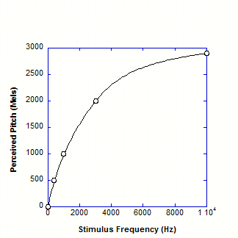
Pitch = f(Frequency)
MEL Scale
Semi-Log Plot
Reference unit of perceived PITCH:
1000 Hz = 1000 Mels
Perceived pitch increases “linearly” with stimulus frequency below 4KHz; but grows at a much slower rate at 4KHz and above.
Linear Plot

Slide 48
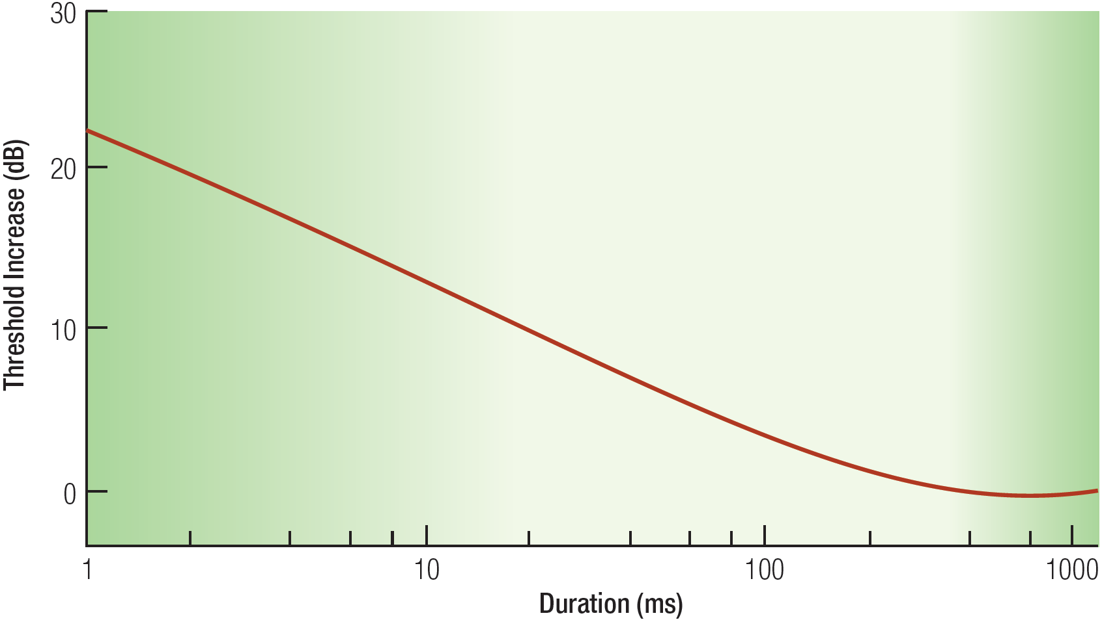
Temporal Summation (< 200 msec)
Complements Binaural (i.e., Spatial) Summation

Slide 49
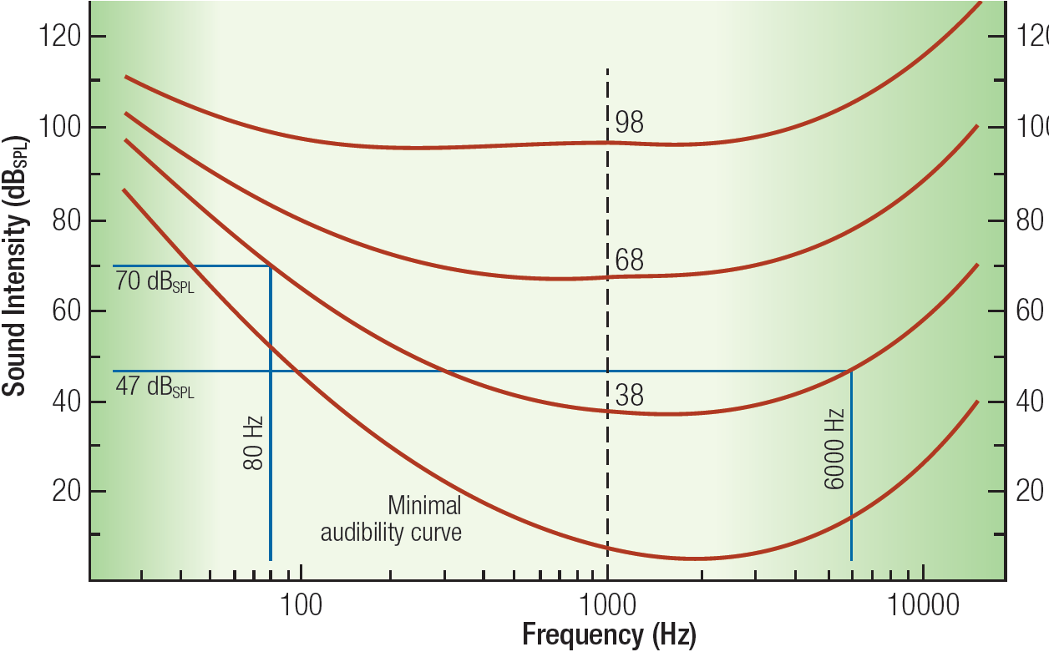
Equal Loudness Contours
Frequency differentiation is flattened at high amplitudes; Speech and music sounds “tinny” at high loudness levels; Remember change in cochlear nerve tuning at higher intensity levels.

Slide 50
Sound Localization

Slide 51
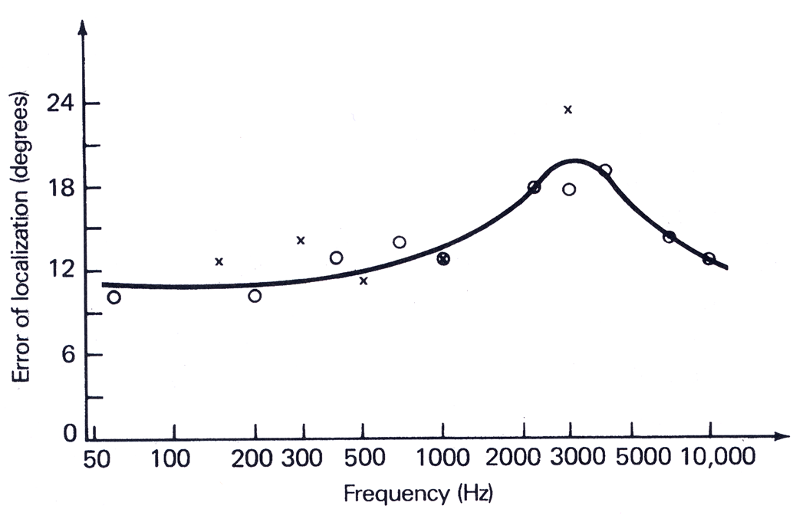
Localization Accuracy vs. Frequency
Signature of a dual-mechanism process?

Slide 52
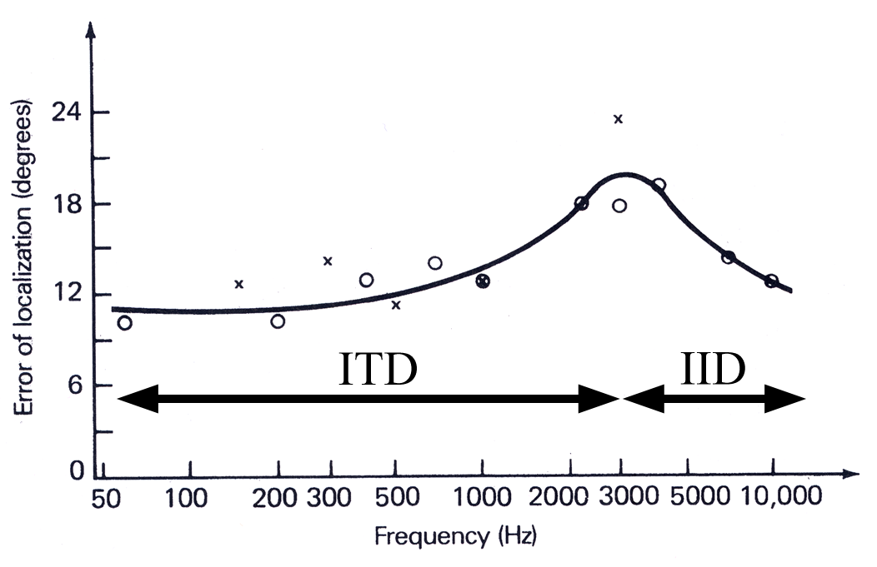
Localization Accuracy vs. Frequency:
Low Freq – Interaural Time Difference
High Freq – Interaural Intensity Difference
ΔT
ΔI

Slide 53
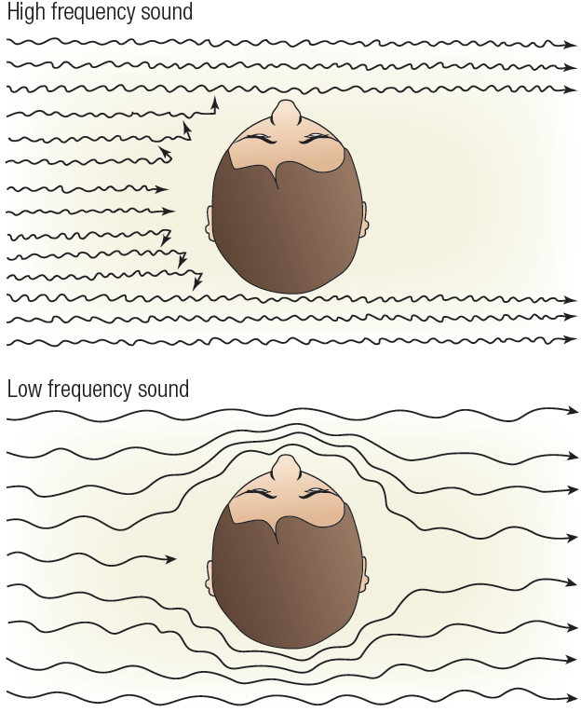
Sound Shadowing
(Interaural Intensity Difference –IID)
High-frequency sound waves are “blocked” by the human head and cast a “shadow” at the far ear
(Strong IID cue)
Low-frequency sound waves wrap easily around the head and cast little or no sound shadow (Weak IID Cue)
ΔI

Slide 54
IID = f(Location, Frequency)
ΔI
Straight
Ahead
Straight
Behind
Right Ear
(Perpendicular)

Slide 55
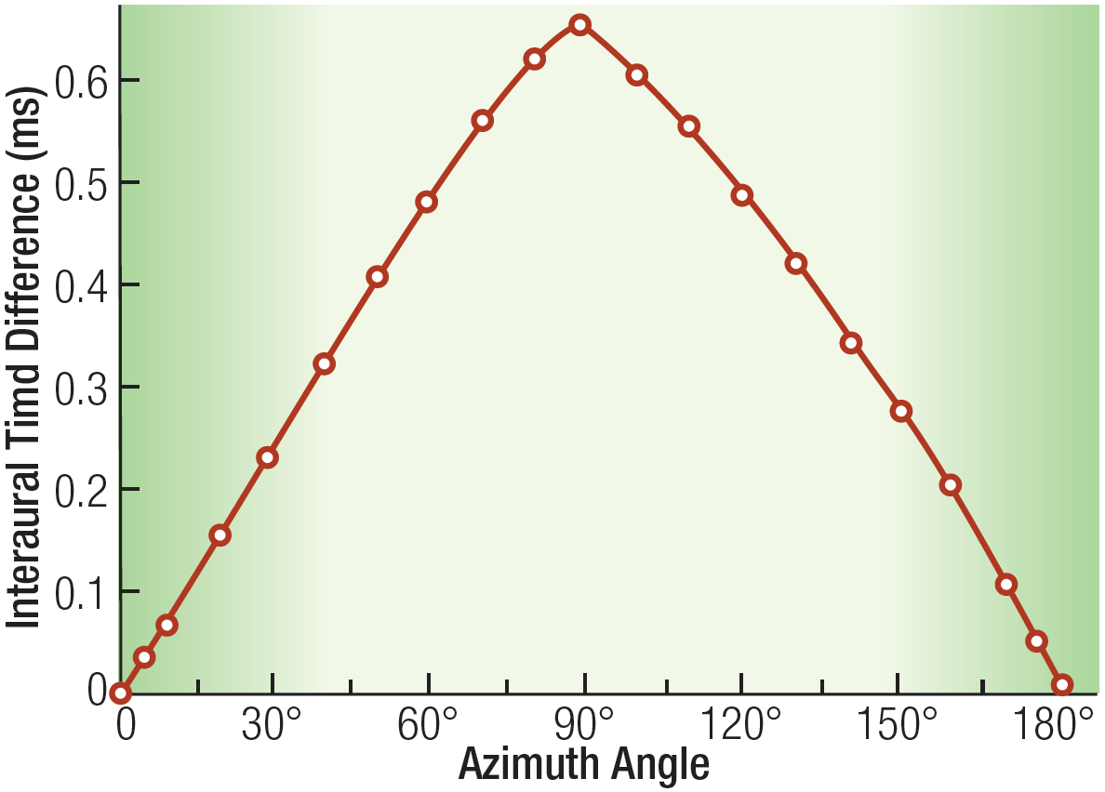
ITD versus Location
ΔT
Straight
Ahead
Straight
Behind
Right Ear
(Perpendicular)

Slide 56
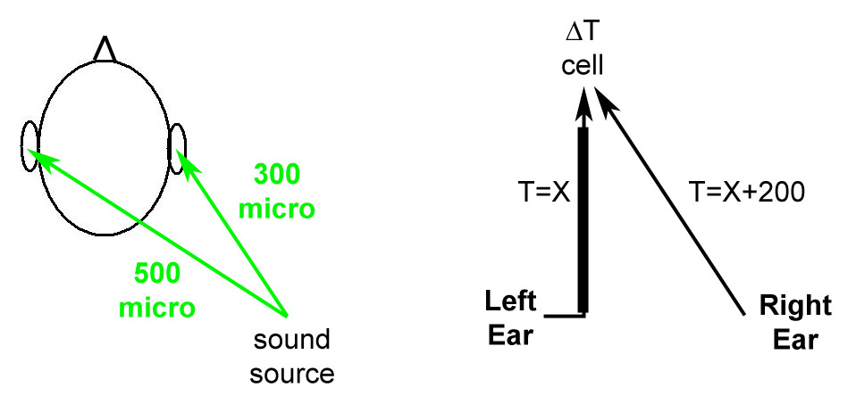
Delay Line Theory
(How to Build a Cell tuned to delta-T Signals)
Delta-T = 200 microsec

Slide 57
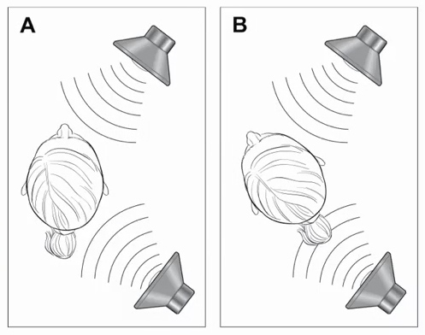
“Active” Localization
(Continuous Sound Sources)

Slide 58
Straight Ahead vs. Straight Behind
Relatively good localization performance despite same IID and ITD levels (i.e., zeros)
Differential sound distortion (“coloration”) introduced by interaction with pinna
Modifying shape of pinna causes immediate reduction in localization accuracy (Hoffman, et al., 1998)
Listening through the ears of another yields “ahead” vs. “behind” confusion (chance performance)

Slide 59
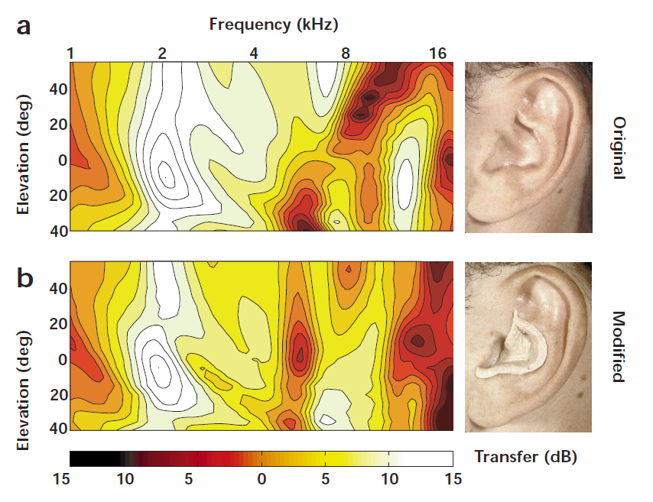
Modifying the Pinna Transfer Function
(Hoffman, et al., 1998) Earprints?

Slide 60
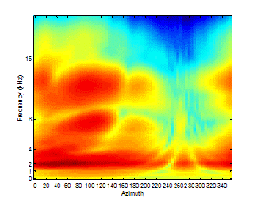
Cross-Section of a
Head-Related Transfer Function
(Spectral Coloration by Head, Torso & Pinnae)

Slide 61
Auditory/Visual Integration
Ventriloquism Effect
Visual capture of sound localization
McGurk Effect
“Compromise” between conflicting sound and visual cues in speech understanding
What you hear is what you see

