Slide 1
Somatosensory System

Slide 2
The Integument (aka “Skin”)
Giant, washable, stretchable, water-proof sensory organ…The boundary between you and not-you
6-10 pounds
12-20 sq-ft

Slide 3
The Integument
Epidermis (Thin outer layer)
Dermis (Thick inner layer)
Humans “shed” 50 million epidermal cells per day (Whole ecosystems are based upon the accumulations of household dander)

Slide 4
The Skin (Integument)
Glabrous Skin Smooth, thick skin on palms and soles of our feet
Epidermis = 1.5 mm
Dermis = 3 mm
Hairy Skin
Thin skin populated with hair follicles
Epidermis = 0.1 mm
Dermis = 1-2 mm
Sweat Glands
Eccrine – secrete saline (heat regulation)
Sebaceous – secrete complex cell cytoplasm (signaling?)
(Primary source of human body odor)

Slide 5
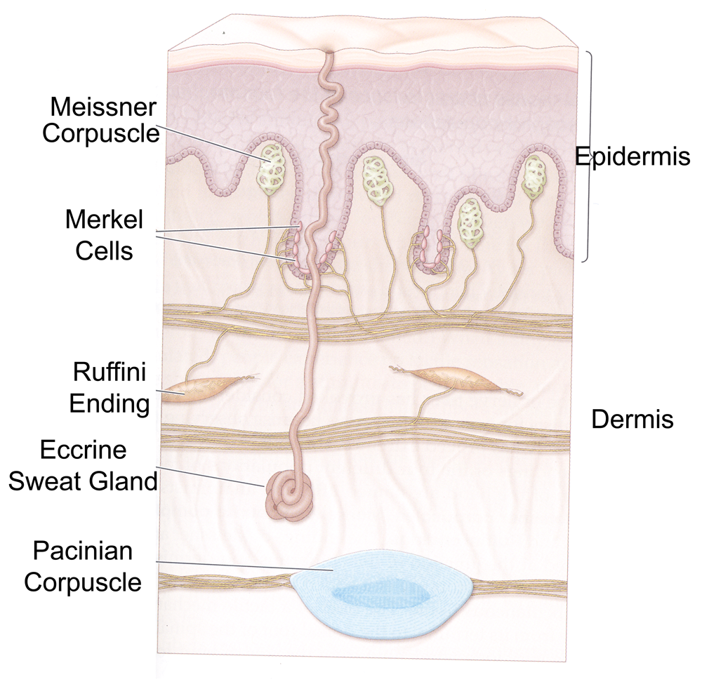
The Skin (Integument)

Slide 6
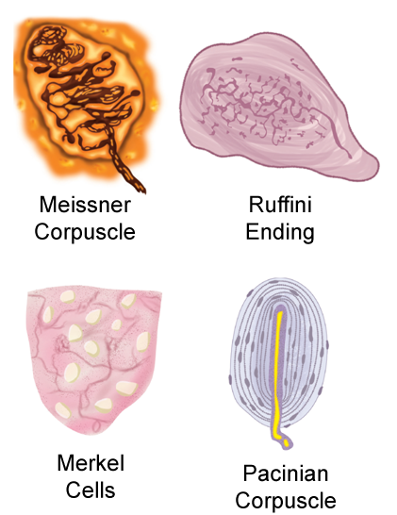
Mechanoreceptors
Other somatosensory transducers
Free nerve endings:
Temperature (hot; cold)
Proprioception (limb/muscle state)
Nocioception (pain)

Slide 7
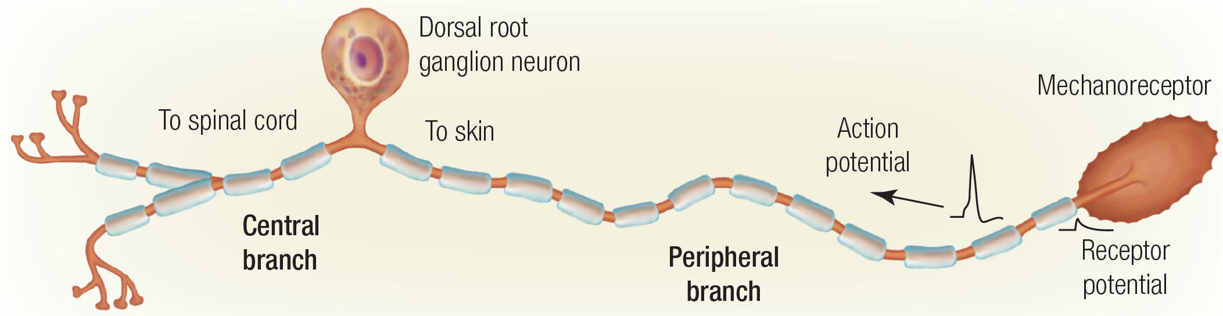
Bipolar Neurons
Physical “strain” at the nerve terminus forces Na+ ion channels to open.
Influx of sodium results in rapid depolarization of the resting potential.
Depolarization triggers an “action potential” at the nerve terminus.
Conduction velocity depends upon diameter and myelinization.
(mechanoreceptor αβ axons are long, wide and fast)

Slide 8
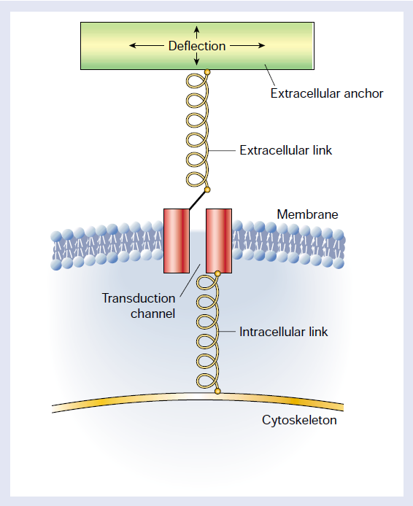
Mechanoreceptor Transduction
Na+ ion influx
(depolarization)

Slide 9
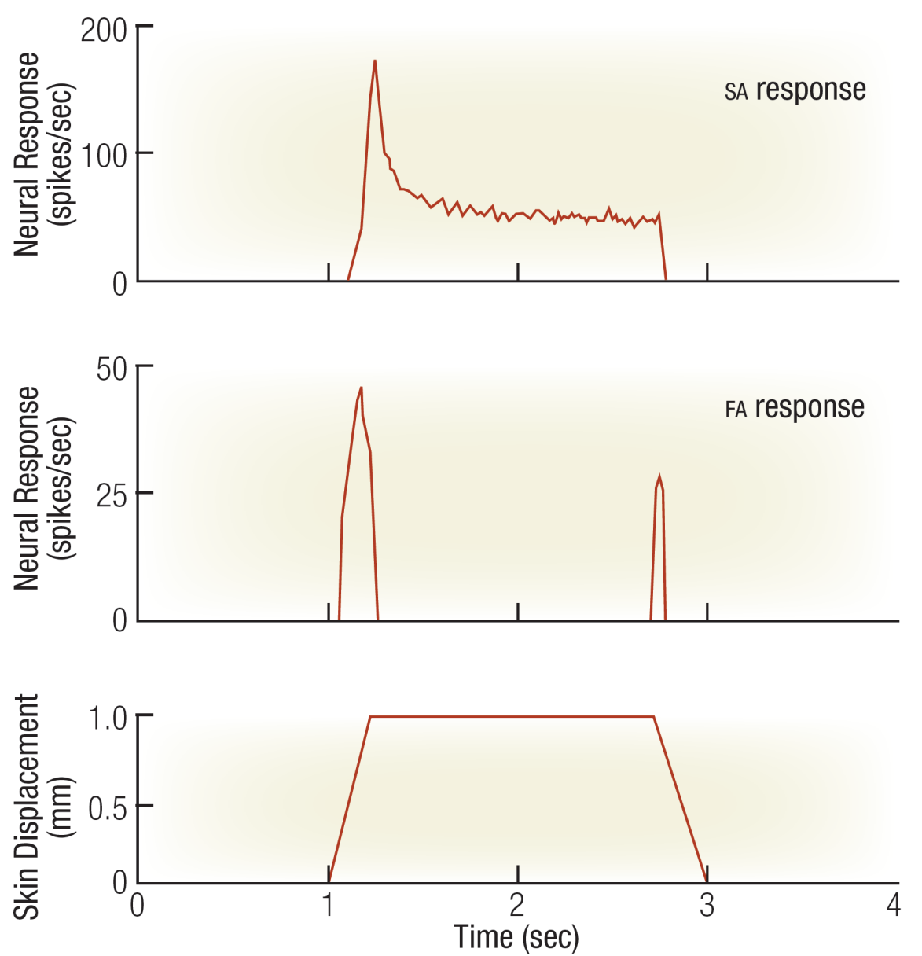
Slow-Adapting vs. Fast-Adapting

Slide 10
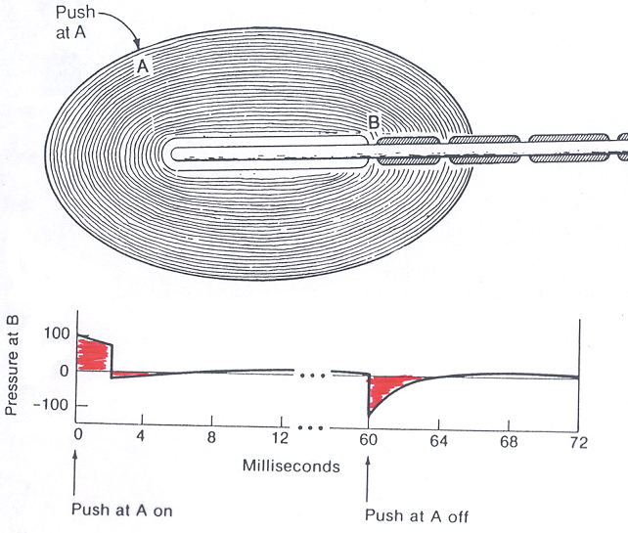
Pacinian Corpuscle as Temporal Differentiation Machine

Slide 11
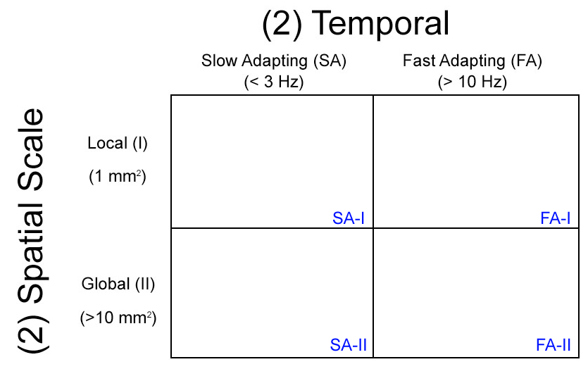
4-Channel Model of Touch Perception

Slide 12
4-Channel Model of Touch Perception
MERKEL
Sustained pressure;
Spatial shape;
Texture discrimination

Slide 13
4-Channel Model of Touch Perception
MERKEL
Sustained pressure;
Spatial shape;
Texture discrimination
RUFFINI
Parallel to skin surface;
Deep lateral stretch;
Grip stability/slippage

Slide 14
4-Channel Model of Touch Perception
MERKEL
MEISSNER
Sustained pressure;
Spatial shape;
Texture discrimination
Perpendicular to surface;
Bump/hole discrimination
(Touch screens)
RUFFINI
Parallel to skin surface;
Deep lateral stretch;
Grip stability/slippage

Slide 15
4-Channel Model of Touch Perception
MERKEL
MEISSNER
Sustained pressure;
Spatial shape;
Texture discrimination
Perpendicular to surface;
Bump/hole discrimination
(Touch screens)
RUFFINI
PACINIAN
Parallel to skin surface;
Deep lateral stretch;
Grip stability/slippage
Parallel to skin surface;
Curvature; Rigidity;
Deep pressure
(Fingerprints)

Slide 16
Ascending Pathways

Slide 17
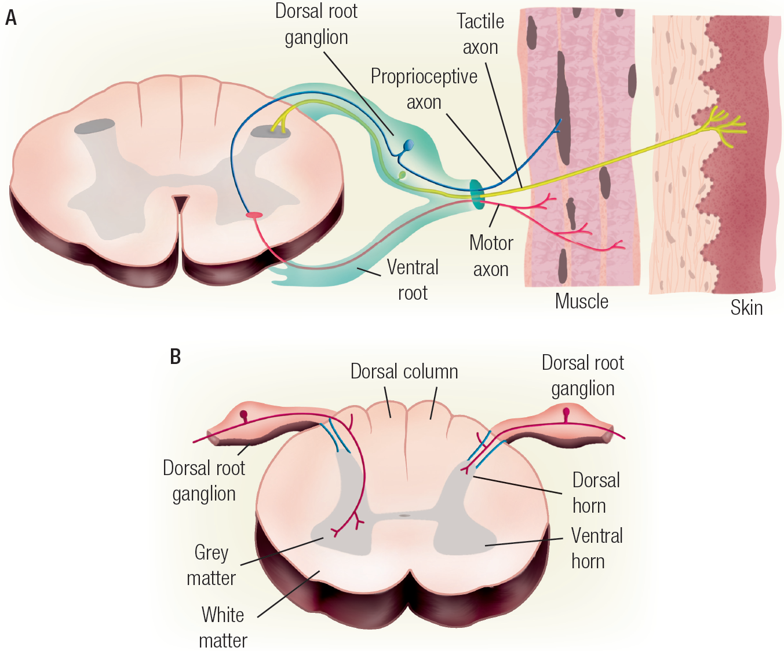
Innervation via Spinal Nerves
Bell-Megendie Law
dorsal = sensory afferents
ventral = motor efferents

Slide 18
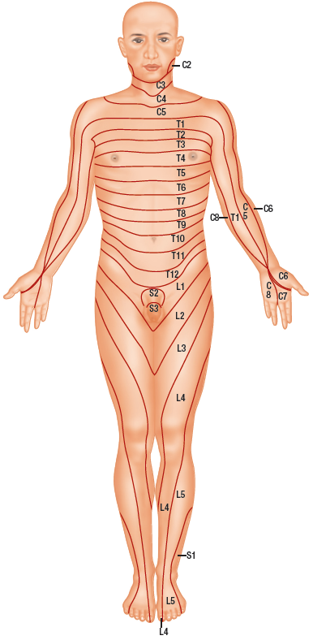
Diagnostic Dermatomes
e.g.,
“Shingles” eruption
(Latent herpes virus)

Slide 19
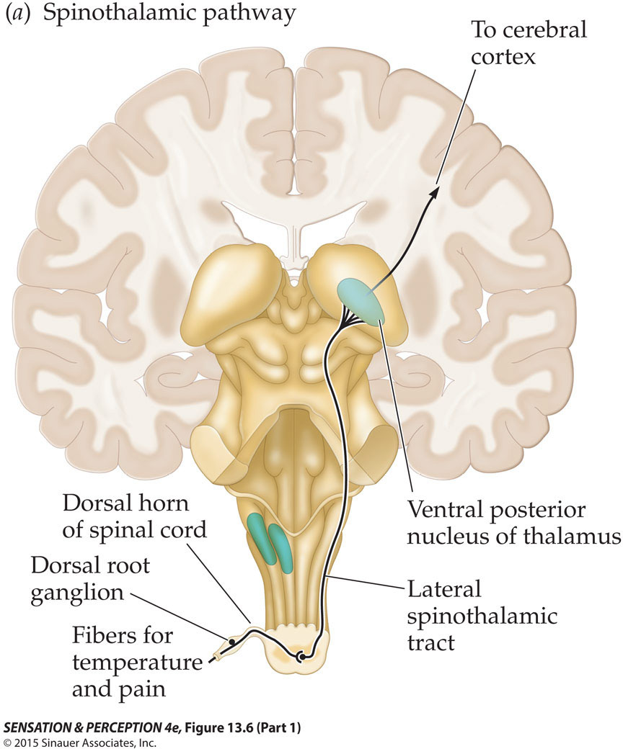
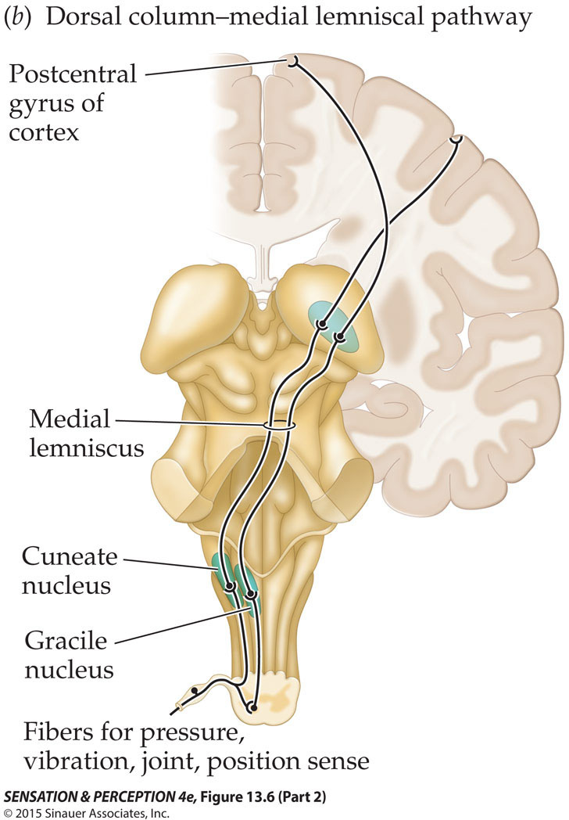
Ascending Pathways

Slide 20
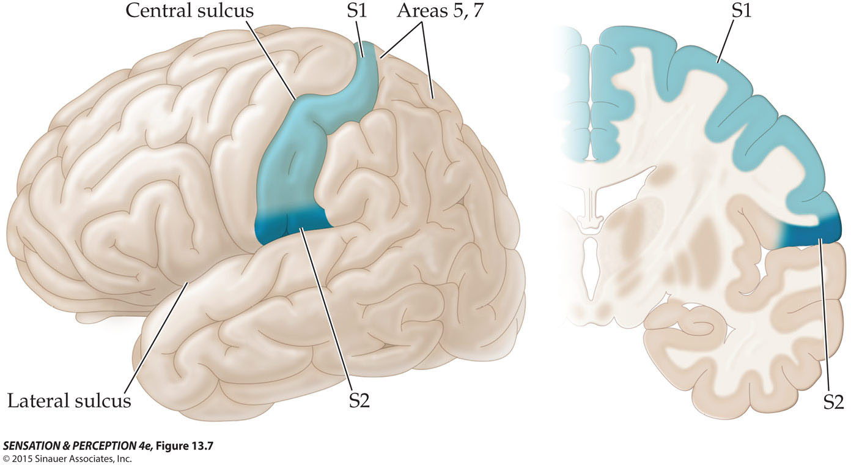
Somatosensory Cortex (Postcentral Gyrus)

Slide 21
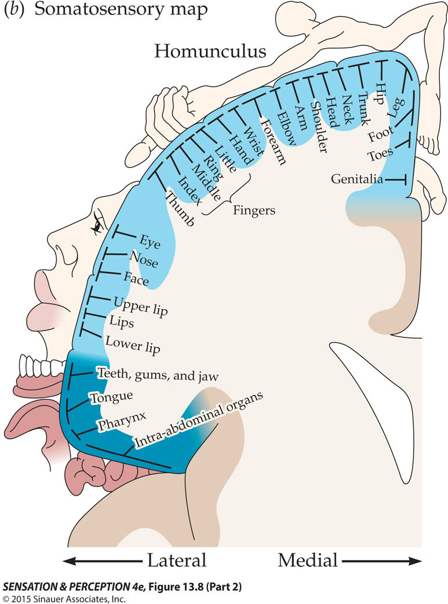
Somatosensory Cortex
Parallel to pre-central motor cortex
Somatosensory map:
Cortical volume changes with
mechanoreceptor density variation
across skin regions
(so-called “homunculus”)

Slide 22
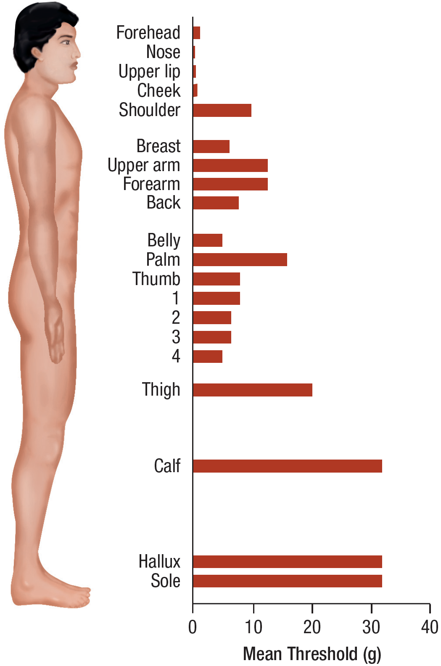
Absolute Threshold Map
Von Frey Hairs
Sensitivity varies with
“cortical magnification”

Slide 23
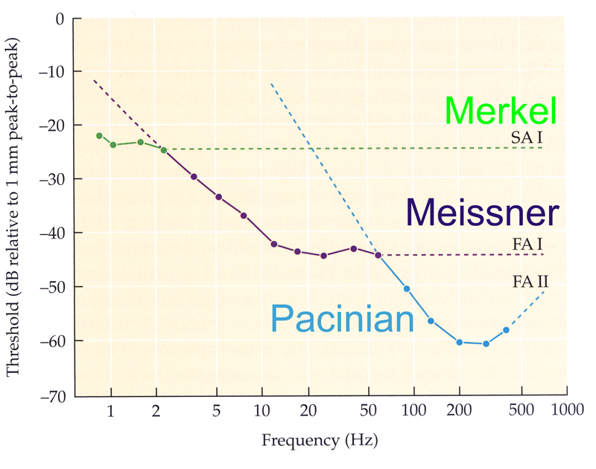
Touch Thresholds depend upon Vibrotactile Frequency
Touch detection thresholds
vary with vibrotactile stimulus
frequency and probe area consistent with the 4-channel model.
This figure depicts how vibrotactile frequency maps to the different classes of mechanoreceptors.
Vibrotactile stimulator is a “work horse” tool in the arsenal of neurologists.

Slide 24
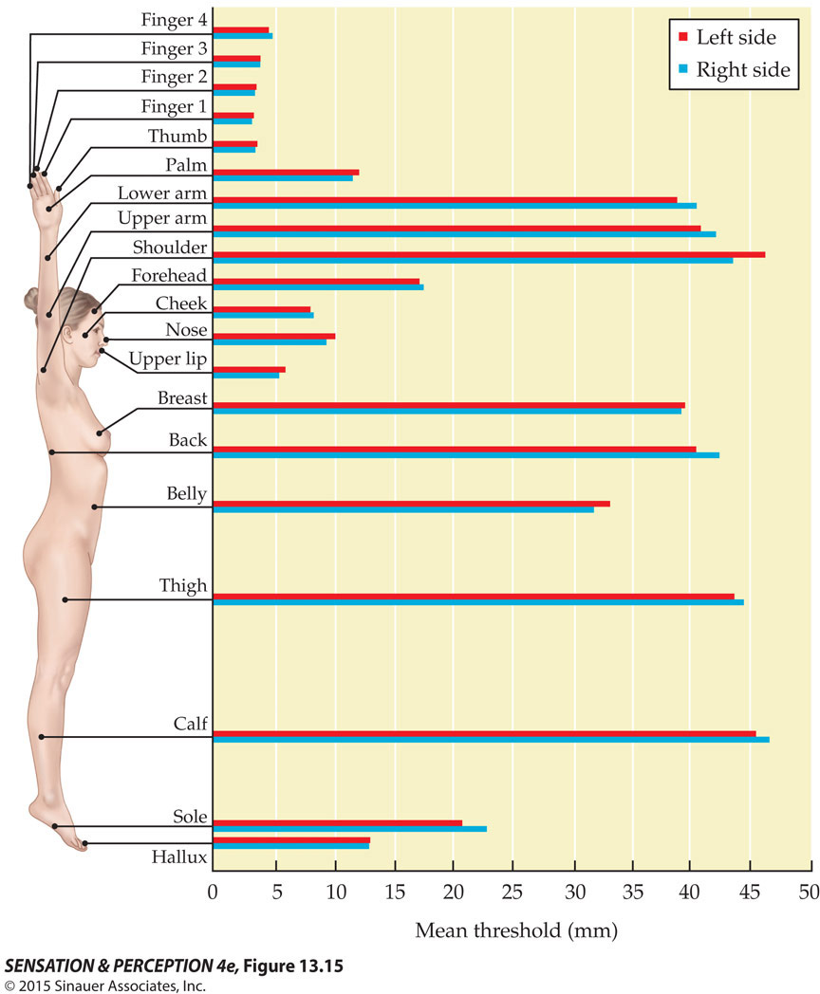
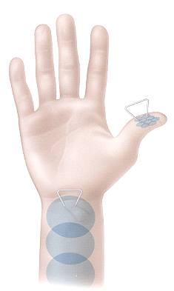
Two-Point Threshold
Relationship between mechanoreceptor receptive field size and the 2-point threshold

Slide 25
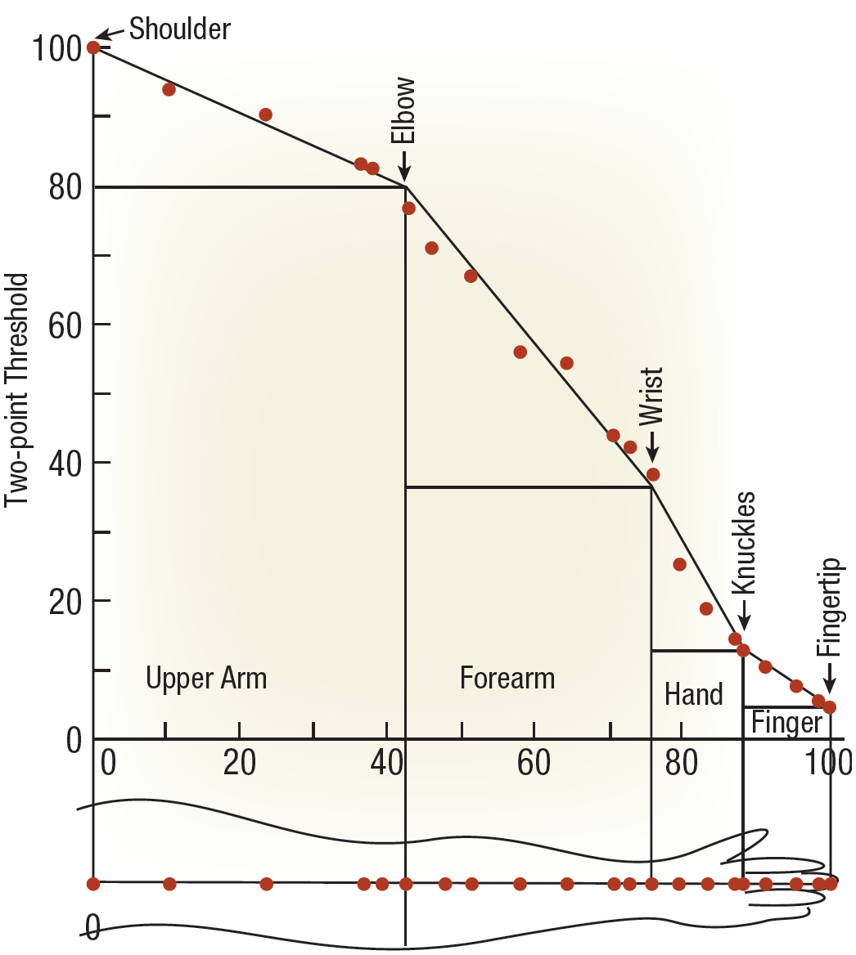
Two-Point Threshold
Sensitivity drops 20-fold
from finger-tip to shoulder

