Slide 1
Use of Isoluminant Stimuli
Reveals Segregation of Functions across the
Magnocellular vs. Parvocellular
Systems

Slide 2
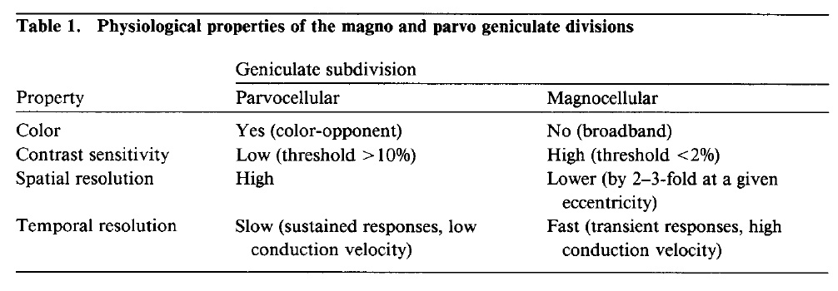
Properties of M vs. P Neurons

Slide 3
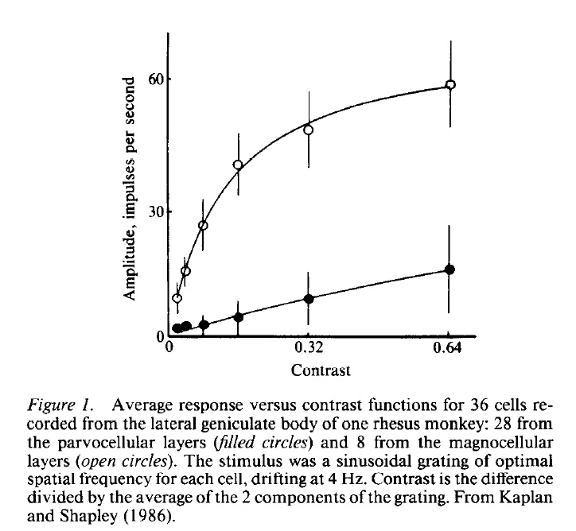
Contrast Sensitivity

Slide 4

P-System
Resolves
Many
Levels of Gray

Slide 5

M-System
Resolves
Few
Levels of Gray

Slide 6
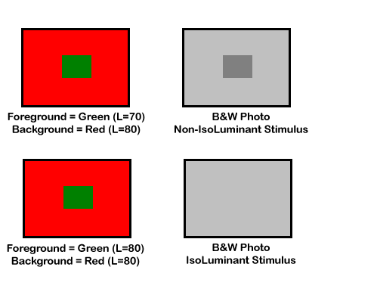
Isoluminant Stimulus Paradigm
(Simplified B&W Camera Analogy)

Slide 7


Flicker Photometry Stimuli

Slide 8

Counter-Phase Red/Green Flicker

Slide 9

Increase Flicker Rate
Until Color Fusion Threshold
Color fusion threshold usually around 12-15 Hz.

Slide 10

Adjust Intensity of Green Stimulus
Until Luminance Flicker Minimized
The values of the Red and Green stimuli at the point of complete flicker fusion
establishes the ISOLUMINANT POINT for the current observer.

Slide 11
REMEMBER:
The M-system is insensitive to
Isoluminant Stimuli

Slide 12
ASSUMPTION:
Perceptual Abilities Lost under IsoLuminant Conditions are Mediated by the M-system

Slide 13
Depth/Size Scaling
Size Constancy
Ponzo Illusion
Muller-Lyer Illusion
Texture Gradients
Stereopsis
Motion Parallax

Slide 14
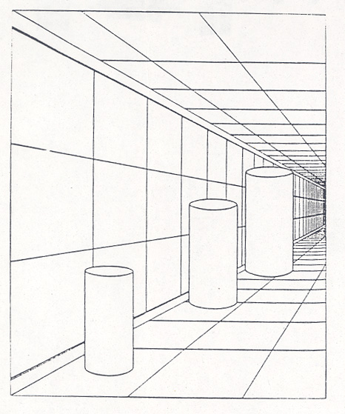
Size Constancy

Slide 16
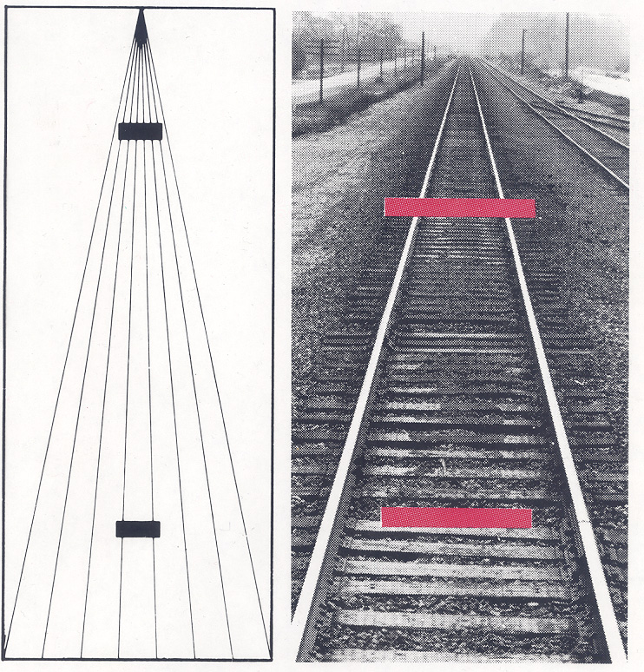
Ponzo Illusion

Slide 17
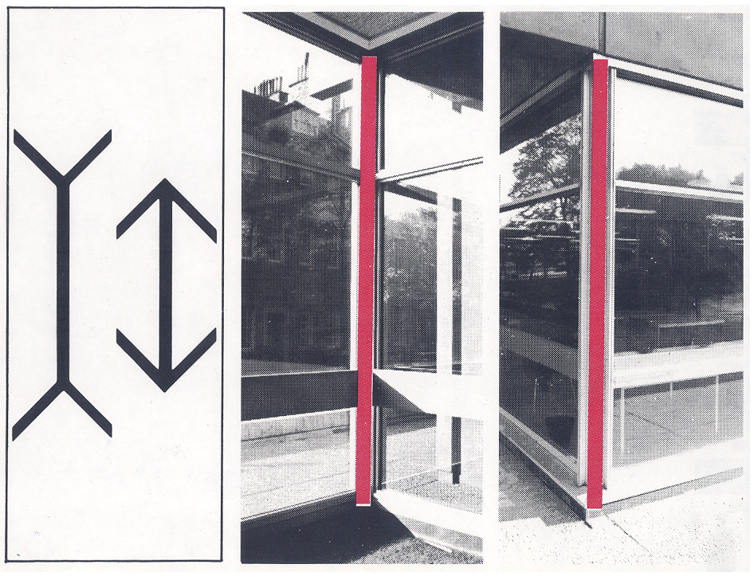
Müller-Lyer Illusion

Slide 18
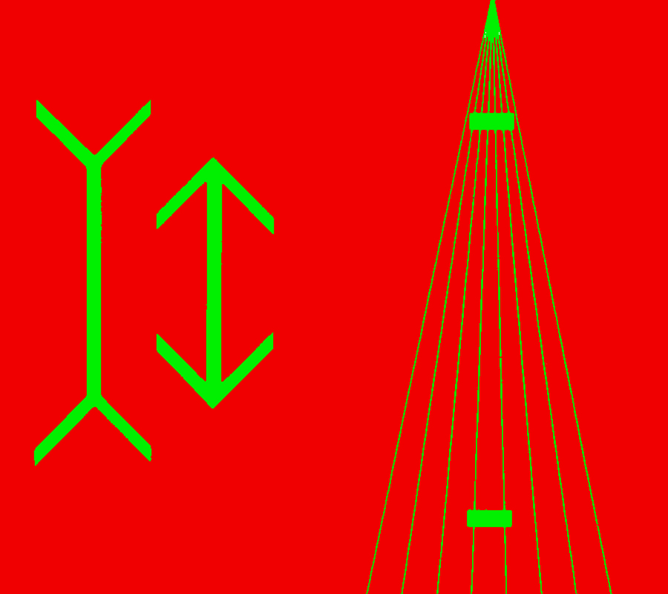
Green-on-Red Stimulus Format

Slide 19
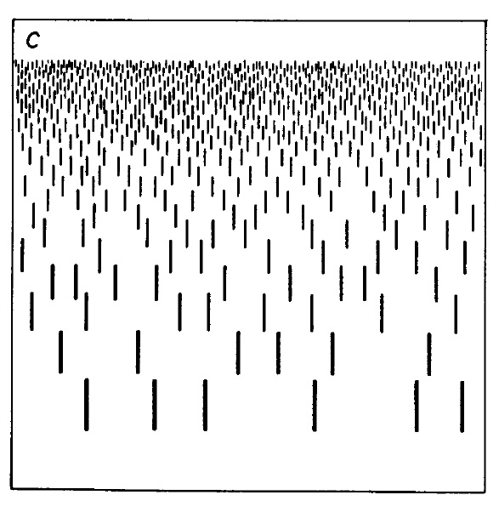
Depth/Distance from Texture Gradients

Slide 20
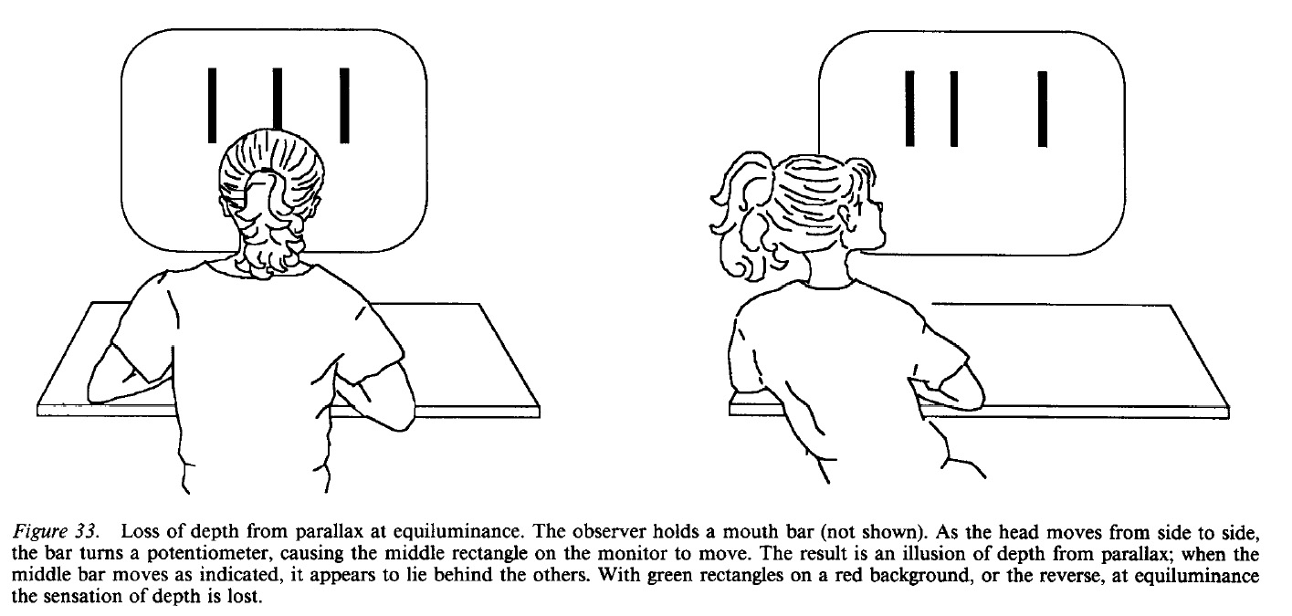
Depth from Motion Parallax
3D via Head Tracking Demo

Slide 21
Motion Analysis
Structure from Motion
Synchronized Apparent Motion
(Grouping by Proximate Motion)

Slide 22
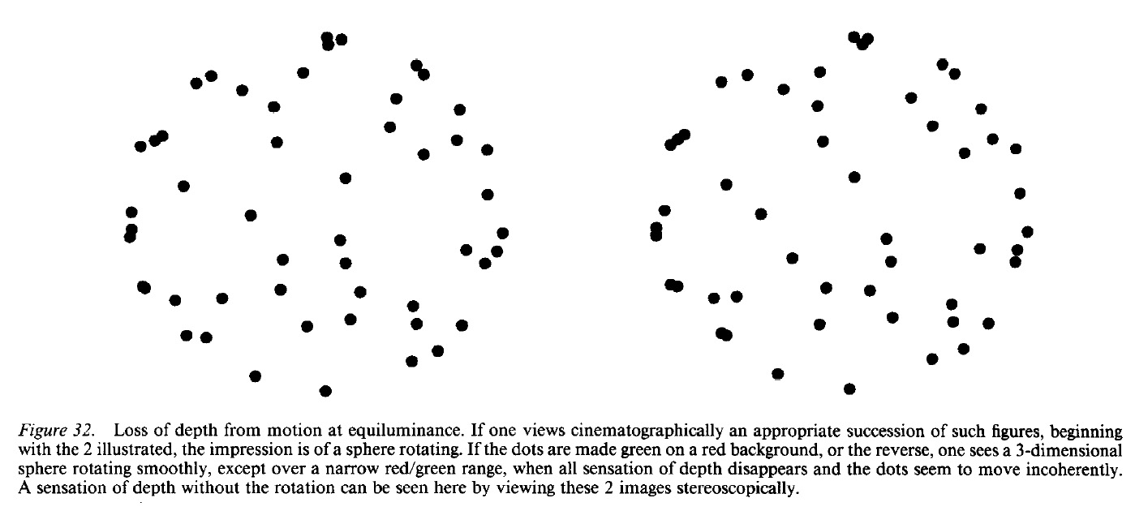
Structure from Coherent Motion
http://www.michaelbach.de/ot/col_equilu/index.html

Slide 23
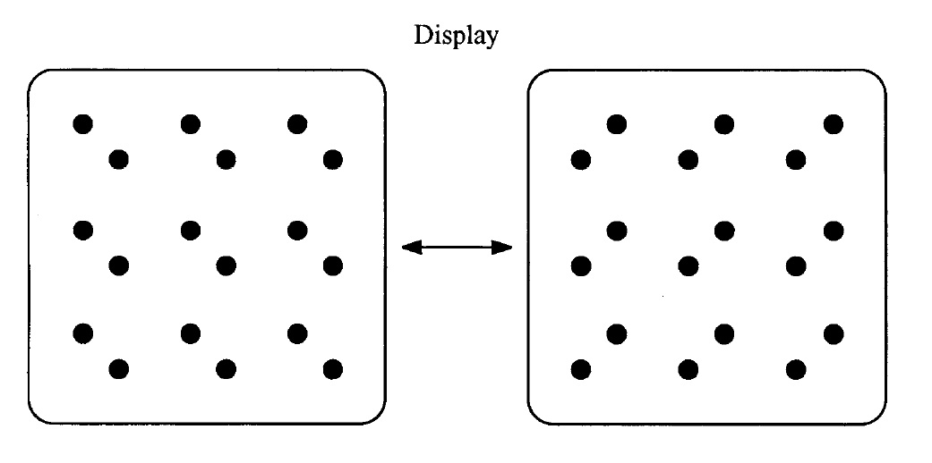
Grouping by Motion
Frame-1
Frame-2

Slide 24
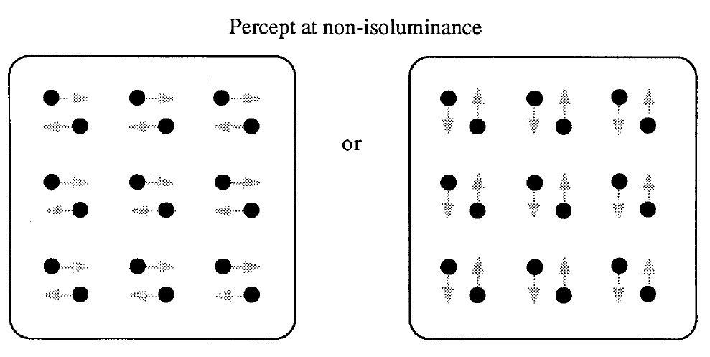
Grouping by Motion

Slide 25
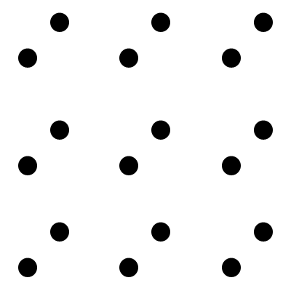
Grouping by Motion

Slide 26
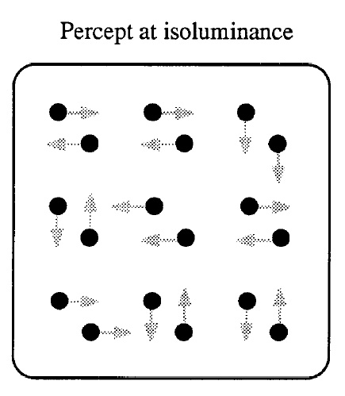
Grouping by Motion

Slide 27
Figure/Ground Segregation
Rubin’s Vase
Subjective Contours
(Kaniza figures)

Slide 28
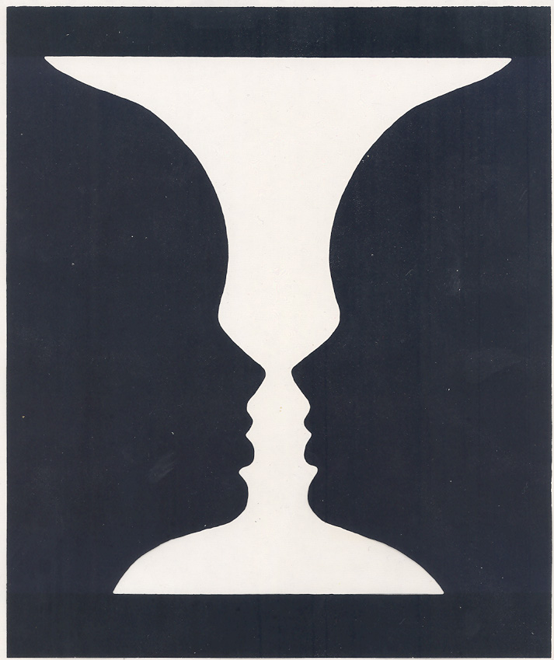
Rubin’s Vase

Slide 29
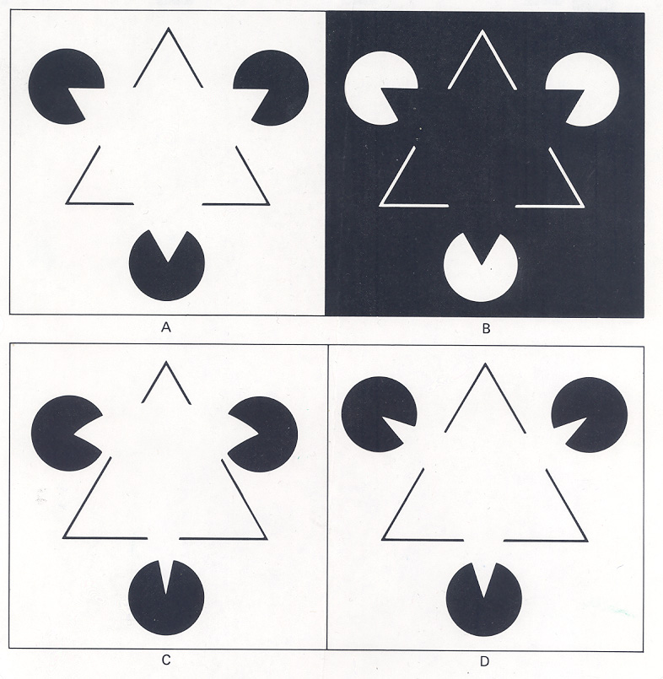
Subjective Contours

Slide 30
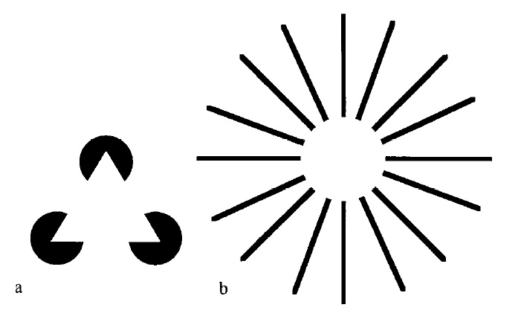
Subjective Contours

Slide 31
Object Perception
Binding Primitive Features into Objects
Grouping by Colinearity
(AI: “Block World”)

Slide 32
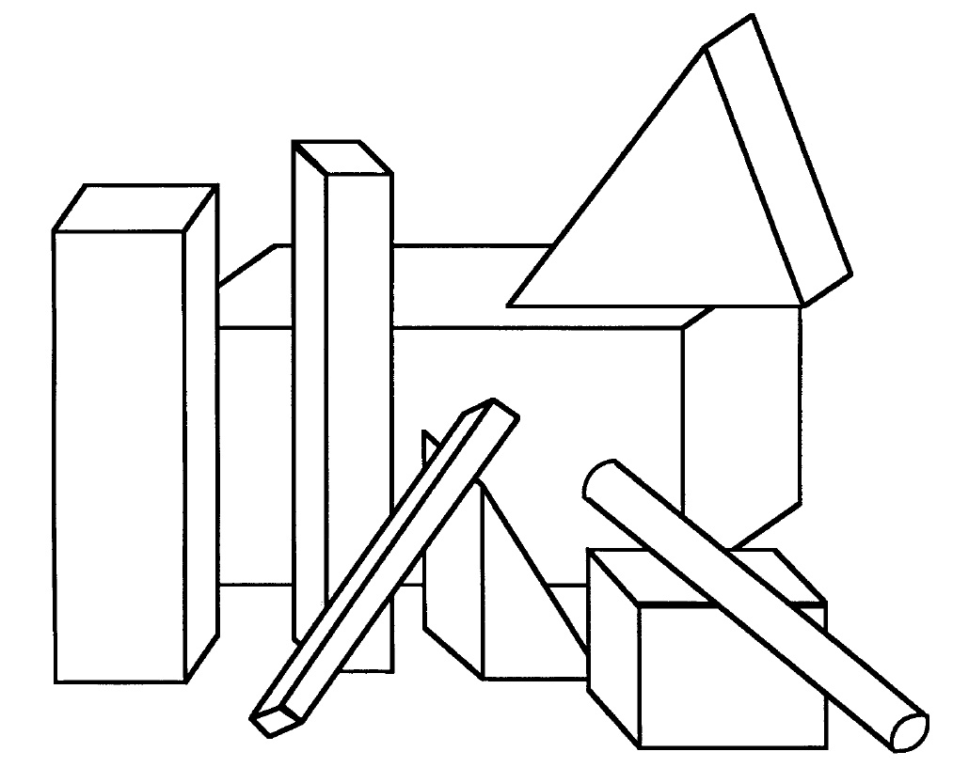
Grouping by Colinearity
(“Block World”)

Slide 33
Appendix

Slide 34
