Slide 1
Use of Isoluminant Stimuli Reveals Segregation of Functions across the Magnocellular vs. Parvocellular Systems

Slide 2
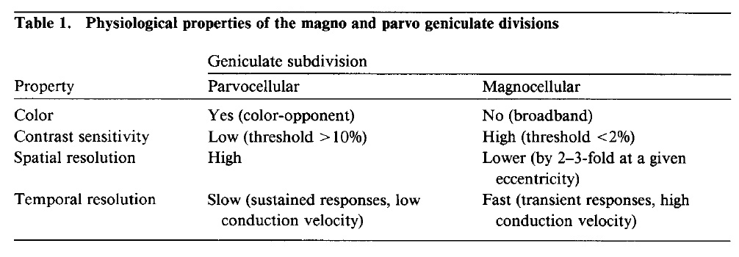
Properties of M vs. P Neurons

Slide 3
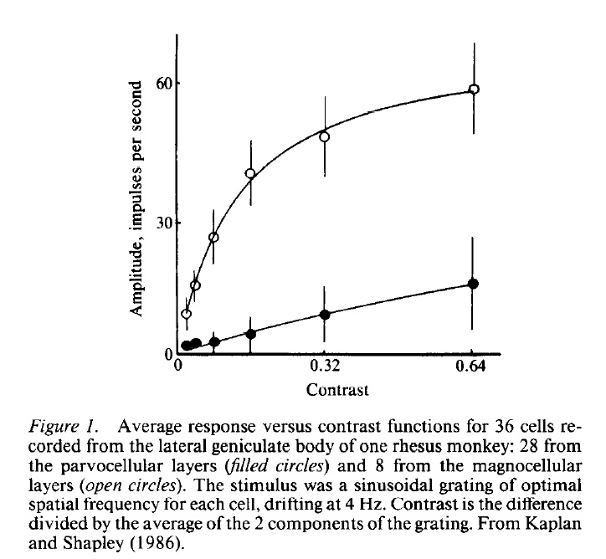
Contrast Sensitivity

Slide 4
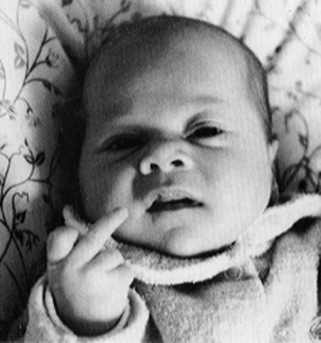
P-System Resolves Many Levels of Gray

Slide 5
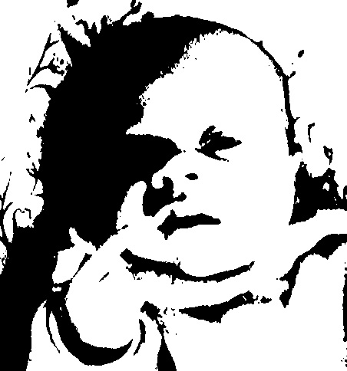
M-System Resolves Few Levels of Gray

Slide 6
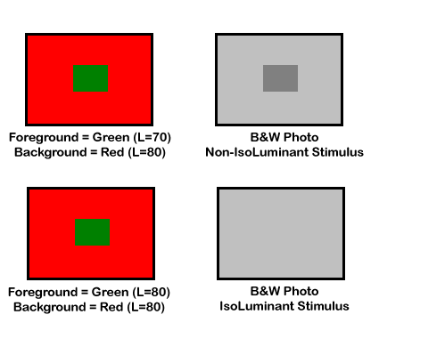
Isoluminant Stimulus Paradigm

Slide 7


Flicker Photometry Stimuli

Slide 8

Counter-Phase Red/Green Flicker

Slide 9

Increase Flicker Rate Until Color Fusion Threshold
Color fusion threshold usually around 12-15 Hz.

Slide 10

Adjust Intensity of Green Stimulus Until Luminance Flicker Minimized
The values of the Red and Green stimuli at the point of complete flicker fusion
establishes the ISOLUMINANT POINT for the current observer.

Slide 11
Depth/Size Scaling
Size Constancy
Ponzo Illusion
Muller-Lyer Illusion
Texture Gradients
Stereopsis
Motion Parallax

Slide 12
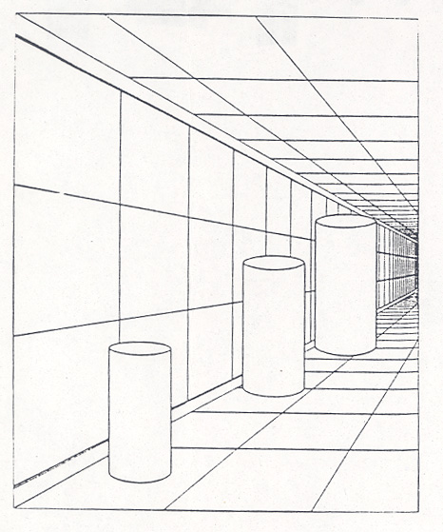
Size Constancy

Slide 13
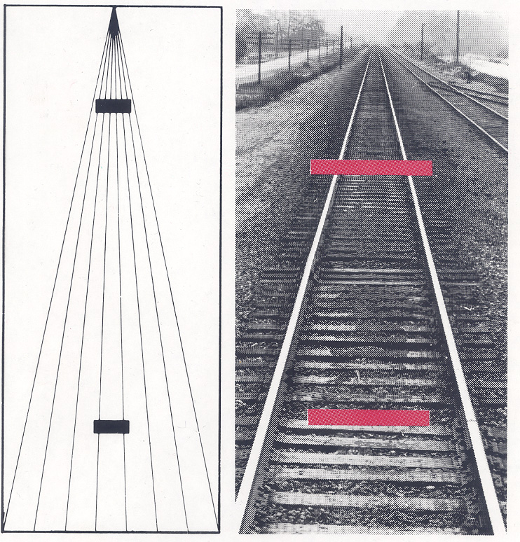
Ponzo Illusion

Slide 14
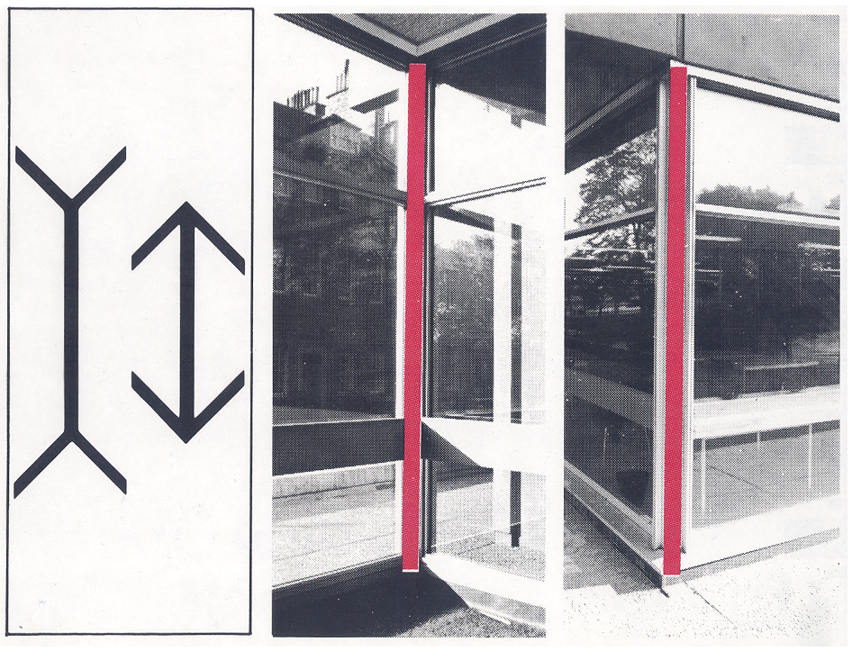
Müller-Lyer Illusion

Slide 15
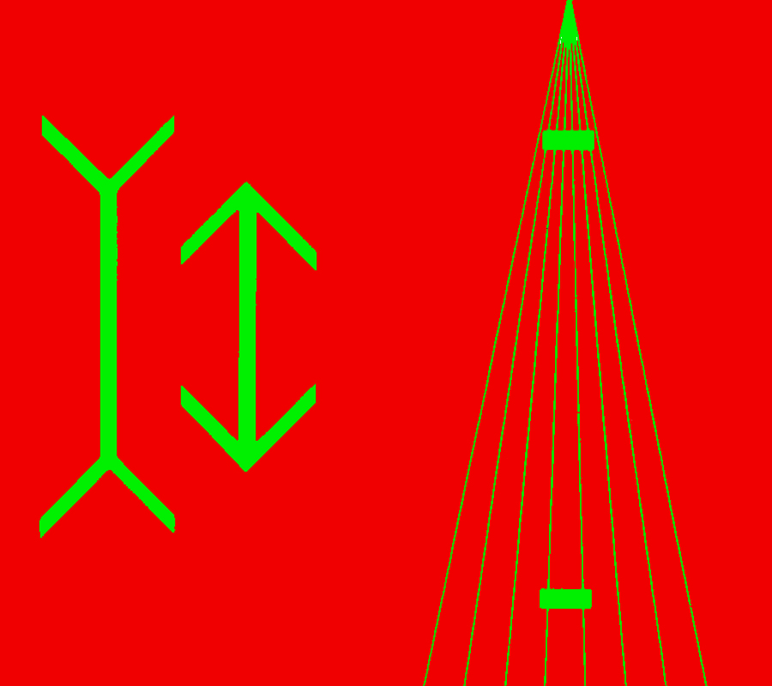
Green-on-Red Stimulus Format

Slide 16
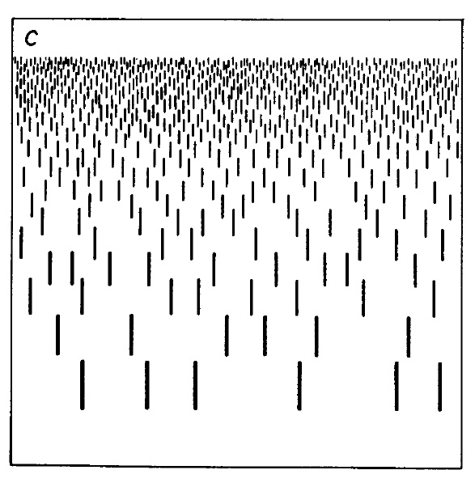
Depth/Distance from Texture Gradients

Slide 17
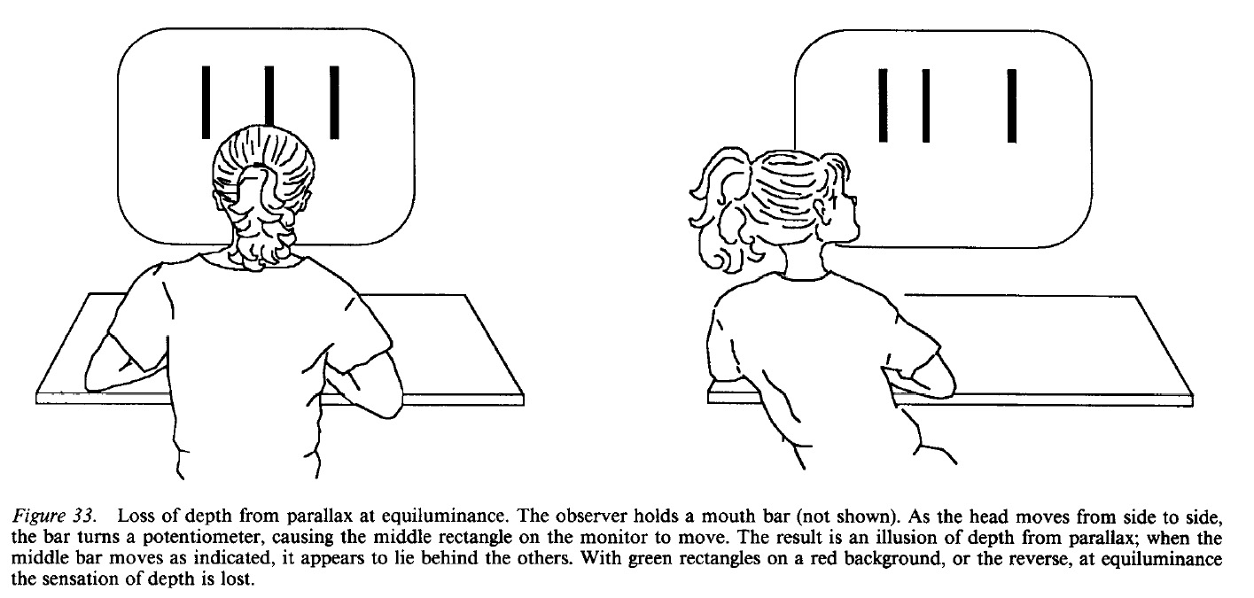
Depth from Motion Parallax (Youtube Demo)

Slide 18
Motion Analysis
Structure from Motion
Synchronized Apparent Motion (Grouping by Proximate Motion)

Slide 19
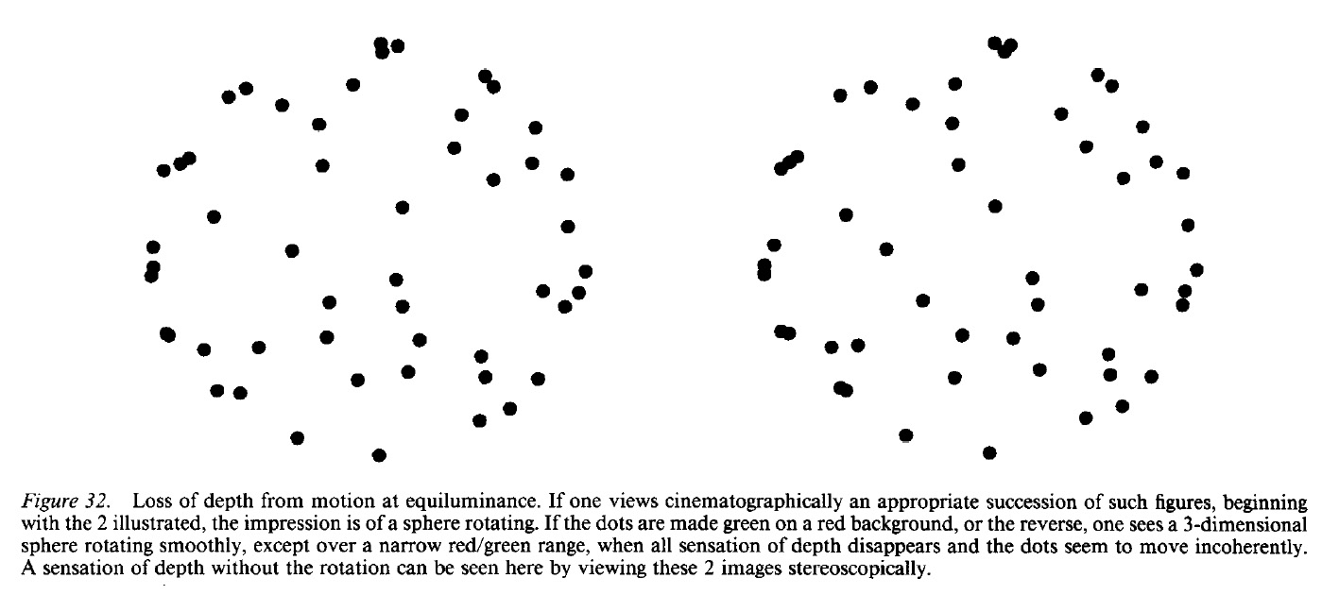
Structure from Coherent Motion
http://www.michaelbach.de/ot/col_equilu/index.html

Slide 20
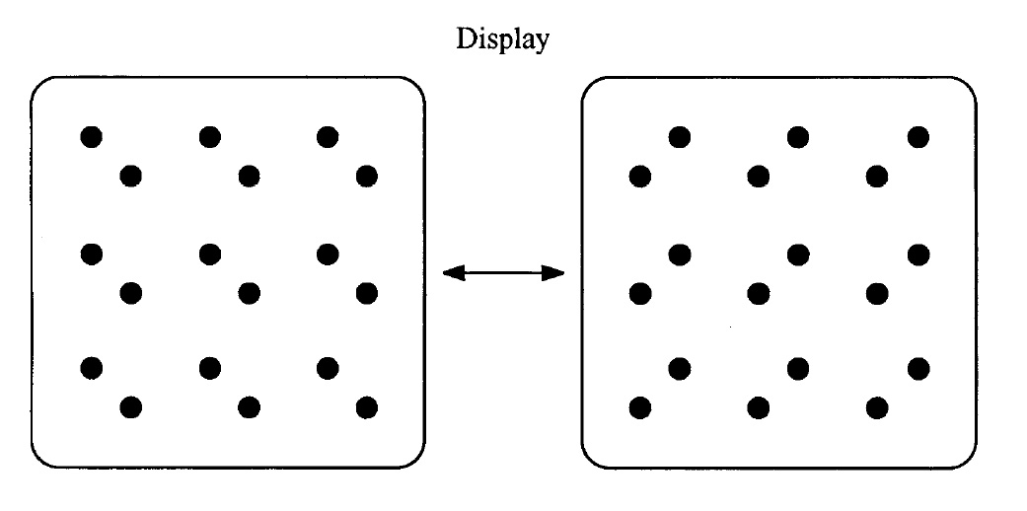
Grouping by Motion
Frame-1
Frame-2

Slide 21
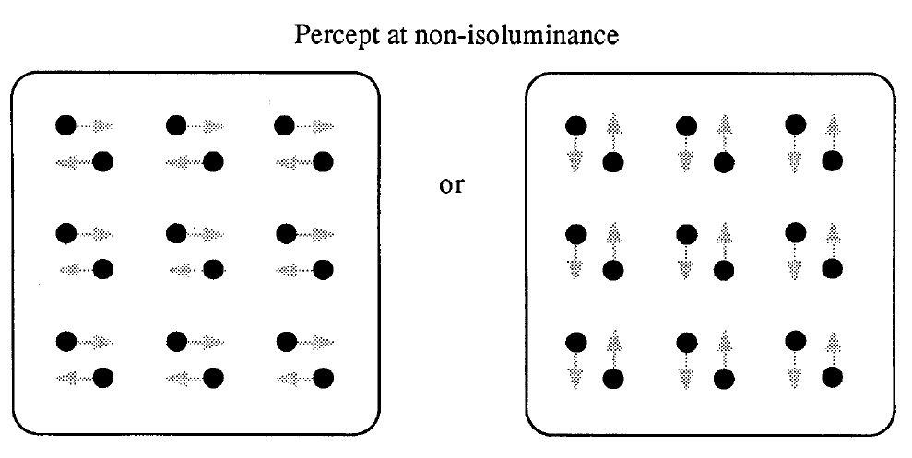
Grouping by Motion

Slide 22
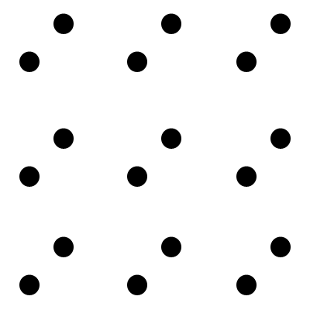
Grouping by Motion

Slide 23
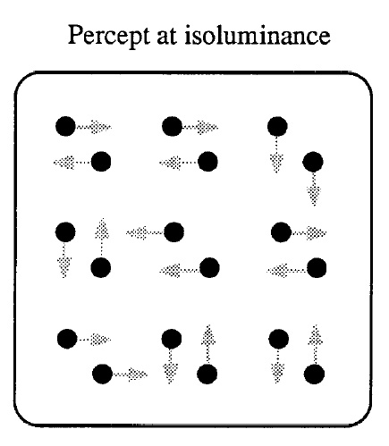
Grouping by Motion

Slide 24
Figure/Ground Segregation
Rubin’s Vase
Subjective Contours (Kaniza figures)

Slide 25
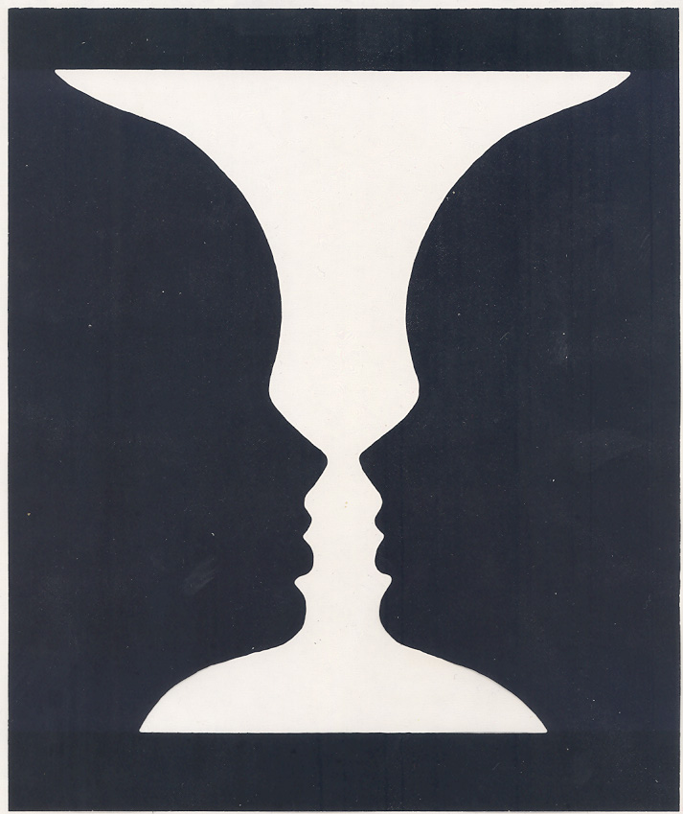
Rubin’s Vase

Slide 26
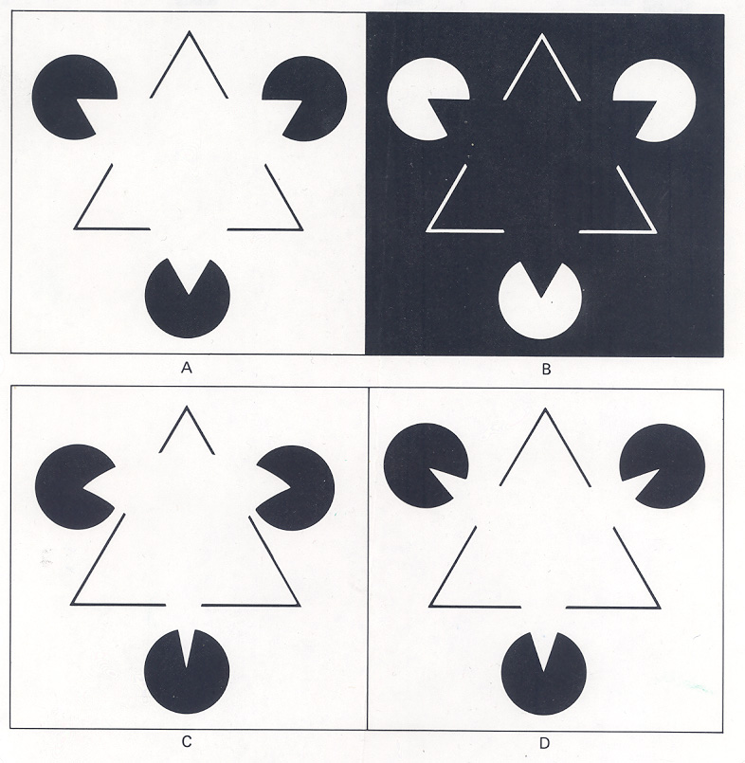
Subjective Contours

Slide 27
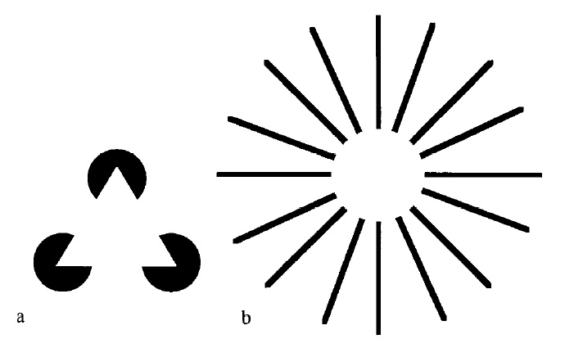
Subjective Contours

Slide 28
Object Perception
Binding Primitive Features into Objects
Grouping by Colinearity (AI: “Block World”)

Slide 29
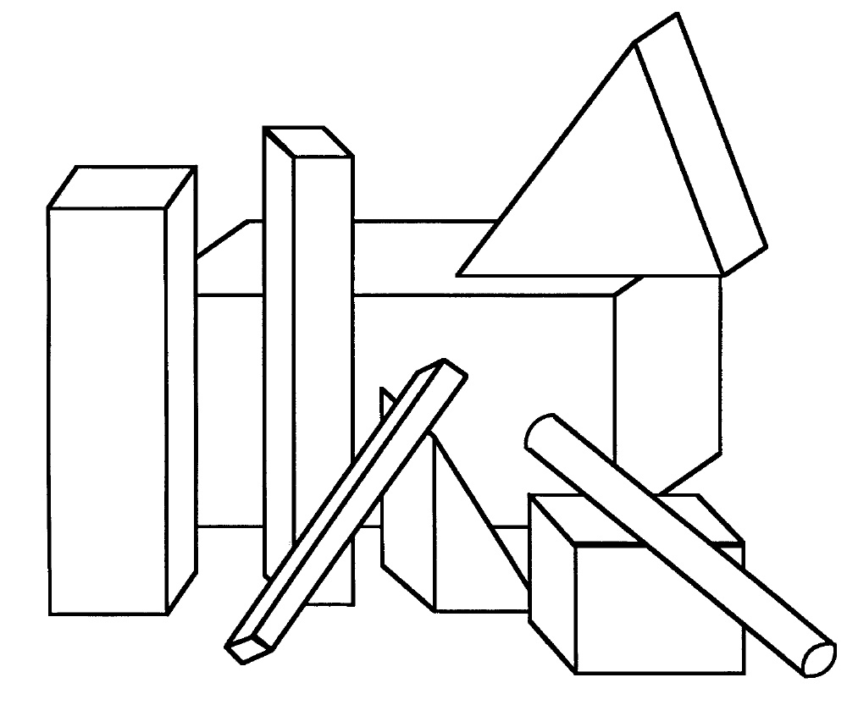
Grouping by Colinearity (“Block World”)

Slide 30
Appendix

Slide 31
