Slide 1
DRL Induced Glare
An Analytical Study of the Effects
of Peak Luminous Intensity

Slide 2
NHTSA Proposed Rulemaking
August 7, 1998
Federal Motor Vehicle Safety Standard 108:
Lamps, Reflective Devices and Assoc. Equip.
^{Proposed Rule Change:}
Reduction in the maximum permitted
luminous intensity for vehicle daytime
^{running lights [DRLs]}

Slide 3
Rational for Proposed Rulemaking
400+ complaints re: excessive glare
^{from U.S. public on file}
(N.B. Virtually no complaints in Canada)
“This action is intended to provide the
public with all the conspicuity benefits of
^{DRL’s while reducing glare”}

Slide 4
U.S. DRL Intensity Specification
Current Maximum: 7000 cd
• compatible with Canadian specification
• compatible with high-beam headlamps
^{operated at half voltage}
• 34-inch maximum mounting height
(else 3000 cd – rearview mirror glare)

Slide 5
Proposed Maximum: 3000 cd (Phase I)
^{1500 cd (Phase II)}
• demonstrated “conspicuity” benefits under
high ambient daytime illumination
(based on “search conspicuity” paradigms)
^{• minimal discomfort glare}
(especially re: rearview mirrors)

Slide 6
Modeling the Magnitude of Glare Effects
Disability Glare
Adrian & Bhanji (1991) equation
Relative elevation of contrast threshold
Discomfort Glare
^{deBoer Subjective Rating Scale}
Schmidt-Claussen & Bindels (1974) model

Slide 7
^{Analytic Conditions}
^{(4) DRL Intensities}
^{1500, 3000, 5000, 7000 cd}
(Proposed – Current NHTSA Maximum)
^{(5) Observation Distances}
^{20, 40, 60, 80, 100 m}
(6) Driver Light Adaptation States
^{1, 50, 100, 500, 1000, 5000}
^{(Dark-to-Brightest Summer Day)}

Slide 8
Driver Luminance Adaptation States
^{Adaptation Ambient}
Time of Day State Illumination
^{(cd/m2) (lux)}
^{road at night 5 100}
^{twilight / dawn 250 5000}
clear winter day 500-1500 10,000-30,000
brilliant summer day 5000 85,000+
Luminance (cd/m2) = illumination (lux) * reflectance / p
assumption: average scene reflectance = 0.15
(asphalt road = 0.10, grass = 0.20)

Slide 9
Adrian & Bhanji (1991)
Disability Glare Model

Slide 10
Influence of Veiling Luminance
(Reduction of Retinal Contrast/Visibility)
^{Nominal Contrast = L}_{target} ^{– L}_{background} ^{/ L}_{background}

Slide 11
Effects of Glare upon Contrast Sensitivity
(Due to Veiling Luminance)
Threshold _{elevation} = Retinal Contrast without Glare
Retinal Contrast with Glare

Slide 12
1% Contrast Elevation Factor
Blackwell (1946) showed that small and mid-size objects in the
roadway environment can be detected at a contrast of 1%
across a broad range of photopic luminance levels.
The effect of veiling retinal luminance upon this nominal
detection threshold can be estimated as follows:

Slide 13
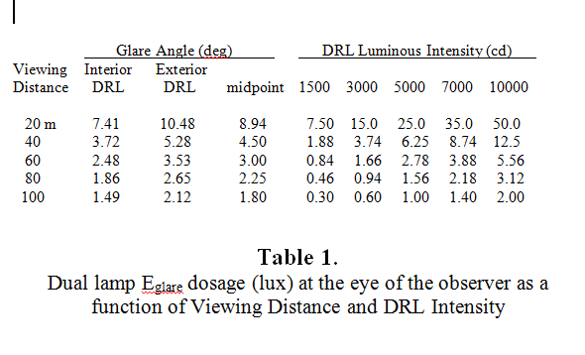
Glare Illumination:
Viewing Distance & DRL Intensity

Slide 14
Disability Glare Drops Rapidly with Increasing Luminance Adaptation
Conclusion:
DRLs can cause some
“disability” at nighttime
but not between
dusk and dawn.
But…What about
“discomfort” glare?

Slide 15
Discomfort Glare
  deBoer Subjective Rating Scale
  1 Unbearable
  2
  3 Disturbing
  4
  5 Just Acceptable
  6
  7 Satisfactory
  8
  9 Just Noticable

Slide 16
Schmidt-Claussen & Bindles (1974)
Disability Glare Model

Slide 17
deBoer Discomfort Glare
DRL=1500 cd; Changing Adaptation Level
Adaptation Level
Day/Clear Sky
Dusk/Dawn

Slide 18
deBoer Discomfort Glare
DRL=3000 cd; Changing Adaptation Level

Slide 19
deBoer Discomfort Glare
DRL=5000 cd; Changing Adaptation Level

Slide 20
deBoer Discomfort Glare
DRL=7000 cd; Changing Adaptation Level

Slide 21
Saturn Special Case
Alternator Over voltage => 10,000 cd

Slide 22
DRL Discomfort Borderlines

Slide 23
European Glare Sensitivity?

Slide 24
DRL Intensity > 2000 cd
Small Gains in Visibility
Large Increases in Discomfort

